Slide 1
Ch. 12 – Income MAnagement
Budgeting

Slide 2
Budgeting
Plan for smart spending and savings based on one’s income and expenses.
Personal Budgeting
daily, weekly, and even monthly.
Many people believe budgeting is too difficult, or it will limit their enjoyment of life.
Learning to budget can actually help find money for the things you really want or need.
Notes:
With a budget you can reach financial goals and control what you spend your money on.
PERSONAL BUDGETING
A student budget could address aspects such as savings, post-secondary savings, charitable donations, planned spending, and mad money.
See Figure 12.6, “Budgeting Your Allowance”, on page 381.
Start getting into the habit of budgeting early in life to develop planning skills that will enable you to reach your financial goals throughout your lifetime.
Setting Personal Goals
Families can prepare budgets together that set goals that are important to everyone.

Slide 3
Budgeting - Setting Personal Goals
Setting up a personal financial plan requires establishing realistic and achievable short- and long-term goals.
Most people need to set aside specific minimum monthly amounts to achieve long-term financial goals.
Notes:
With a budget you can reach financial goals and control what you spend your money on.
PERSONAL BUDGETING
A student budget could address aspects such as savings, post-secondary savings, charitable donations, planned spending, and mad money.
See Figure 12.6, “Budgeting Your Allowance”, on page 381.
Start getting into the habit of budgeting early in life to develop planning skills that will enable you to reach your financial goals throughout your lifetime.
Setting Personal Goals
Families can prepare budgets together that set goals that are important to everyone.

Slide 4
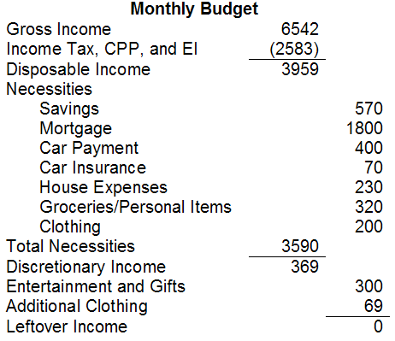
Preparing a Personal Budget
Step 1: Calculate the amount of expected income.
Step 2: Calculate expenses.
Include regularly occurring fixed expenses.
Estimate variable expenses that change monthly.
Step 3: Calculate amount left over.
Notes:
Preparing a Personal Budget
Step 1: Calculate the amount of income you expect to earn or receive.
Step 2: Determine the two types of expenses:
Fixed expenses occur on a regular basis and usually cannot be adjusted.
Savings, usually about 10% of of income, should be saved.
Variable expenses differ from one month to the next.
Step 3: Calculate the amount of money left over.
This money can be added to savings or can be added to discretionary income.
The goal of a personal budget is to have all income allocated and not to have any leftover.
Reviewing your budget can help you compare expected and actual spending and to see if you are buying on impulse.
If you are spending too much, expenses will have to be decreased or income increased.
Goals may have to be re-evaluated and time-lines adjusted.

Slide 5
Managing Money for Business Use
Types of Business Income
revenue, gross income, and net income.
Budgeting for a Business
Business success is determined by its ability to stay within a budget.
Two types of business budgets
start-up budgets and operating budgets
Notes:
Business owner spends money to make money, wage earner makes money to spend money.
Business budgeting and planning are tools for creating profit and growth, not simply cutting back on expenses.
Spending in a business is good as it helps increase sales in an effort to increase profit.
TYPES OF BUSINESS INCOME
Revenue is the money a business receives from products and/or services it sells or from investments.
Gross income is the total amount of money received by the business minus the cost of goods sold.
Net income is gross income minus the business expenses.
BUDGETING FOR A BUSINESS
All Interconnected budgets are needed for projects, departments, and divisions.
Often created by top management, budgets should receive input for all organizational levels.
A start-up budget shows the money needed to open a business.
Often underestimated, start-up budgets need enough capital to last more than a year.
Operating budgets are done monthly, yearly, or per project.
Sets out ongoing revenues and expenses for the business.
See Figure 12.9, “Before Starting a Business”, on page 387.
SETTING BUSINESS GOALS
Goals could be for business aspects such as launching a new product, expanding internationally, increasing research and development, or closing a division.

Slide 6
Managing Money for Business Use
Setting Business Goals
Managers set company goals that are measurable and specific.
Budgets often involve a variety of different departments (production, marketing, HR, finances etc)
Notes:
Business owner spends money to make money, wage earner makes money to spend money.
Business budgeting and planning are tools for creating profit and growth, not simply cutting back on expenses.
Spending in a business is good as it helps increase sales in an effort to increase profit.
TYPES OF BUSINESS INCOME
Revenue is the money a business receives from products and/or services it sells or from investments.
Gross income is the total amount of money received by the business minus the cost of goods sold.
Net income is gross income minus the business expenses.
BUDGETING FOR A BUSINESS
All Interconnected budgets are needed for projects, departments, and divisions.
Often created by top management, budgets should receive input for all organizational levels.
A start-up budget shows the money needed to open a business.
Often underestimated, start-up budgets need enough capital to last more than a year.
Operating budgets are done monthly, yearly, or per project.
Sets out ongoing revenues and expenses for the business.
See Figure 12.9, “Before Starting a Business”, on page 387.
SETTING BUSINESS GOALS
Goals could be for business aspects such as launching a new product, expanding internationally, increasing research and development, or closing a division.

Slide 7
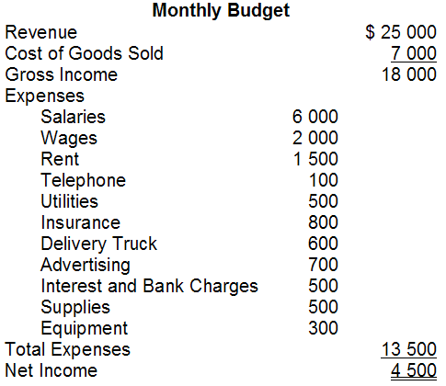
Preparing a Business Budget
Step 1: Calculate amount of business income expected.
Step 2: Calculate expenses, including fixed and variable.
Step 3: Calculate amount left.
Step 4: Review budget.
Notes:
PREPARING A BUSINESS BUDGET
The steps in preparing a business budget are similar to those of preparing a personal budget.
Step 1: Calculate the amount of business income expected; this is total revenue.
Step 2: Calculate all business expenses; these include fixed and variable expenses.
Examples of fixed expenses are rent, salaries for full-time employees, and property insurance.
Examples of variable expenses are part-time workers, cost of goods sold, utilities, advertising, and bank charges.
Step 3: Determine the amount of money left, also known as net income.
Business budgets should have income left over because this is the business’s profits.
Step 4: Review the budget to compare actual spending with expected or projected spending.
If a business is spending more than it earns, expenses need to be adjusted or an increase in income has to be realized.
Income can be increased by increasing sales, raising prices, advertising more, or the introduction of new product lines.

