Slide 1
Steps for creating a Balance Sheet
Mr.Singh

Slide 2
Business and Financial Statements
Present financial information in a way that helps business people keep track of the financial health of the business
BALANCE SHEET
INCOME STATEMENT
STATEMENT OF CASH FLOWS
Notes:
helps owners and managers keep track of the financial health of the business.
provide outsiders with accurate information about the business.

Slide 3
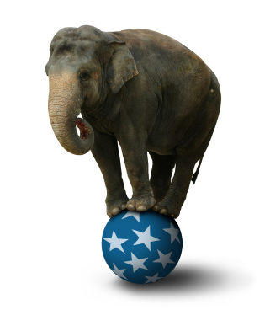
Balance Sheet
Snapshot that shows how a business is doing on a specific day
Does not indicate whether a business has made a profit
Notes:
See Figure 9.1, “Types of Financial Statements”, on page 281.
Preparing a Balance Sheet
On any given day the balance sheet should be different, that is why it is like a snapshot.
Balance Sheet Equation Method
If the business did not have any debts the balance sheet equation would be: Assets = Owner’s Equity.

Slide 4
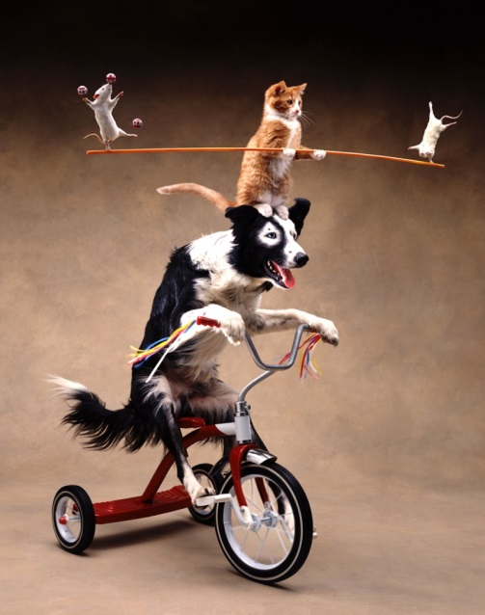
Balance Sheet Equation
“Balanced” because the left side (LS) must equal the right side (RS):
ASSETS = LIABILITIES + OWNER’S EQUITY
Notes:
Balance Sheet Equation Method
left side of the equation (assets) ALWAYS equals the right side (liabilities plus owner’s equity).
Assets are owned by one of two groups
owner(s) of the business (owner’s equity)
individuals or businesses owed money (liabilities)

Slide 5
5 Steps to Prepare Balance Sheet
Fill in the Statement Heading
Three lines, centered, at the top of the page:
Who? (Name of business / organization)
What? (Name of the financial statement)
When? (Single Date)
The Sandwich Shop
Balance Sheet
May 7, 2015

Slide 6
WHO?
WHEN?
The Sandwich Shop Balance Sheet May 7, 2015
Assets |  |  | Liabilities
Cash | $ 1,150 |  | Accounts Payable – Buns R Us | $ 1,350
Accounts Receivable - Subway | 3,400 |  | Loan Payable - Salami Finance | 25,170
Equipment | 13,575 |  | Total Liabilities | $ 26,520
Building | 42,500
 |  |  | Owner’s Equity
 |  |  | Mr. Sandwich, Capital | $ 34,105
Total Assets | $ 60,625 |  | Total Liabilities and Owner’s Equity | $ 60,625
WHAT?

Slide 7
5 Steps to Prepare Balance Sheet
List the Assets
Assets must meet the following criteria:
provide future economic benefit (i.e. help make $$)
Cost Principle - recorded at historical cost (the price you paid on the day you bought them)
Depreciation – loses value over time
→ Your Turn: Imagine you own a landscaping business; brainstorm a list of the items of value that your business might own.
Notes:
Cost Principle and Depreciation
recording an asset at the actual amount it costs the business
Even when an asset depreciates or loses value over time the asset value on the books remains the same.

Slide 8
CURRENT ASSETS
Items owned by a business that are “used up” quickly, usually in one year or less
LIST in ORDER OF LIQUIDITY – how quickly the asset can be converted to cash (most liquid to least liquid):
Cash (on hand or in the bank)
Accounts Receivable Money owed to the business by customers (usually paid within 30 days)
Inventory (only if merchandising business that sells a good)
Supplies (items used in performing services or office supplies)

Slide 9
FIXED ASSETS
Items that a business keeps for a longer period of time and uses to perform services
List in ORDER OF USEFUL LIFE – longest useful life to shortest useful life
Land
Building
Equipment
Furniture
Vehicles

Slide 10
Example
For our example, the assets would be:
CURRENT ASSETS
Assets
Cash | $ 1,150
Accounts Receivable - Subway | 3,400
Building | 13,575
Equipment | 42,500
Total Assets | $ 60,625
In order of liquidity
LONG-TERM ASSETS
In order of useful life

Slide 11
5 Steps to Prepare Balance Sheet
List the Liabilities
Liabilities represent a future sacrifice or obligation for the business (i.e. they must be repaid at some point)
They must be the result of a past transaction
Accounts payable- purchases made on credit/account that have not yet been paid

Slide 12
CURRENT AND LONG-TERM LIABILITIES
CURRENT LIABILITIES
Debts that must be paid within one year
List in order of ACCOUNTS PAYABLE due
LONG-TERM LIABILITIES
Debts such as a mortgage loan, that take longer than one year to repay; must be repaid in order:
Bank Loan Payable: we borrowed $ from the bank
Mortgage Payable: we borrowed $$ to purchase land or a building
Ex. you purchase a $300 000 house with a $50 000 down payment; the remainder is a Mortgage Payable:
A = L + OE → $300 000 = $250 000 + $50 000

Slide 13
Example
CURRENT LIABILITY
Our liabilities would be:
In order of accounts payable due
Liabilities
Accounts Payable – Buns R Us | $ 1,350
Loan Payable - Salami Finance | 25,170
Total Liabilities | $ 26,520
LONG-TERM LIABILITY
Short to Long Term

Slide 14
5 Steps to Prepare Balance Sheet
Calculate Owner’s Equity
Using the BS equation, can rearrange to calculate OE:
Assets – Liabilities = Owner’s Equity
From our example, Assets = $60,625 and Liabilities = $26, 520
$60,625 - $26, 520 = $34,105

Slide 15
5 Steps to Prepare Balance Sheet
Balance Sheet Conventions
No Abbreviations
2. No corrections or changes on sheet
3. Line up figures and dollar signs
4. Underline totals and double underline final totals
Put It All Together
The Sandwich Shop Balance Sheet December 1, 2014
Assets |  |  | Liabilities
Cash | $ 1,150 |  | Accounts Payable – Buns R Us | $ 1,350
Accounts Receivable - Subway | 3,400 |  | Loan Payable - Salami Finance | 25,170
Equipment | 13,575 |  | Total Liabilities | $ 26,520
Building | 42,500
 |  |  | Owner’s Equity
 |  |  | M. Sandwich, Capital | $ 34,105
Total Assets | $ 60,625 |  | Total Liabilities and Owner’s Equity | $ 60,625

Slide 16
→ Your Turn
Given the following information, prepare a Balance Sheet for Luigi’s Repair Shop owned by Luigi on today’s date:
Cash in the bank ($6 100)
Money owed by customers, Accounts Receivable ($8 100)
Office Supplies ($500)
Parts inventory ($4 000)
Equipment, including a truck, that is necessary to run the business ($25 500)
Building and land ($175 000)
Debts owed to another business, Accounts Payable ($7 350)
Bank loan for the truck ($11 050)
Mortgage on building, Mortgage Payable ($110 000)

Slide 17
Luigi’s Repair Shop Balance Sheet December 9, 2014
Assets Cash AR Parts Inventory Supplies Building & Land Equipment Total Assets | $ 6 100 8 100 4 000 500 175 000 25 500 $ 219 200 |  | Liabilities Accounts Payable Bank Loan Mortgage Payable Total Liabilities Owners Equity Luigi’s, Capital Total Liabilities & Owner’s Equity | $ 7 350 11 050 110 000 $ 128 400 $ 90 800 $ 219 200

