Slide 1
Canadian federal government
Mr. Singh

Slide 2
Electoral system

Slide 3
Electoral system
In Canada – First past the post system AKA Single member plurality system
Canada is divided into small areas called Ridings
People living within a riding is called a constituent
Ridings are determined by population size and geographic factors (roads, rivers, cities or towns)

Slide 4
Electoral system
During an election people in each riding will compete for the job of the representative
These people are known as candidates
Usually they’re associated with a political party
If they’re not part of a political party what are they called?
Independent
1 person elected per riding to represent its constituents

Slide 5
Electoral system
The winner of each electoral district (riding) goes to Ottawa to sit in the House of Commons and represent their geographic area
In Canada there are 338 ridings, up from 308 in 2011

Slide 6
Electoral system
Yukon, Nunavut & Northwest Territories - 1 riding each
British Columbia - 42 ridings
Alberta - 34 ridings
Saskatchewan - 14 ridings
Manitoba - 14 ridings
Ontario - 121 ridings
Quebec - 78 ridings
New Brunswick - 10 ridings
Prince Edward Island - 4 ridings
Nova Scotia - 11 ridings
Newfoundland and Labrador - 7 ridings

Slide 7
Electoral system
Majority vs Minority Government
338 MP’s are voted into the House of Commons
338 mini elections across the country
The Party with the most number of wins will likely form government and they’re leader will be the Prime Minister
If the governing party has 170 or more seats – Majority government
If less than 170, they have a Minority government

Slide 8
Electoral system
In order for a bill to pass, it needs the support by more than half of its members = 170 votes
It may be tough for a minority government to pass a bill they feel strongly about since they don’t have a majority voting power

Slide 9
Canadian parliament
House of Commons
The House of Commons is the Lower Chamber
The house has 3 key roles - not in order of importance
1 - to represent their geographic region at the federal table
2 - to pass laws in the form of acts or statutes for the governing of Canada
3 - to act as a watchdog, keeping an eye on the Cabinet and the civil service - obviously carried out by members of the opposition

Slide 10
Canadian parliament

Slide 11
Canadian parliament

Slide 12
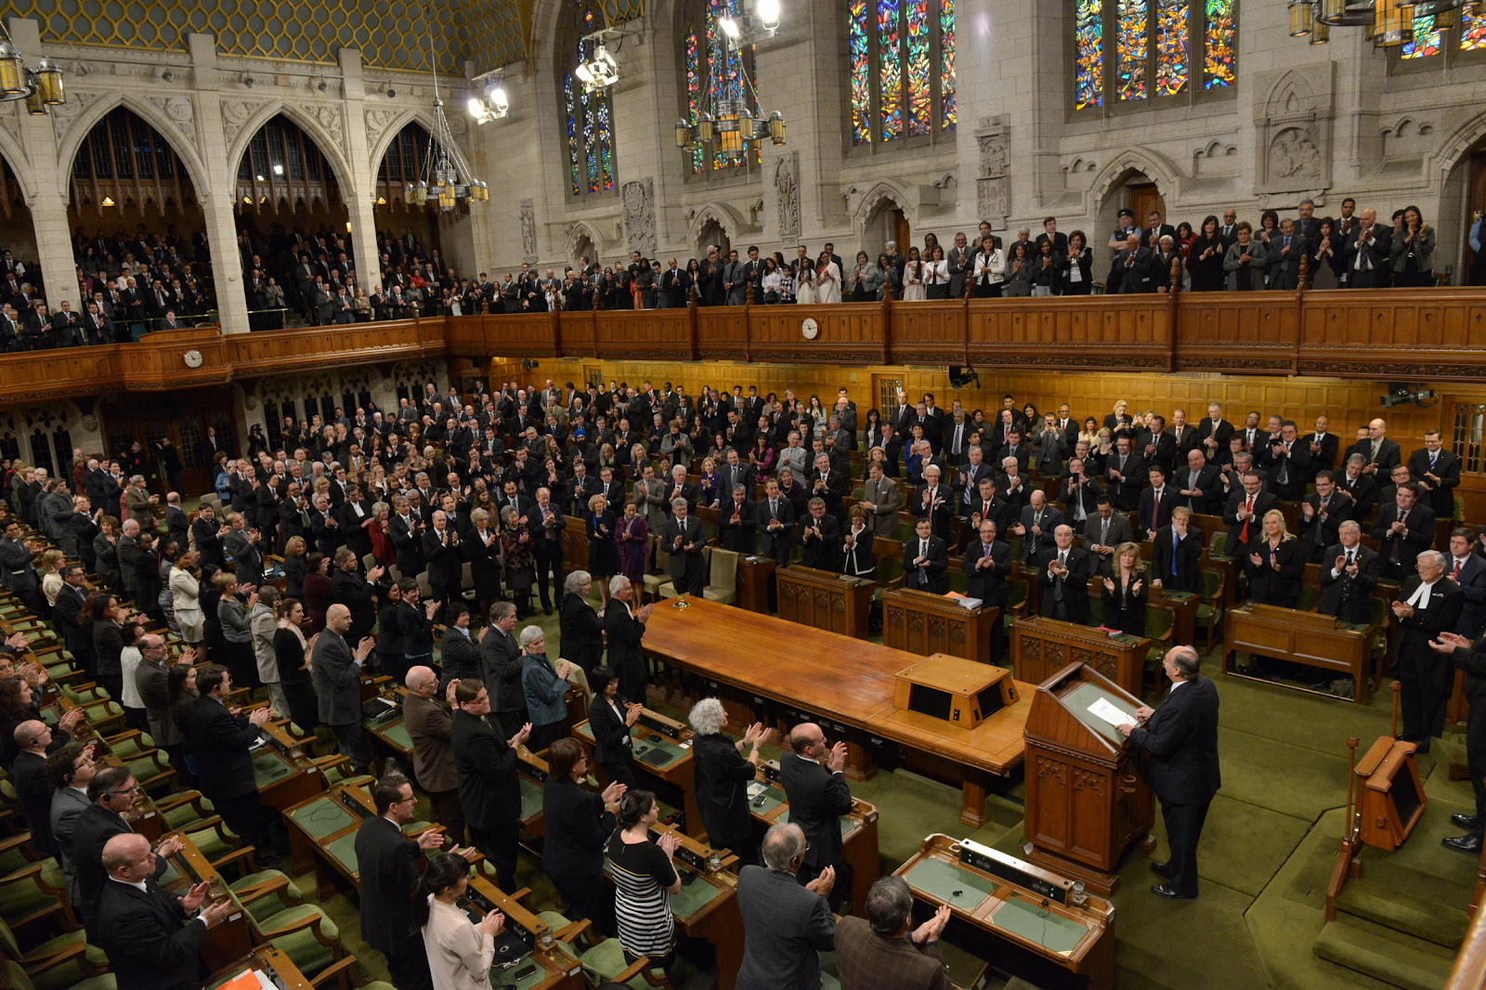

Slide 13
Canadian parliament
Senate
Located in the upper chamber, also referred to as the “Red Carpet”
Consists of 105 members (senators) appointed by the governor general with the advice of the Prime Minister
Senators represent regions, provinces and/or territories
Spend a lot of time voting and debating on bills
Senators do a lot of work in committee’s debating bills and talking to witnesses

Slide 14
Canadian parliament
Senate
Senate must approve a bill before it becomes an act and thus the law of the land
Senators are appointed for life
The Senate can reject bills passed by the Commons
In recent years, the Senate has lost its legitimacy, come to be seen as a house of patronage

Slide 15
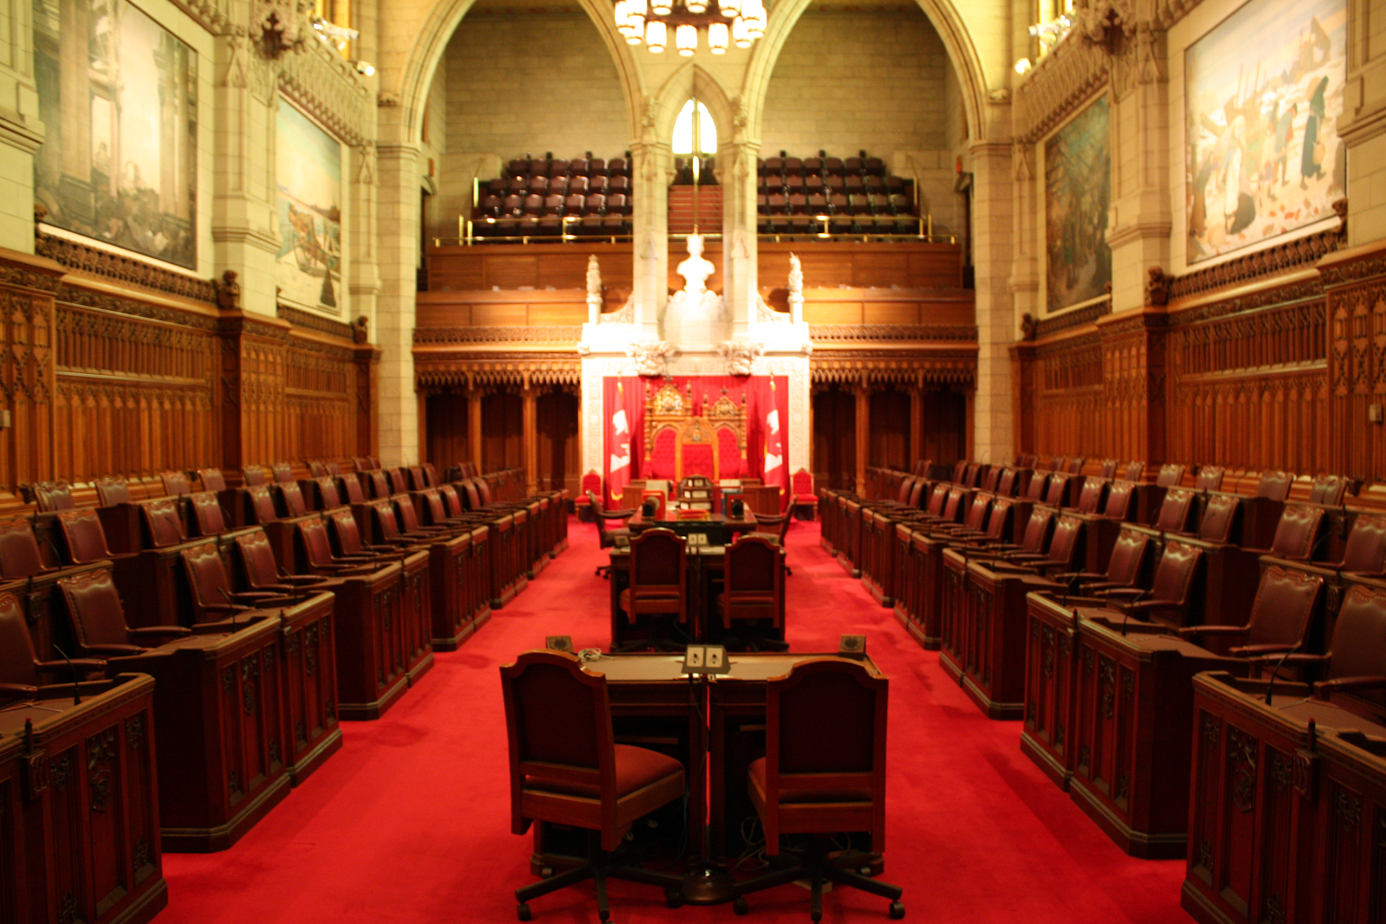

Slide 16
Canadian parliament
Governor General
Represents the Queen in Canada
Queen appoints the Governor General on the advice of the Prime Minister
Governor General acts on the Queens behalf while she is not in Canada
This reflects the fact that Canada is a constitutional monarchy
Queen is head of state, Prime Minister is head of government
How does this differ in the US
President is both head of state and head of government

Slide 17
Canadian parliament
Governor General
Appoints cabinet ministers and other positions of responsibility on the advice of the PM
These duties are ceremonial, formal but politically inconsequential
Advantage of having a governor general is that they are non-partisan therefore more suited to represent the country as a whole
Governor General does have the power to summon, prorogue and dissolve government
Normally these actions are taken on the advice of the PM

Slide 18
Canadian parliament
Prime Minister & Cabinet
1. Develop policy to deal with issues facing the country
2. Introduce bills to carry these policies into law
3. Supervising the civil servants who apply the policies and administer the law on a daily basis
Neither the PM or the cabinet are directly elected by the Canadian public

Slide 19
Party loyalty in Canadian politics
PM and members of cabinet are rarely called into question by members of their own party
If a member of a party’s caucus breaks from the party line they risk losing the chance at becoming a Minister (become a permanent back bencher)
May even lose the support of their party in their riding nomination (leader must sign off on all party candidates before election)
The concept of “party loyalty” is unique to the British Parliamentary System and among Commonwealth countries it is strongest in Canada

Slide 20
Party loyalty in Canadian politics
The “Party Whip” is a caucus position that keeps the members in line and schedules a party’s speaking order
Party loyalty also dulls debate in the house as Members of Parliament refuse to do anything but tow the party line

Slide 21
Party loyalty in Canadian politics

Slide 23
Civil service
The actual day-to-day work of the government of Canada is carried out by full time employees known as the civil service or public service
The majority of these employees work for government Ministries (Agriculture, Fisheries, Health, Environment, Revenue, Transport …)
Each Ministry is headed by a Minister who is a member of the Cabinet
Ministers are held responsible for the performance of the civil servants within their Ministry

