Slide 1
Chapter 4: Demand and Supply Part 2
Mr. Singh

Slide 2
Changes in Supply and Demand
So far the only change in supply and demand deals with Price and quantity
What happens when something else affects the demand and supply curve?
Changes in non-price factors cause the whole curve to shift by affecting a product’s demand or supply instead of just quantity demanded or quantity supplied

Slide 3
Changes in Demand
There are 5 basic changes that can take place in customer demand for a product, and any one of them can have the effect of causing the whole demand curve to shift its position on the graph
Income
If the incomes of buyers increase substantially, they might be willing to buy more of a product at whatever the previous price is

Slide 4
An increase in demand for T-shirts
Price of T-shirt | Old Quantity Demanded | New Quantity Demanded | Quantity Supplied
$20 | 16 | 20 | 0
$24 | 12 | 16 | 4
$28 | 8 | 12 | 8
$32 | 4 | 8 | 12
$36 | 0 | 4 | 16

Slide 5
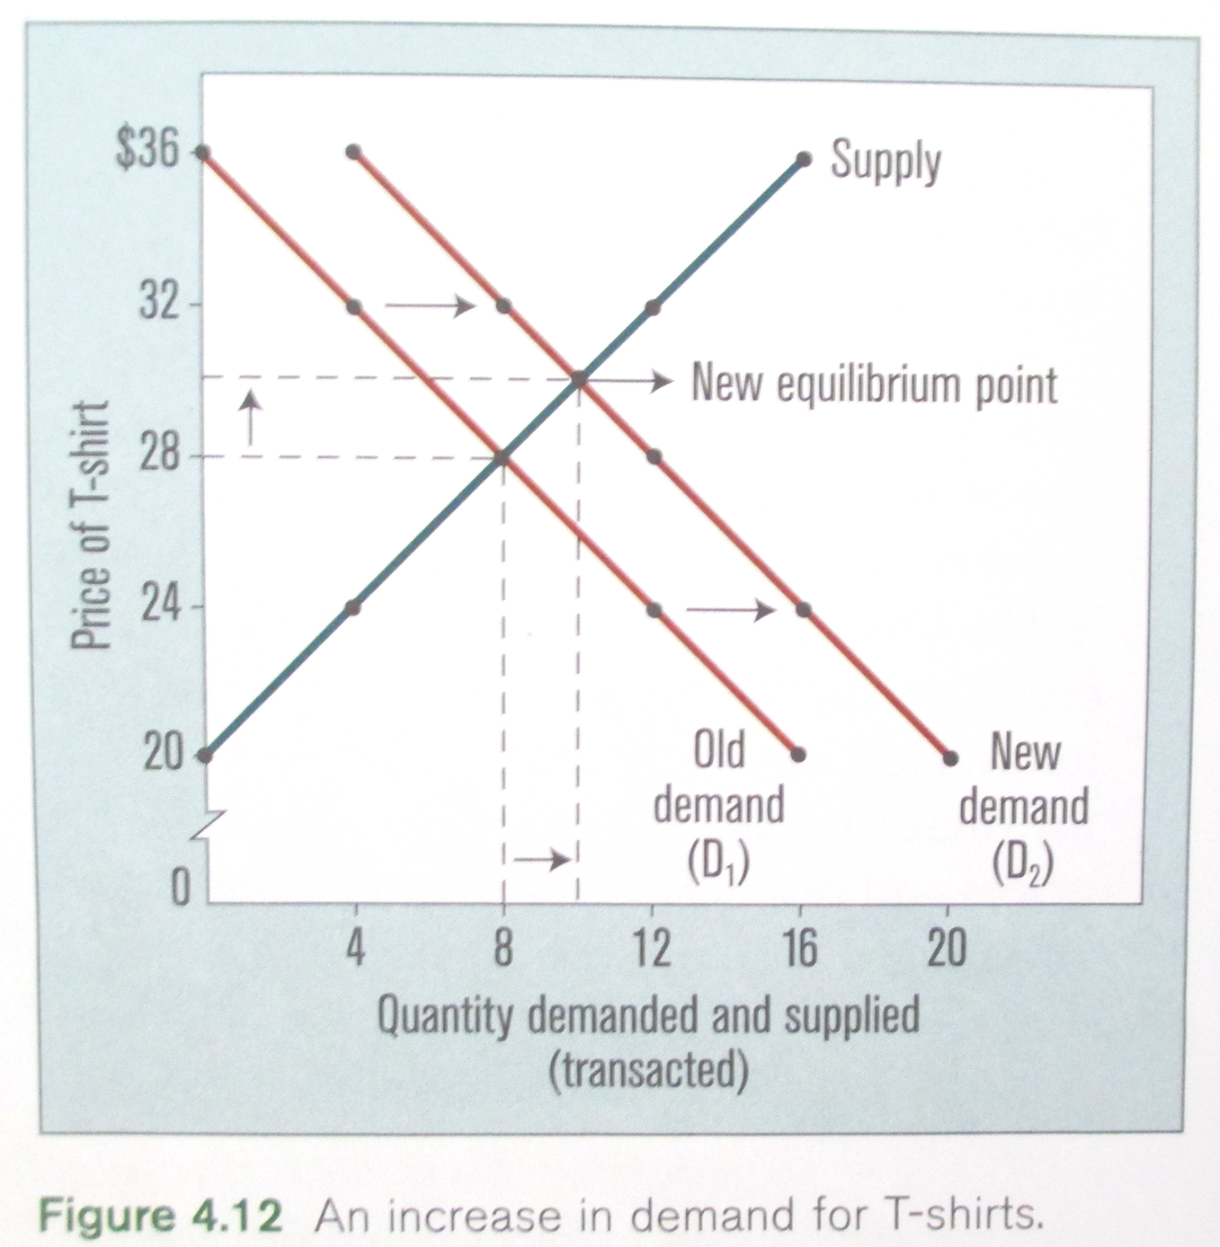

Slide 6
Changes in Demand
Population
An increase in the number of consumers should cause an increase in demand, shifting the demand curve to the right with the same increase in equilibrium price
A decrease in the number of consumers should have the opposite effect, shifting the demand curve to the left and causing equilibrium prices to fall
Many businesses carefully monitor demographics, population statistics that show changes in age, income, and overall numbers, in order to determine whether or not the demand for their product is increasing

Slide 7
Changes in Demand
Tastes and preferences
Changes in taste for a product cause increases or decreases in demand for it
A good example of this is the fashion industry. Clothing fads come and go, and this affects the demand for different types of clothing
Companies can also use advertising to increase demand for a product. If they mount a successful advertising campaign, the demand curve will shift to the right

Slide 8
Changes in Demand
Expectations
If consumers believe that the price of a particular product is going to rise in the future, they may decide to purchase it immediately, thereby increasing the demand for the product
Increased purchases by consumers cause prices to rise, driving the demand curve to the right
If consumers expect the price for a product to fall in the future, they may delay purchasing that product, which will drive down the demand for it

Slide 9
Changes in Demand
Prices of substitute goods
Many goods have substitute goods, that is, goods that are similar to them.
Ex: Butter and margarine can be substituted for each other. A price change for margarine will affect demand for butter, and a price change for butter will affect demand for margarine
Some goods are classified, not as substitutes, but as complement goods. These are items that are sold together with other goods.
Ex: Gasoline and cars, country club memberships and golfing equipment, etc.
A fall in the price of either complement will increase demand for the other

Slide 10
Changes in Demand
A change in the price of one product that can substitute for another will directly increase or decrease the demand for the competing product, thereby shifting the demand curve one way or the other
A change in the price of a product that complements another will inversely increase or decrease the demand for the product that it complements, also shifting its demand curve

Slide 11
Changes in Supply
There are 5 basic changes that can take place in supply for a product, and any one of them can have the effect of causing the whole supply curve to shift its position on the graph

Slide 12
Changes in Supply
Costs
An increase or decrease in production costs will affect the quantities the sellers are willing to supply because a change in costs affects profits

Slide 13
An increase in supply for T-shirts
Price of T-shirt | Quantity Demanded | Old Quantity Supplied | New Quantity Supplied
$20 | 16 | 0 | 4
$24 | 12 | 4 | 8
$28 | 8 | 8 | 12
$32 | 4 | 12 | 16
$36 | 0 | 16 | 20

Slide 14
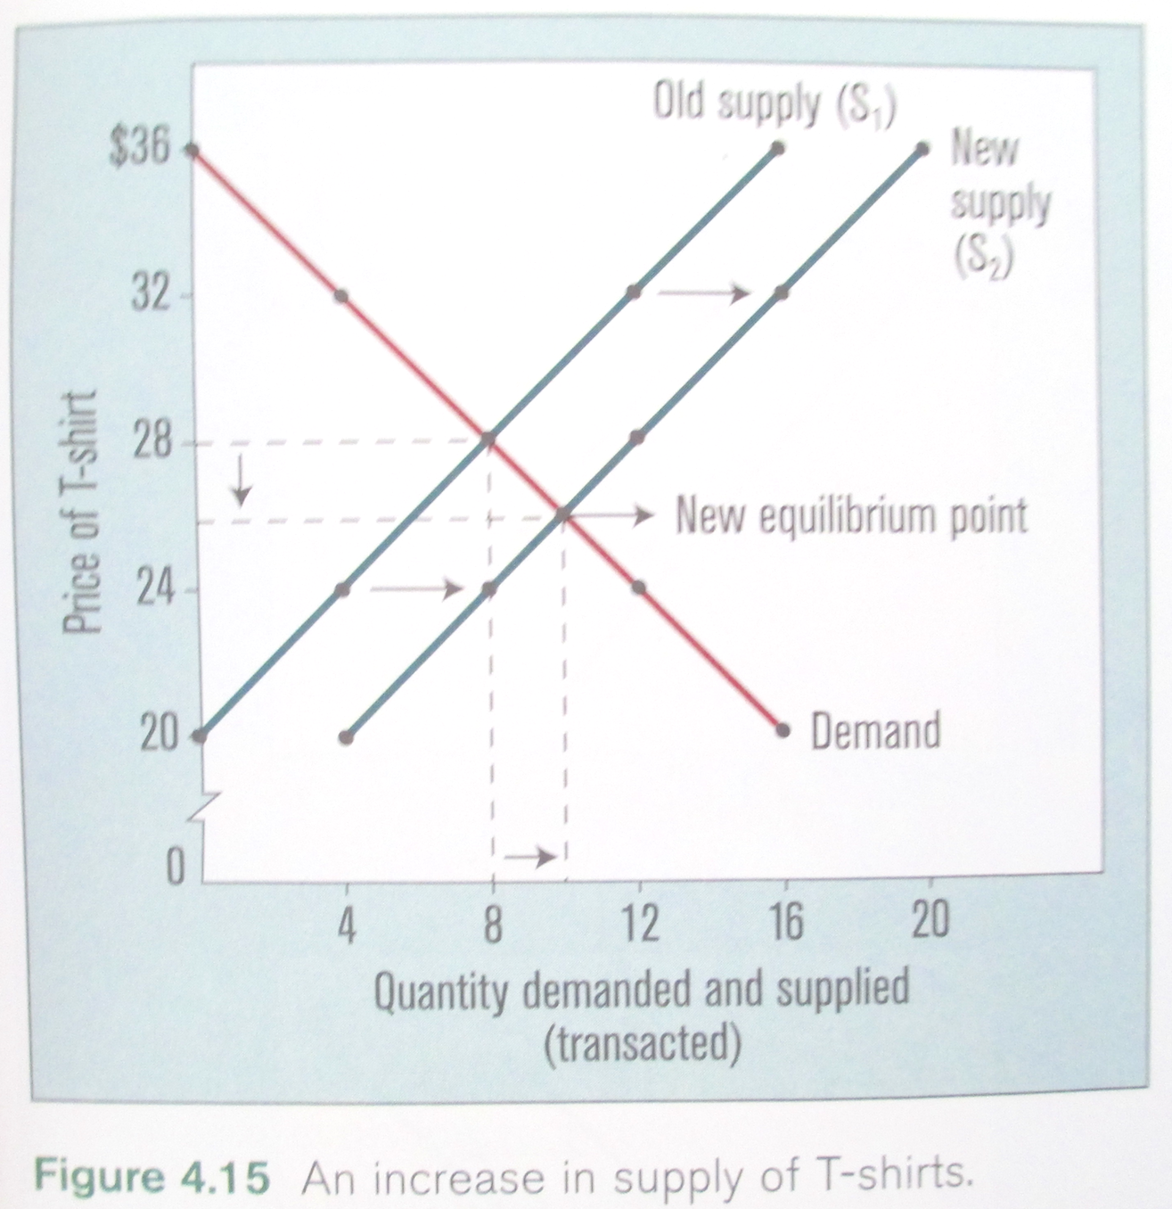

Slide 15
Changes in Supply
Number of sellers
If the number of sellers declines, and if the remaining sellers do not increase their production, then the quantities supplied at any given price in that industry will decrease. This will shift the supply curve to the left
If the number of sellers increases, the quantity supplied at any given price will increase, shifting the supply curve to the right

Slide 16
Changes in Supply
Technology
An improvement in technology will decrease the cost of production, and this in turn will enable manufacturers to supply more of a product at any given price
The technological progress of the 20th century has been of such magnitude that the manufacturing costs for almost every product we now buy has fallen
These technological improvements have all enabled manufacturers to increase the supply of their products, thereby shifting their supply curve to the right

Slide 17
Changes in Supply
Nature and the environment
Weather changes (ex: drought) and environmental disasters (ex: collapse of the Atlantic cod stock) can have an enormous impact on supplies for certain products.
Ex: The collapse of the Atlantic cod stock has decreased the quantity of cod supplied to fish retailers, which has driven up the price of this particular fish. This decrease in supply has shifted the supply curve for the Atlantic cod to the left.

Slide 18
Changes in Supply
Prices of related outputs
The production of one item may affect the supply of another related item
Ex: Farmers may switch from growing oats to growing barley if the market price of barley rises. This in turn will reduce the supply of oats offered at any given price, shifting its supply curve to the left

Slide 19
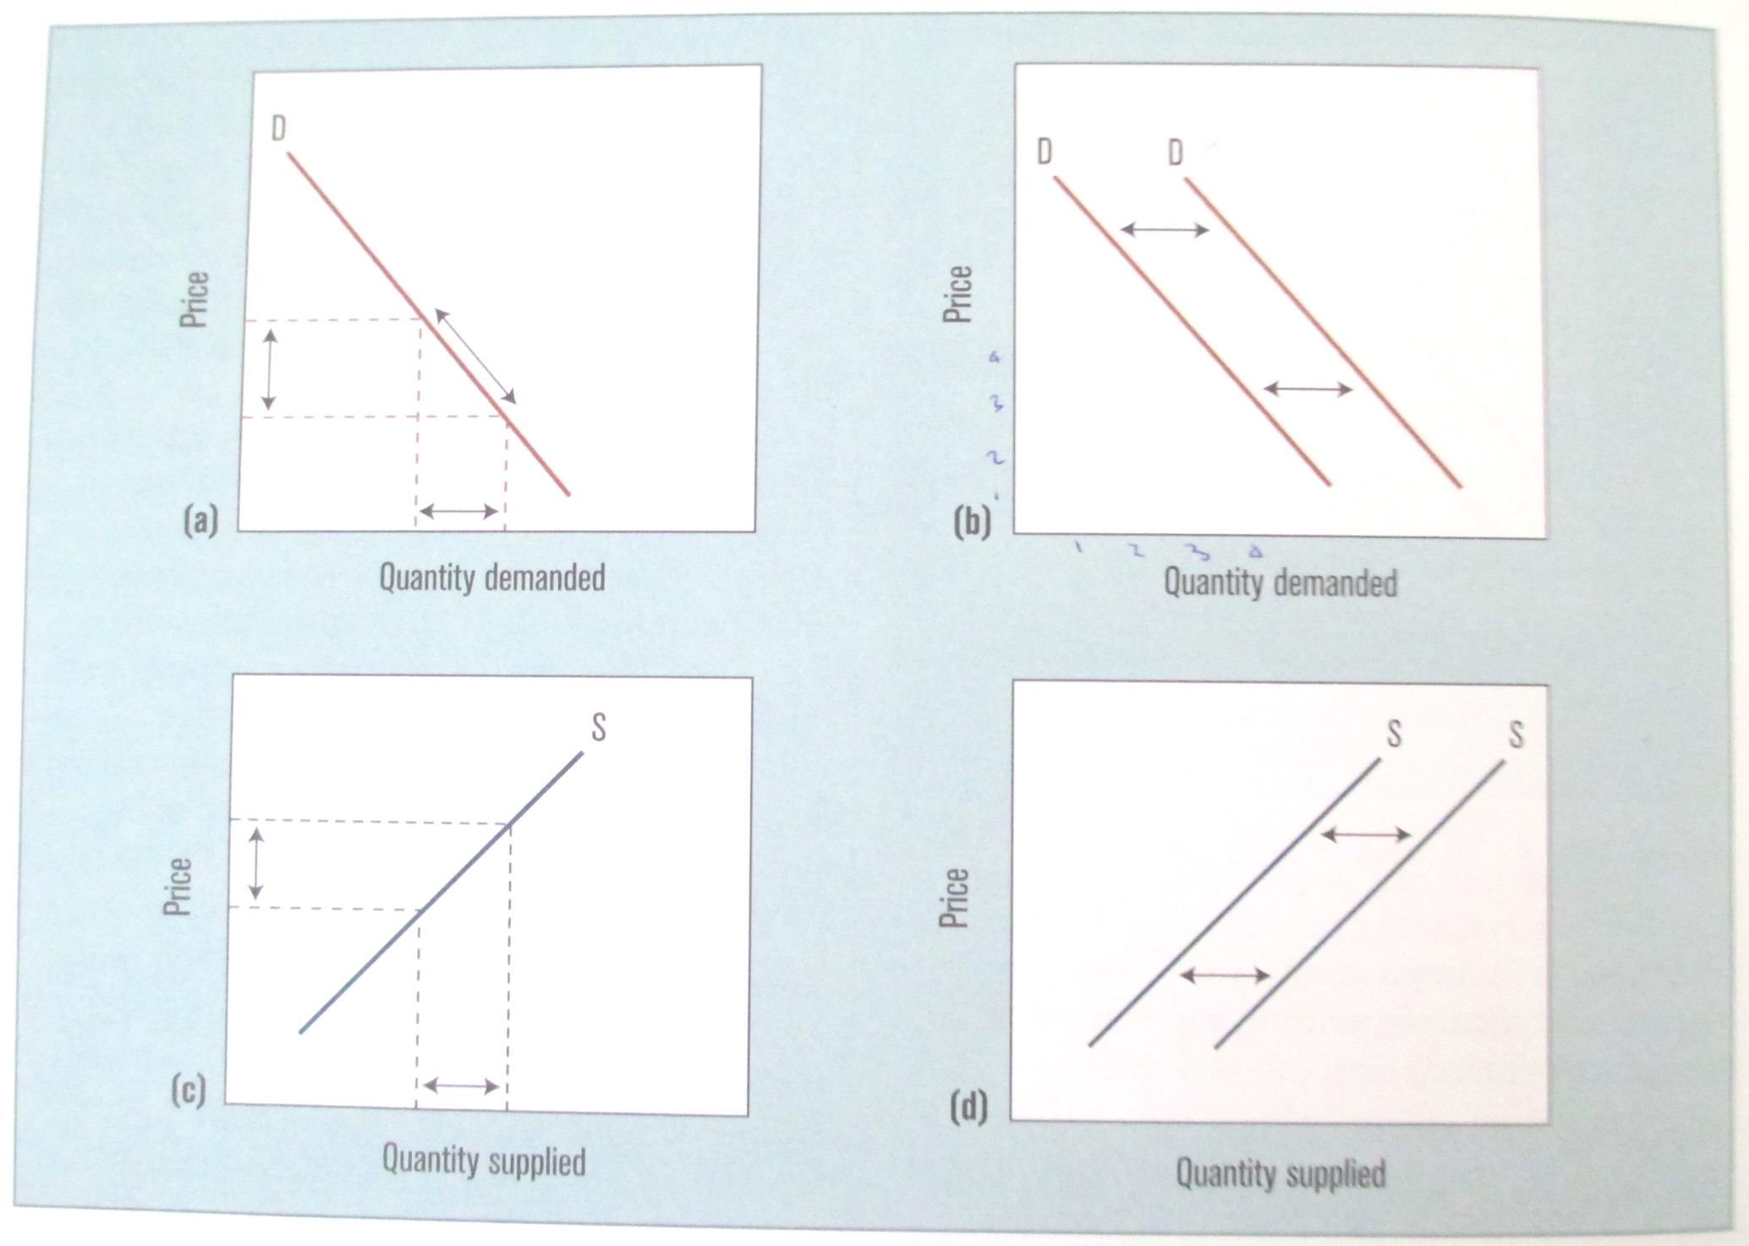

Slide 20
The Determination of Price
A competitive market exhibits the following characteristics:
It has many producers or sellers, with no single one large enough to dominate the market
It has many buyers, with no single one large enough to dictate price to sellers
Each seller’s product is exactly the same as the others so that no seller can increase price based on higher-quality product than another seller
All sellers and buyers know what the prices and conditions are throughout the entire market, thereby eliminating the possibility of price differences

Slide 21
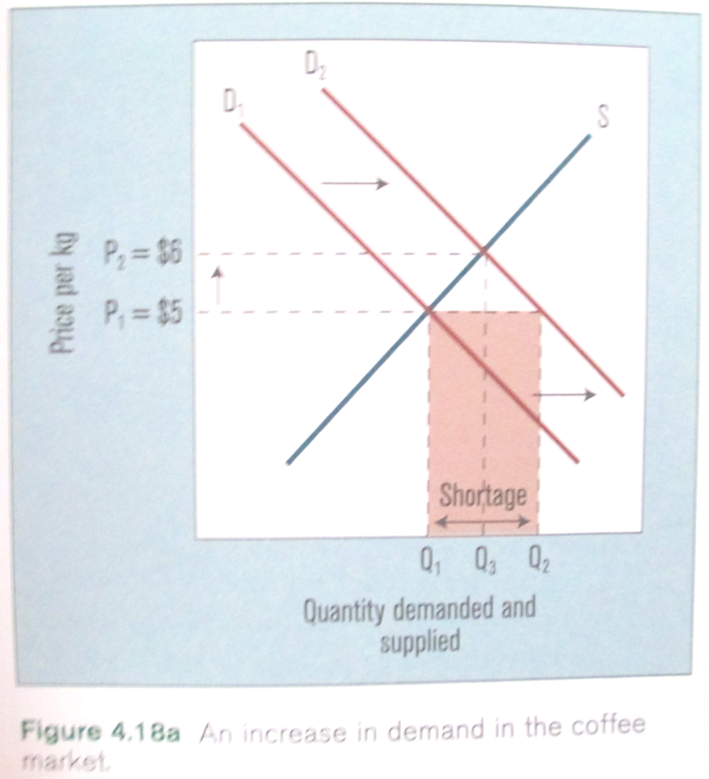
The Coffee Market in Canada
An Increase in Demand
Suppose retailers pay $5 per kilogram for Columbian coffee. Then, in the 1990s, the spread of coffee houses as social meeting places increases the demand for Columbian coffee in Canada.

Slide 22
The Determination of Price
This kind of market is called pure (or perfect) competition
This is an ideal or model that economists use to compare and evaluate actual markets for the products and services bought and sold in free-market systems
The coffee market in Canada comes as close as any other market to the model, and it shows us how changes in demand and supply, with their shifting curves, cause equilibrium prices to rise and fall

Slide 23
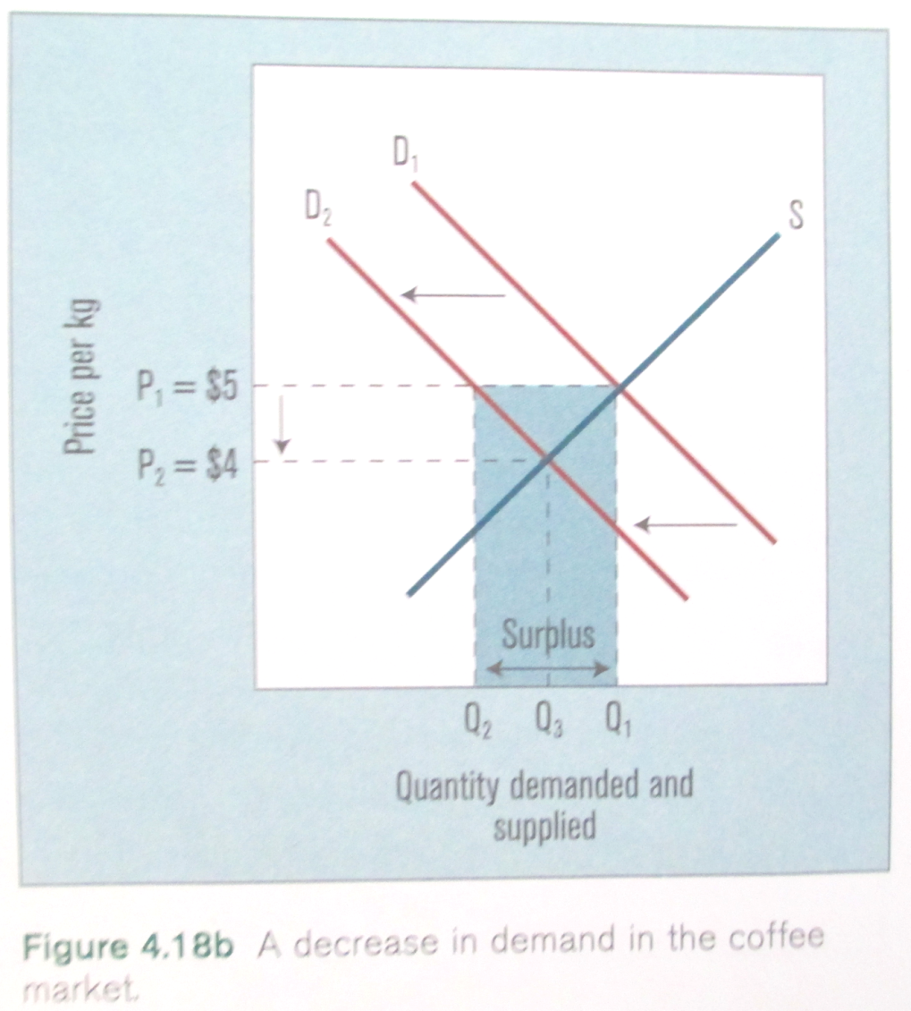
The Coffee Market in Canada
A Decrease in Demand
Suppose a best-selling book raises health concerns about excessive caffeine intake. As a result, many Canadians cut back on the amount of coffee that they drink, thus reducing the demand for coffee in Canada.

Slide 24
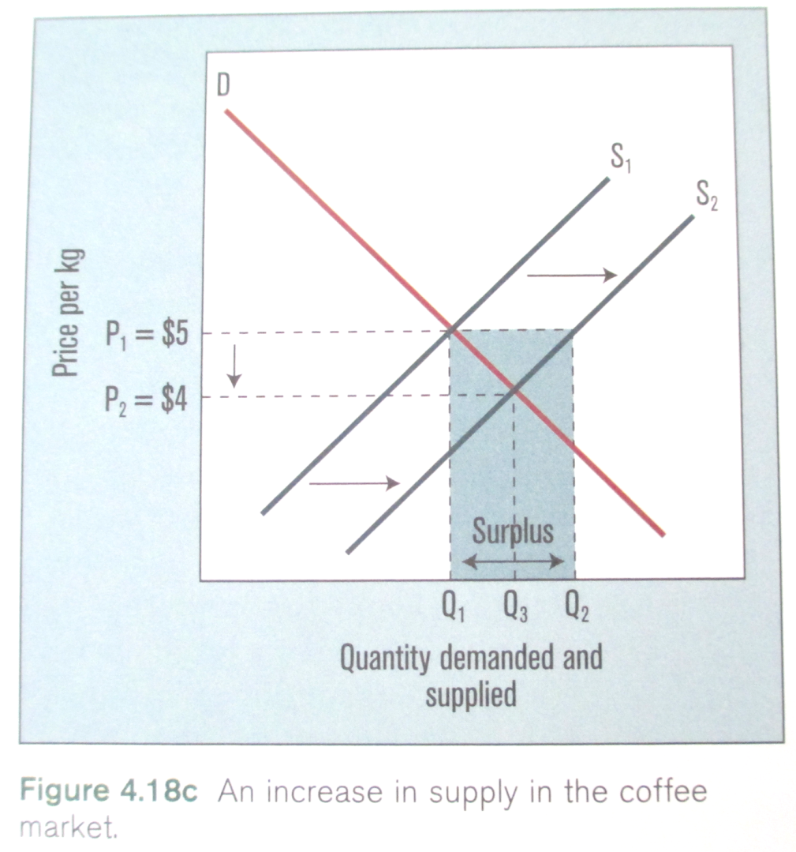
The Coffee Market in Canada
An Increase in Supply
Suppose scientists discover a way to produce a faster-growing coffee plant through genetic manipulation

Slide 25
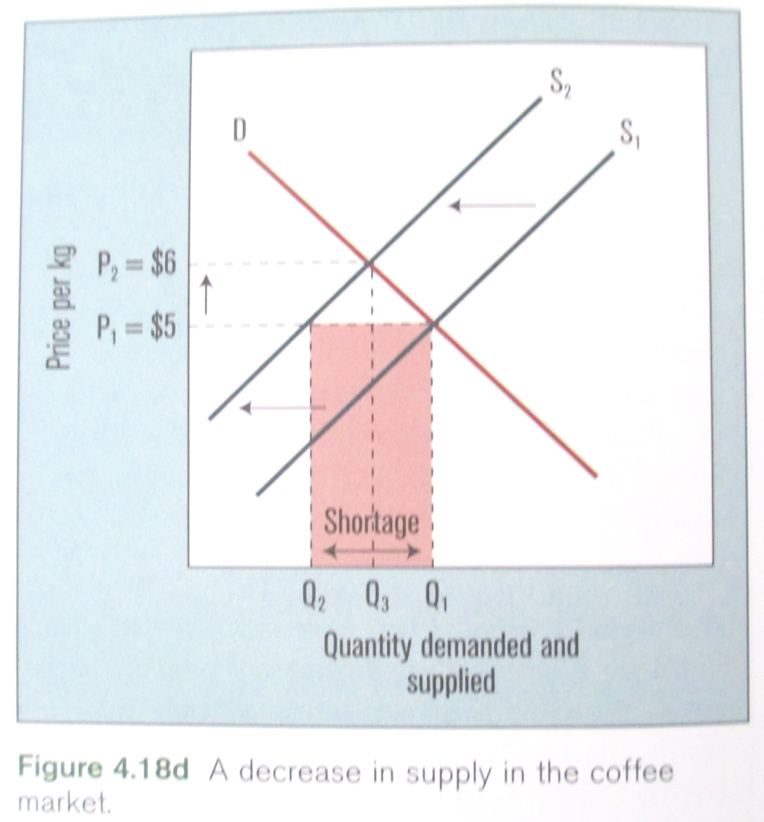
The Coffee Market in Canada
A Decrease in Supply
Suppose a mildew that strikes coffee plants decimates coffee production in the mountains of Columbia. Supplies of Columbian coffee in Canada are at an all-time low.

