Slide 1
Big and Small Businesses
Small business are the engine that fuels the Canadian economy due to the large number of them
Big businesses employ thousands of Canadians and have a great deal of political influence
They are the wheel that steers the national economy in a given direction
There is such a wide range of enterprises in Canada, so there is no general definition of a small or large business

Slide 2
Big and Small Businesses
The Canadian Federation of Independent Business (CFIB) uses numbers of employees to classify Canadian businesses into the following three categories:
Small business includes independently owned firms with fewer than 50 employees
Medium-sized business includes all independently owned firms with between 50 and 499 employees
Big business includes all independently owned firms employing 500 workers or more

Slide 3
Small Businesses
Small businesses are limited in the size and scope of their operations
They face intense competition from numerous other small firms
This level of competition keeps small businesses operating efficiently
Many small businesses maintain their competitive advantage by limiting their operations to one specialized field or process
Since they are small and focused on one area of specialization, these firms are usually very sensitive to changes in the niche marketplace

Slide 4
Small Businesses
The most successful small firms are those that:
Best anticipate market conditions
Best respond to market changes
Successful small businesses tend to be aggressively innovative and tend to maximize profits at the expense of weaker competitors
Over time, the most productive and effectively managed businesses force their weaker rivals out of business or buy them out
In the process, these successful small firms grow larger

Slide 5
Big Businesses: Horizontal Integration
Smaller firms often grow larger through horizontal integration
Occurs when a firm purchases control of another firm which produces/offers the same good or service
This can generate cost savings if:
There are economies of scale involved in production
It’s possible to eliminate the duplication of effort
Ex: If two companies merge and consolidate their research and development (R&D) departments, a substantial amount of money in employee salaries will be saved
By increasing the size and efficiency of operations, these larger firms can compete more effectively on a global scale

Slide 6
Big Businesses: Horizontal Integration
This horizontal merger, or consolidation, can also give the larger enterprise better access to both domestic and foreign markets
Ex: In 1998, Chrysler Corporation in the US merged with Daimler-Benz in Germany
This merger opened more European markets for Chrysler vehicles and provided additional marketing opportunities in North America and Asia for Mercedes-Benz products
Billions of dollars were saved by combining purchases, exchanging components, and sharing distribution and technology
Ex: In 1998, Sobeys Canada Inc. of Nova Scotia acquired the Oshawa group to become one of Canada’s largest supermarket chains
These are two examples of friendly mergers
Corporation takeovers can also be hostile if forced by an aggressive buyer

Slide 7
Big Businesses: Vertical Integration
Vertical integration is when companies involved in successive stages of the production (or consumption) process are combined into a single firm
Vertical integration can diversify and extend the scope of a firm’s operations
Helps it to establish markets for its products
Secures sources of supplies required for the production process
Vertical integration can also enable a firm to assume more control over the quality, quantity, and prices of required goods
A large and diversified corporation may not be as adversely affected by a decline in one industry

Slide 8
Big Businesses: Vertical Integration
Big businesses benefit from economies of scale and from the accumulation and concentration of their employees’ expertise
Large-scale enterprises can:
Afford to maintain state-of-the-art R&D to improve products and production processes
Acquire the latest technology by purchasing control of smaller companies that have pioneered technological innovations
Assume larger risks and accumulate the investment capital required to initiate expensive and complex undertakings

Slide 9
Big Businesses: Corporate Alliances
Firms can choose to collaborate on projects with competitors or suppliers
Avoids the ownership struggles and investment anxieties that mergers can bring
A corporate alliance is a group of companies that form a business network that operates as a single company

Slide 10
Big Businesses: Corporate Alliances
For example, in 1999 International Business Machines Corp. (IBM) entered into a $16 billion alliance with Dell Computer Corp.
The 7 year agreement calls for the sharing of patented technology between the companies and for joint work on the development of new technologies
By 1995, 10,000 corporate alliances were being made annually
Within a decade, alliance agreements are expected to more than double
If present trends continue, the traditional business landscape will be significantly redefined by this volume of corporate collaboration

Slide 11
Big Businesses: Corporate Concentration
A large amount of business activity is concentrated in a handful of corporations
In 1999, the 50 largest corporations in Canada controlled close to half of all corporate assets in Canada and accounted for one-third of all business revenues
The 100 largest companies (representing less than 1 per cent of Canada’s business enterprises) accounted for 40% of corporate revenues

Slide 12
Big Businesses: Corporate Concentration
Holding companies are enterprises that are not engaged in any form of industrial activity
Their sole purpose is to acquire large blocks of shares in other companies in order to influence and sometimes control them
This allows holding companies to create corporate conglomerates
A conglomerate is a group of companies involved in different industries but controlled by a central management group, often the directors of the holding company
Sometimes enterprises become too big and manipulative
Governments must use existing competition legislation in order to restrict enterprises that seek to manipulate the marketplace for personal gain or to hurt competitors

Slide 13
Multinational Corporations in the Global Economy
As part of their natural growth and expansion, many firms:
Sell a portion of their output abroad
License foreign companies to use their manufacturing processes
Establish their own branch plants, or subsidiaries, abroad
When this involvement abroad becomes substantial enough to involve several countries, the company’s managers begin to base their financial, production, and marketing decisions on global (rather than on domestic or national) concerns
Firms that are large enough to operate from this global perspective are called multinational corporations (MNCs)
By capitalizing on the relatively peaceful times that followed the Second World War, MNCs have been able to grow rapidly since the 1950s

Slide 14
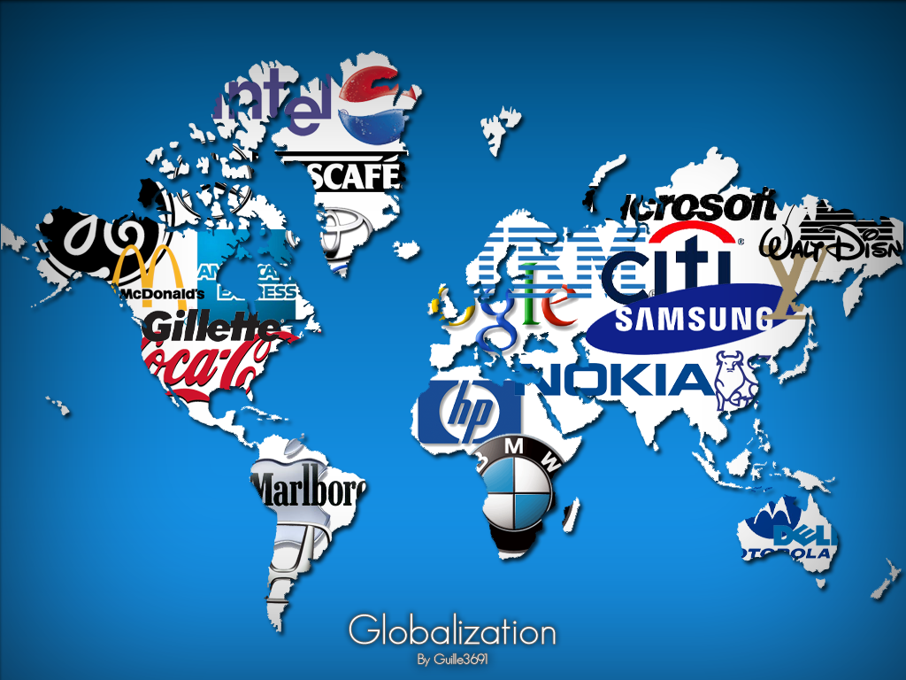

Slide 15
Multinational Corporations in the Global Economy
Many multinational corporations are based in the US due to American managerial ability, technological expertise, and financial resources
Many US MNCs have chosen to operate subsidiaries in Canada because of its geographic proximity, political stability, abundance of natural resources, and well-developed markets
The degree of US involvement and control in Canada’s economy has been so high at times that Canada has been referred to as having a branch-plant economy
Many Canadian firms operate subsidiaries in other countries, so a good number of MNCs have their home offices in Canada

Slide 16
Multinational Corporations in the Global Economy
Corporations prefer to operate as multinationals to improve their profitability
Foreign branch plants provide free access to new markets and the increased revenues these markets represent
Having offices and factories abroad allows the company direct access to comparatively cheap raw materials and labour, reducing operating costs
Foreign governments eager to attract industrial activity provide tax concessions or development grants to firms willing to operate subsidiaries in their country
The financial stability of an enterprise is greatly enhanced by the geographic diversification of having branch plants in a number of countries
Market fluctuations and political upheaval in one country may be offset by stability and growth in others

Slide 17
Multinational Corporations in the Global Economy
Corporate decision-making for a multinational enterprise is complex
The head office makes decisions about important financial and investment matters and these decisions are binding on all branch plants
Decisions dealing with marketing and product distribution are often made at the branch-plant level
In the important field of research and development, decision-making is carefully controlled by the parent firm
The bulk of research is usually conducted at the head office and under closely supervised conditions

Slide 18
Multinational Corporations in the Global Economy
Various economists argue that Canada’s R&D industry has been severely limited by the amount of foreign investment in the Canadian economy
Many expert researchers from Canada have been attracted to the US, while expert managers have been attracted to head offices in the US and abroad
This drain of enterprise (often called brain drain) has had a disruptive effect on Canadian productivity and economic growth

Slide 19
Multinational Corporations in the Global Market
Since their activities cross political border, MNCs can effectively operate beyond the control of national institutions, such as governments
They are sometimes called transnational enterprises
Their wealth and mobility give MNCs a strong political influence in many of their host countries, which sometimes raises ethical questions
If an MNC is operating in a country with strict environmental laws, it may react in one of two ways:
It may simply shut down its offices in that country and move them to another where environmental laws are not so strict
It could influence the politicians in the first country to change their environmental laws or to grant the MNC special exemptions
Either way, critics would charge the MNC with putting concern for its profits above concern for the environment

Slide 20
Multinational Corporations in the Global Market
MNCs can be seen in a negative or positive light
It can be argued that these large transnational corporate empires are the modern-day equivalent of the exploitative 19th-century colonial empires that grew out of the period of human history known as the Age of Imperialism
However, the products and profits generated by multinational operations are seen to contribute greatly to contemporary lifestyles and investment securi

Slide 21
Financing Corporate Expansion
In Canada today, the majority of business enterprises are corporations
In the manufacturing sector alone, more than 95% of the enterprises are corporations
Like proprietorships and partnerships, corporations can obtain the funds needed to finance expansion by borrowing from banks and by reinvesting profits in their growing businesses
Because of their legal status, corporations can also raise investment capital by selling bonds and additional ownership shares

Slide 22
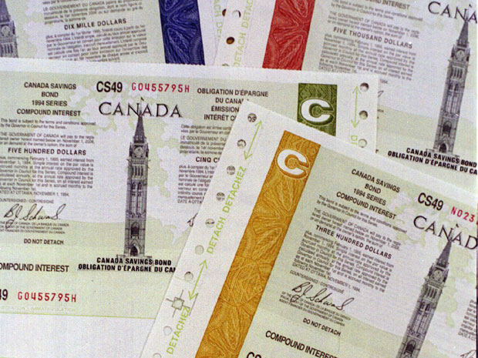
Different Forms of Securities
Bonds
Corporate bonds represent a fixed debt, which the corporation borrows from a buyer and must pay back at some fixed future date, usually 10, 15, or 20 years after the date of issue
The buyer, or bondholder, will receive periodic interest payments, usually at 6-month intervals and for a fixed interest rates
On the maturity date, the bondholder will receive the full amount of the original loan, known as the principal

Slide 23
Different Forms of Securities
As a general rule, the longer the loan period, the higher the interest rate required to persuade investors to tie up their funds for the longer period
The bondholder can resell the bond for whatever price the market will bear
Sometimes the bonds are discounted by the seller in order to complete a transaction
The new buyer assumes all existing conditions of the bond, including the interest rate and date of maturity
It is important to note that the bondholder is not a part owner of the corporation, but

Slide 24
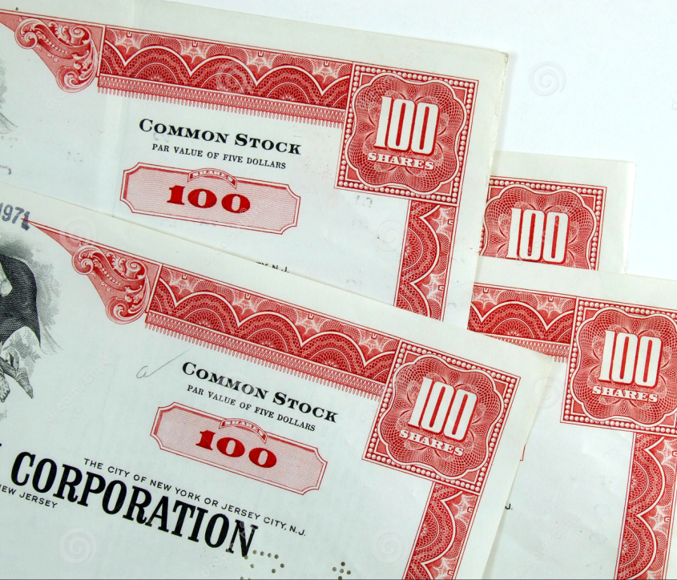
Different Forms of Securities
Shares
Corporations can raise investment funds by issuing and selling additional ownership shares
These shares (common or preferred) represent additional part ownership of a corporation’s capital
The corporation often uses the funds raised to acquire additional assets, so the asset value of each share may not be adversely affected
The asset value is each share’s portion of the corporation’s net worth (asset minus liabilities)

Slide 25
Different Forms of Securities
The book value of a share is the value at which it was originally issued
Shares in a publicly traded corporation can be easily sold through a stockbroker
There is no guarantee that the stockholder will receive either the asset or book value of the shares
The market value of a share is the actual price or value that a share will fetch on the stock market, and it varies significantly over time

Slide 26
Securities Markets and Trading
Shares in a publicly traded company can be bought and sold in the stock market
The stock exchange is the actual building where publicly held shares are traded
The ease with which stocks can be traded through a formal stock exchange encourages individuals and institutions to provide capital for business expansion

Slide 27
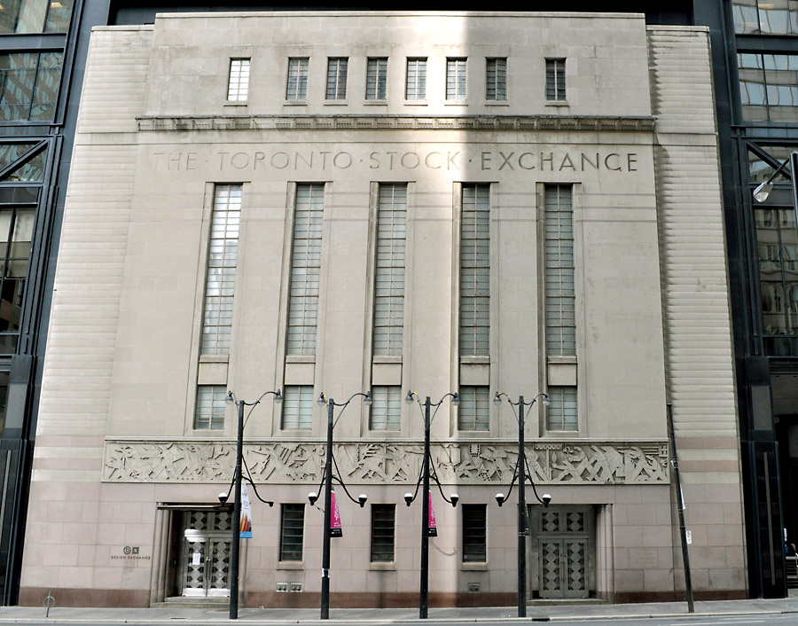
Securities Markets and Trading
The first stock exchange in Canada opened in Toronto in 1852
The Toronto Stock Exchange (TSX) is the largest exchange in the country, accounting for 95% of total shares traded in the country in 2000, based on the number of transactions and also based on the dollar value
On a global scale, the largest exchanges (in terms of the value of stocks traded) are New York. Tokyo, and London

Slide 28
Securities Markets and Trading
Since it was founded in 1971, the National Association of Securities Dealers Automated Quotation (Nasdaq) has grown to become one of the largest stock markets in the world
By 2001, over 4100 of the world’s leading companies were listed on the Nasdaq
Unlike other stock exchanges, Nasdaq has no central location for trading
Instead, brokers acting on behalf of clients place orders with certain Nasdaq brokers, called market makers, who concentrate on trading specific stocks
Trades are made directly between brokers and market makers by telephone or online

Slide 29
Securities Markets and Trading
In order to invest in a company on the Toronto Stock Exchange, you would first have to contact a brokerage firm with a seat on the TSX
A stockbroker acts as your agent for all transactions
Trading is done by computer through a series of networks linking member brokerage firms to TSX computers
Member brokers of the TSX must pay an annual fee for their trading privileges, which buys them a seat on the exchange
In turn, brokers charge their clients a commission based on the dollar value of all transactions completed on their behalf
Direct computer links to the TSX allow online brokerage firms to execute trade orders quickly and, sometimes, at discounted rates
As online trading technology continues to advance and as trading rules become more relaxed, major investors may eventually be able to bypass stock exchanges altogether

Slide 30
Securities Markets and Trading
The price of a company’s stock may fluctuate greatly in response to change in the supply (the amount of shares offered for sale) and the demand (the number of shares being sought for purchase)
Factors influencing the demand for shares include:
Current profits and dividend shares of the corporation
Degree of confidence in the corporate management team
Trends in the industry to which the firm belongs
General economic climate and outlook
The rule that David Ricardo discovered 200 years ago still applies:
Investors react to bad news by undervaluing certain stocks and to good news by overvaluing them

Slide 31
Securities Markets and Trading
Mutual funds were developed for people who prefer a more passive investment
They want to own stocks but prefer not to be bothered with the details of buying and selling
For a fee, expert fund mangers lump together the investment dollars of many clients, amass a diversified portfolio of investments, and then mange the fund on behalf of their clients

Slide 32
Commodities Markets
A commodity market is a place or an institution through which commodities are traded in bulk
A commodity is a standardized raw or semi-processed good resulting from primary industrial activity

Slide 33
Commodities Markets
Non-standardized commodities (such as fish and fresh vegetables) which require physical inspection prior to trading, are often still traded in markets
Ex: The Ontario Food Terminal in Toronto, where farmers bring their produce to sell to merchants, restaurateurs, and retailers
For standardized commodities (such as gold, heating oil, gasoline, corn, and wheat), the physical marketplace is being replaced by a network of telephone and computer links designed to facilitate instant trading

Slide 34
Commodities Markets
Commodities markets include:
Spot markets where goods are traded for immediate delivery
Ex: The Ontario Food Terminal
Futures markets where prices are agreed to in advance, for delivery at various dates in the future
Speculators invest in crops that are yet to be harvested or minerals that are yet to be mined
If the market price of the commodity changes, the speculators that predicted correctly will realize a profit
In order to facilitate transactions, futures are generally traded through a stock exchange

Slide 35
Commodities Markets
Most investors in commodity futures do not intend to receive delivery of the actual product
Future markets deal in the trading of futures contracts, or options
These contracts commit both parties to buy and sell commodities at a fixed price and on a set date
A call option is a contract giving the holder the right but no the obligation to buy a commodity at a pre-arranged date and price
A put option is a contract giving the right but no the obligation to sell a commodity at a pre-arranged date and price
Options are usually purchased for large quantities of commodity

Slide 36
Commodities Markets
As a form of security deposit, both parties pay a set percentage of the market value of the contract to commodities market
The difference between the contract price and the market price, on the day the contract matures, is paid by one party to the futures market
The futures market will then transfer this amount into the account of the other party in order to satisfy the contract

Slide 37
Commodities Markets
Future markets are highly speculative and full of risk
For example, if you are confident that oil-producing nations are about to cut production in order to improve the market price for crude oil, and if you are confident that the following winter will be cold, you may decide to buy heating oil futures at today’s market prices, with the hope of realizing a profit from increases in market price
As a general rule, if the market price is above the contract price, the futures buyer profits and the futures seller loses money
If the market price is below the contract price, the seller profits and the buyer loses

Slide 38
Understanding Stock Market Indicators
The Dow Jones Industrial Average (The Dow) is the most widely quoted indicator of general stock market trends in the US
It is calculated daily, based on the closing prices of 30 blue-chip (or safe and stable) US corporations traded on the New York stock exchange
These companies are carefully chosen to represent all key sectors of the US economy
The Dow is considered a mirror of the stock market as a whole
If it goes up 5%, it is projected that the entire New York Exchange is up, on average, by the same amount
The Dow can be used over a period of time to track patterns in stock price changes on the New York Exchange

Slide 39
Understanding Stock Market Indicators
From 1977-2002, Canada’s leading market indicator was the TSE 300 Composite Index
This indicator was based on 300 stocks divided into 14 groups representing the Canadian economy
Companies were each given a weighting in the index, roughly based on their number of shares
In this way, stock price changes for smaller companies had less impact on the composite index
Changes un the TSE 300 were believed to mirror what was happening in the entire Toronto Stock Exchange

Slide 40
Understanding Stock Market Indicators
In May 2002, the TSE 300 was replaced by the S&P/TSX Composite Index
Instead of being based on a set number of companies, this new index uses two main criteria for inclusions:
Company size
Trading activity on the TSX
The index incorporates the Standard & Poor’s Global Industry Classification Standard, giving investors an accurate comparison of the performance of Canadian indices with those around the world

Slide 41
Understanding Stock Market Indicators
The Nasdaq Composite Index jumped from 1000 in 1995 to 3000 in 2000 before closing out the year at 2400 because the technology sector had experienced a sharp year-end decline
This decline was fueled by a decrease in sales and in investor confidence at the US economy started to slow down
These conditions created a bear market – a stock market under the influence of traders who expect prices to fall
Traders may attempt to sell off stock, hoping to buy it back after the price has fallen
When a large number of investors are like-minded, the actions of the traders, known as “bears”, tend to be self-fulfilling

Slide 42
Understanding Stock Market Indicators
Traders who expect stock prices to rise are called “bulls”
They will buy stock, speculating that they will profit by owning the stock while it appreciates in value
By increasing the demand for shares, the actions of bulls can also be self-fulfilling
A market influenced by a large number of investors expecting price increases is called a bull market

Slide 43
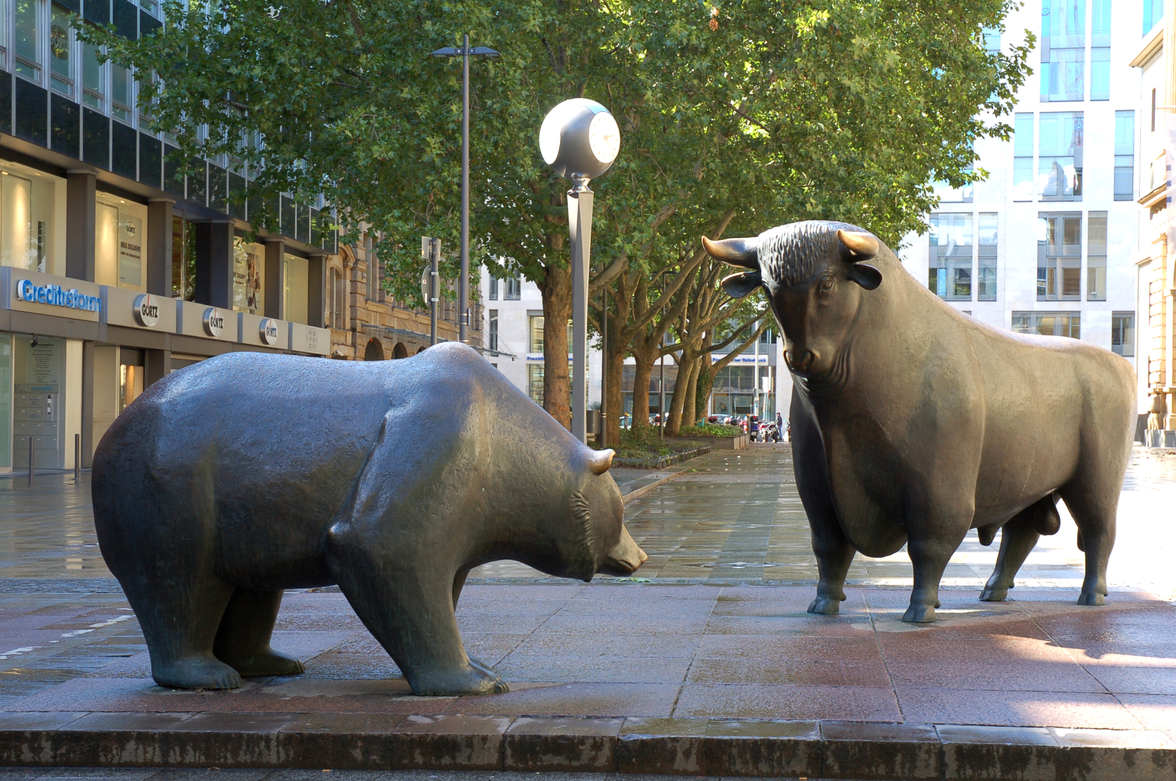

Slide 44
Assignment: Part 2
Explain the difference between the following pairs of terms:
corporate sticks and corporate bonds
bull market and bear market
futures and spot markets
commodities and stock markets

Slide 45
Assignment: Part 3
Research the activities of two multinational corporations of your choice. Write a short report addressing the following points about each corporation:
Describe their goals and objectives
Assess their impact on the economy
Do you think they have a positive or negative effect on society and the economy? Why?
Make sure to cite any references you use!

