Slide 1
Chapter 6: Business Organization & Finance
Mr. Singh
June 20th 2016

Slide 2
Types of Industrial Activity
All human industrial activity can be classified into one of four types, based on the the nature of the activity
Primary industrial activity = natural resources (or raw materials) are being harvested
Secondary industrial activity (manufacturing) = processing raw materials into final or semi-processed goods
Tertiary Industry (Service) – Provide services to consumers ( Retail, stores, etc)

Slide 3
Types of Industrial Activity
Quaternary activity = high-tech services provided to people, firms, and institutions
Economists used to consider this high-tech sector part of the growing tertiary (or service) sector
As high-tech services continued to expand and become more complex and important, a special category was created for them
The importance of the quaternary sector has continued to grow in the contemporary economy
Since industrial activity in this sector is so expensive and highly specialized its presence remains limited

Slide 4
Table 6.1: The four types of industrial activity
 | Industrial Category | Type of Activity | Specific Examples
Goods-Producing Industries | Primary | Resource extraction | Farming, fishing, forestry, mining, hunting
 | Secondary | Manufacturing | Steel mills, paper mills, automobile assembly plants, breweries, furniture and appliance factories
Services-Producing Industries | Tertiary | Provision of services | Wholesale and retail sales outlets, medical clinics, legal offices, schools
 | Quaternary | Provision of highly specialized and expensive technology and support services | Research and development laboratories, information technology design, applied nuclear technology

Slide 5
The Historical Development of Canadian Industry
An economy begins by developing its activities in the following order:
Natural resources
Manufacturing activities
Service sector
High-tech industries
A nation’s economy develops in a linear progression from the primary through to the quaternary sector

Slide 6
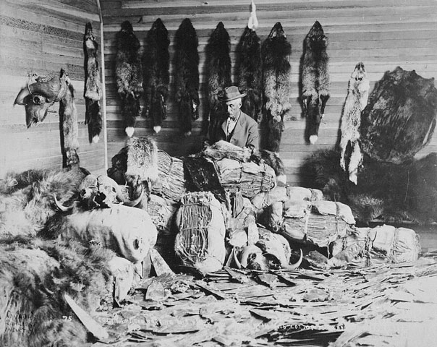
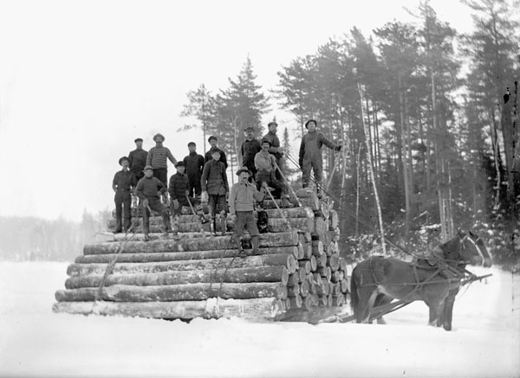
Primary Industries
Canada’s economy first emerged and grew in response to the demands of urbanized European communities for Canadian natural resources
During the 16th, 17th, and 18th centuries, fish, fur, and lumber were the export staples that gave the new economy the largest part of its income
These abundant resources attracted labour and capital from Great Britain and France

Slide 7
Primary Industries
Primary industries were the first type of industrial activity to develop in Canada on a significant scale
Canadian fish, fur, and lumber could be sold in European markets for gold and silver
The British and French governments carefully controlled the expansion of these industries

Slide 8
Primary Industries
Canadian colonists served as an additional market for European manufactured goods
The early colonists had few manufacturing industries of their own
As settlement in Canada increased and moved westward, first wheat, then iron, nickel, gold copper, and other metals were added to the growing list of export staples
This attracted more specialized labour and capital into the economy, and Canadians began to manufacture locally some of the expensive consumer goods that had previously been available only from from Europe
This local production meant that manufactured goods became cheaper for Canadians to buy

Slide 9
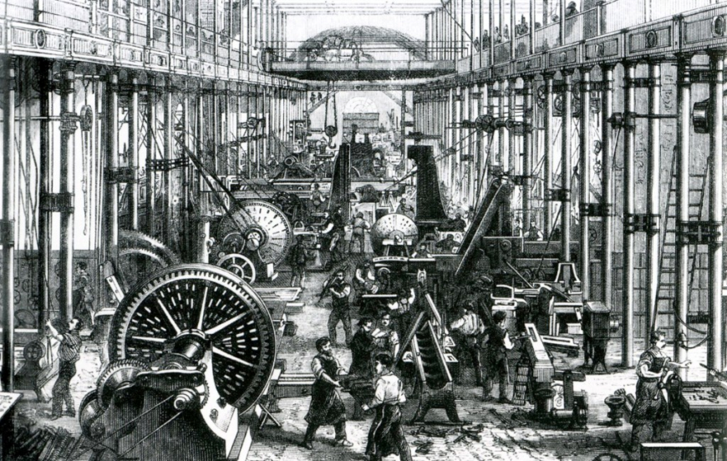
Secondary Industries
The Industrial Revolution that started in Britain around 1780 changed the way manufactured goods were produced
With the development of fast steam-powered trains and ships after 1850, it also affected the free trade of goods between countries

Slide 10
Secondary Industries
As more labour and capital were attracted to secondary industrial activities in Canada, the national infrastructure slowly shifted focus from resource extraction to manufacturing and distribution
After Confederation in 1867, the federal government imposed tariffs on Canada’s industries in order to develop sustained markets for their goods

Slide 11
Services Industries
The surplus of production workers encouraged a shift of labour and capital from export staple production to specialized services such as:
Transportation and warehousing
Finance and insurance
Retail and wholesale trade
Health and education
Entertainment
Personal grooming

Slide 12
Services Industries
By the middle of the 20th century, Canada had become an industrial nation and had achieved a more balanced economy with strong primary, secondary, and tertiary sectors
Canada’s prosperity and growth remained dependent on its ability to find export markets for foodstuffs, raw materials, and manufactured goods
In any economy, the development of a large service (tertiary) sector is supported by goods-producing industrial sectors that establish a strong export base and a steady flow of money into the economy

Slide 13
Services Industries
The employment shift toward the service sector intensified during the economic boom that followed the Second World War and continues to the present day
The level of service specialization has increased significantly over the last 25 years as Canada has developed its quaternary industries

Slide 14
Service Industries
Today, Canada is a major exporter of:
Fibre optics technology
Nuclear power generation technology
Satellite sensing technology
And other high-tech applications

Slide 15
Forms of Business Organization
In order to engage in business activities in any sector of the Canadian economy, people organize their funds and abilities into units of ownership called firms
Firms are designed to achieve maximum profits by providing goods and services that customers are willing to pay for
These business ventures can be set up in one of five ways:
Sole proprietorship
Partnership
Corporation
Co-operative
Government enterprise

Slide 16
The Sole Proprietorship
A sole proprietorship is a business owned and operated by one person
Even though proprietors may employ other people, they make all the business decisions
Proprietors are solely responsible for all the firm’s debts and solely entitled to all the firms profits

Slide 17
Advantages
This small-scale form of business organization appeals to people who prefer to:
Be their own bosses
Keep their financial affairs, business dealings, and production processes confidential
Most businesses are required to have a municipal license or a provincial vendor’s permit
The name and business particulars of the firm have to be registered with the provincial government only when a name other than the real name of the proprietor is used

Slide 18
Disadvantages
The unlimited personal liability of the owner
The proprietor’s personal assets can be seized to pay off outstanding business debts
No one else to rely on to run the business or raise needed funds
Difficult and expensive to obtain business loans
Since ownership is personal and income tax is progressive (the more one earns, the higher the percentage rate of income tax one must pay), the sole proprietor may pay more income tax than under a corporate form of business

Slide 19
The Partnership
A partnership is a firm owned by two or more people and bound by the terms of a legal document known as a partnership agreement
This document governs the business conduct of all partners and outlines their rights and obligations
This agreement can establish either a general or a limited partnership

Slide 20
The Partnership
General Partnership
All partners take part in the management of the firm and have unlimited personal liability for business loans
Limited Partnership
Includes limited partners and at least one general partner
Are not permitted to take part in the management of the business
Are personally liable for business debts only up to the amount of their original investment
No additional assets can be seized to pay off partnership debts

Slide 21
Advantages
The pooling of talent and capital, high personal motivation, and relatively few legal expenses and restrictions
Appeal to people who prefer not to assume all the risks of business operation alone
Along with the pride of ownership and the satisfaction that comes from being self-employed, partners share all after-tax profits according to the distribution formula specified in the partnership agreement

Slide 22
Advantages
Partnerships attract more capital because it pools the funds of a number of people
It is easier for a partnership to obtain credit and to borrow money because more people are responsible for repayment
Since banks consider these loans more secure, they set slightly lower interest rates for them
Partnerships must be registered with the provincial government and the municipal government may require a business permit
Professional firms of lawyers, architects, and accountants are often organized into partnerships

Slide 23
Disadvantages
General partners must assume unlimited personal liability
Their personal assets can be seized to pay off business debts
This personal liability is both joint and several
Joint liability
All general partners are liable for the debts of the partnership
Several liability
If the other general partners fail to pay their share of the debt, one or more partners may be required to pay all partnership debts
Partners have to pay a progressive personal income tax, so the percentage of tax they pay increases as their revenues go up

Slide 24
Disadvantages
It is not easy for a partner to sell his or her share in the firm
Most partners must obtain the approval of the other partners before ownership can be transferred to a new partner
The other partners have the right to buy out the retiring partner rather than allow a new partner into the group
Partnerships can only obtain investment funds from within the existing partnership
Partners must use personal savings or take out mortgages on personal assets to raise money for the partnership
Partnerships can’t usually attract large amounts of capital

Slide 25
Disadvantages
Disputes will inevitably arise during the daily management of the firm
Personality clashes and disagreements on what is best for the firm cause many partnerships to be terminated
A partnership legally terminates if one of the general partners:
Dies
Becomes mentally incapacitated
Becomes financially insolvent
Commits a breach of the partnership by acting against the best interests of the firm
Partnerships don’t usually last for a long period of time

Slide 26
The Corporation
A corporation (or limited company) is a business firm legally recognized as a separate entity in its own right
Shares of a private corporation are privately traded
Their transfer or sale must be approved and transacted by the corporation’s board of directors
Shares of a public corporation can be freely traded
Subject to the supervision of the provincial securities commission

Slide 27
The Corporation
A corporation can only be established through government authorization
A document called the articles of incorporation must be filed with:
Federal government, if the corporation is planning on doing business in more than one province
Provincial government, if the corporation plans to do business in one province only

Slide 28
The Corporation
Corporate assets are divided into equal parts called shares
Made available to prospective buyers and can be quickly resold through the stock market
The owners of a corporation are called shareholders
Can have just a few or thousands of shareholders
Shareholders elect a board of directors to run the company on a day-to-day basis at the annual general meeting
Since investors don’t personally have to assume responsibility for the day-to-day operation of the firm, more investors and investment dollars are attracted to it

Slide 29
The Corporation
Corporations offer two types of ownership to investors
Common shares provide a shareholder with voting rights
Preferred shares give a shareholder a preferential position in regard to profits and assets but do not provide voting rights
Shareholders can vote on decisions at the annual general meeting in person or by proxy
A proxy is a document signed by a shareholder appointing another person to vote on behalf of that shareholder

Slide 30
Advantages
One advantage of corporations is their method of profit distribution
At the end of the fiscal year, the majority of shareholders may vote to reinvest a portion of corporate profits into the firm
Provides an internal source of additional investment capital
Due to their size and scale of operations, many large corporations have become self-financing and no longer require bank loans to finance corporate expansion
The promise of even greater profits in the future is usually all the incentive it takes to persuade shareholders to forgo a portion of their current profits
Profits that are not reinvested in the firm are distributed to shareholders in the form of dividends and are paid on a per-share basis

Slide 31
Advantages
Once a corporation is legally established, it can:
Sue and be sued
Enter into contracts
Own property
Incur debts and other obligations
Any obligations incurred are generally the legal responsibility of the corporation, but not of the individual owners
Corporate shareholders have the advantage of limited personal liability
The risk of owners is restricted to the amount they have invested in the business
Creditors can’t claim the shareholder’s other possessions if the corporation goes bankrupt

Slide 32
Advantages
The risks of investing in a corporation are substantially less than those of a partnership or proprietorship
Corporations can attract a much wider pool of investors and a larger amount of investment capital
So corporations can operate on an extremely large scale
Corporations have more longevity since they do not dissolve if a partner dies or decides to leave as the shares can be easily transferred to others
Corporations pay lower rates of income tax and dividends received by shareholders are also taxed at a lower rate

Slide 33
Disadvantages
The legal and government fees for establishing a corporation are very high
Corporations are more closely regulated by the government, and they must:
Keep a set of books that lists their shareholders, directors, assets, and business dealings
Hold annual general meetings
Produce an annual financial statement
File annual corporate tax returns
Executives of many firms believe that these public disclosures can adversely affect the corporation’s privacy by providing important information to competitors
But governments require this info in order to protect investors

Slide 34
Disadvantages
Large corporations may experience reduced personal incentive
Corporations have professional managers, so investors don’t have any hands-on control
The incentive and loyalty of a professional manager is rarely as strong as that of an owner
This is combated in some firms by offering managers stock options, profit sharing, and performance bonuses

Slide 35
The Co-operative Enterprise
A co-operative is a business firm owned equally by its various members
Members of a co-operative must have a common relationship, goal, or economic purpose

Slide 36
The Co-operative Enterprise
Retail co-operatives are formed to provide goods to members at reduced prices
Marketing co-operatives are created to sell the produce of members at the best prices possible
Financial co-operatives are formed to arrange savings and loans for members at better rates than those available at local banks
Service co-operatives provide special services such as housing, medical insurance, and equipment rentals

Slide 37
The Co-operative Enterprise
Co-ops incorporate themselves under their provincial corporations act
Permits them to secure limited personal liability for their members while maintaining all the other privileges of membership
For the purposes of collective decision-making, each member (regardless of the amount invested) is entitled to a single vote
A majority vote is required to carry any decision

Slide 38
The Co-operative Enterprise
Members elect a board of directors annually to handle the day-to-day operation of the co-op
Credit unions are a well-known example of a co-operative enterprise
Financial co-operatives whose members can obtain many of the same services (savings and loans) available from banks but at more favorable interest rates
Unlike banks, credit unions can only accept deposits from and arrange loans and mortgages for members

Slide 39
Advantages
Each member has an equal say in all management decisions
Co-ops are not adversely affected by the death, insolvency, or incapacity of individual members
Members can obtain goods or services through the co-op or sell their products at better prices
Members can enjoy limited personal liability for the debts incurred by the co-op
Any profits made by the co-op that are not reinvested in the business are paid out to the members in the form of patronage returns
These payments are based on the amount of business transacted by each individual member

Slide 40
Disadvantages
The decision-making process can be problematic when many equal members have radically different ideas
The voluntary, and therefore unpaid, nature of the officers’ positions may discourage some capable people from offering their management expertise to the group
Co-operative are able to raise investment funds only from existing members, so they have a limited ability to raise capital when needed
Co-ops are restricted to conducting business with existing members
This limits the number of customers and the volume of business transactions

Slide 41
The Government Enterprise
Government enterprises are owned by the federal, provincial, or municipal government
They generally provide services that the private sector won’t offer because the profits generated are lower than the amount of capital invested
The government may establish an enterprise to:
Provide competition in industries dominated by a single firm
Prevent the total private control of key industries
Increase employment or to centralize and standardize services
In recent years, the federal government and some provinces have actually made a concerted effort to privatize all or part of some government enterprises
Ex: In the 1980s the federal government of Canada privatized a number of Crown corporations such as Canadair, Teleglobe Canada, and Air Canada

Slide 42
The Government Enterprise
Most businesses owned by the federal government are operated as Crown corporations
The federal government holds all or most of the ownership shares of these corporations

Slide 43
The Government Enterprise
At the provincial and municipal levels, government enterprises take on various forms:
Public utilities supply electricity and water
Provincial control boards sell liquor
Housing corporations provide affordable shelter
Transit commissions provide affordable public transportation
Government enterprises operate in the best interests of the community rather than to generate profits for shareholders
The government covers operating expenses and business losses through grants, subsidies, or annual operating budgets

Slide 44
The Government Enterprise
There is a lot of debate over the merits of government enterprise relative to private enterprise
Different provinces have come to different conclusions in regard to certain industries
Private companies in Ontario and Quebec provide telephone communications services, while in Saskatchewan these same services are provided by a provincial Crown corporation. Each method seems to work well for the respective provinces

Slide 45
The Government Enterprise
Certain industries that have a major impact on the common good, such as postal services, power companies, and railways, are state-owned in many countries because they seem to operate best without competition
These enterprises are referred to as natural monopolies

Slide 46
The Government Enterprise
At present, the Canadian public seems to favour privatizing government enterprises to reduce the size and cost of the government
If the public concludes that private interests are not serving the common good adequately then it will pressure government to take over these private industries again
In this way, the Canadian mixed-market economy will continue to exhibit simultaneously both capitalistic and socialistic tendencies as it searches for the most effective balance between the two

Slide 47
Non-Profit and Charitable Organizations
Some organizations are government registered (federally or provincially) as non-profit charitable organizations
These private institutions are not permitted to generate profits
In return, their activities are income-tax exempt
Many of these institutions raise money to cover operating expenses from donations, grants, and fundraising activities

Slide 48
Non-Profit and Charitable Organizations
Examples of private non-profit charitable organizations include:
The Canadian Cancer Society
The Canadian National Institute for the Blind
Local food banks
District school boards are examples of public non-profit organizations
These enterprises are managed by a board of directors or elected trustees and operate through the work of both hired staff and volunteers

Slide 49
Assignment: Part 1
Create a table comparing the advantages and disadvantages of the five forms of business organizations we just discussed. Make sure to label your rows and columns appropriately.

