Slide 1
Content & delivery
Mr. Singh

Slide 2
gathering content for your program
1. Think in terms of tips – start with 10 tips
Pick one and google ‘how to…’ and ‘ways to…’
In the results, look for lists…
Once you’ve clicked on a list, see each point and write it down because you could create content on that
If you find something that you can’t talk about for 2-9 mins, don’t write it down
2. Go back to questions you gathered from your audience – that’s content you’ll want to add too

Slide 3
gathering content for your program
3. Amazon
Type in your topic
Filter by selecting books, and click on look inside to view the contents page to get more ideas
Take a look at the reviews to see what people like and dislike
4. Udemy
Search your topic
And take a look at other courses and their table of contents to get info

Slide 4
gathering content for your program
Now that you know what topic your going to teach, you need to start planning your content
List down all the things you know about the topic
We don’t care about what you don’t know
At least 1-20 things

Slide 5
Organize and structure your content
Take all your tips and organize them into modules or chapters
Each tip is a lesson
You can google lesson plan templates if you want to guide on how to structure your lesson
Keep videos/audios to less than 10 mins
Keep written documents to less than 10 pages
One short ‘lecture’ per key point

Slide 6
Learning outcomes vs Program Goal
What will they be able to DO at the end of your program?
What will they KNOW by the end of your program
How will they FEEL by the end of your program?
E.g. At the end of phase 1, you will be able to apply the technique to jump higher
E.g. #2 – Provide athletes with the tools, skills, and knowledge to increase their vertical jump
Which one is learning outcomes and program goals?

Slide 7
8 steps to enhance content
Generally people have an attention span of 2-5 mins for tutorial videos
Americans have an attention span of up to 12 mins
Step 1: Personal/Personable hook – Get your audience to relate to you
This is where you make them FEEL like you know where they are coming from
They FEEL like that you understand and can help them

Slide 8
8 steps to enhance content
Step 2: Solution – What is your solution to the problems, the questions, the need your audience has
Eg: From step 1 – How would you feel if you could dunk on a 10 ft rim?
Solution: Wouldn’t you love to jump higher, I have the solution for you, I’m going to show you how to jump higher
In step 2 you don’t tell them how to do it but that you have the solution

Slide 9
8 steps to enhance content
Step 3: Theory & Stats – Facts, evidence etc.
“Statistics show that….”
Step 4: Unique/Contextualized Perspective – This is where you differentiate yourself from others
Eg – It’s known that squats and strength training can make you jump higher but our program goes far beyond that and teaches you the technique to jump higher in addition to strength training and plyometrics

Slide 10
8 steps to enhance content
Step 5: How to do it! – You tell your audience how to do it, you tell them your step by step solution
This is where we transform them from A to B
If you can turn it into steps, that’s great
Step 6: Persuasion & Relevance Reinforcement – Provide additional reassurance about your program
E.g. If you don’t follow the technique you won’t be jumping as high as you can

Slide 11
8 steps to enhance content
Step 7: Practical Implementation – Have your audience do activities to help them see results
Eg: Drills, worksheets, etc.
Step 8: Call to Action (CTA) - What do you want to do next
Eg. Sign up, Buy Now, Learn more, etc.
To test the market, you can list your learning outcomes on a survey and see how many people would be interested

Slide 12
Content delivery methods
Content is what you teach, Delivery is how you teach it (Tip: Use Canva for professional templates)
Video*
Audio
Text or PDF
Multimedia
Presentation (PPT, Google slides, etc.)
Downloads
Discussions
Quizzes, Assignments, Exams, etc.

Slide 13
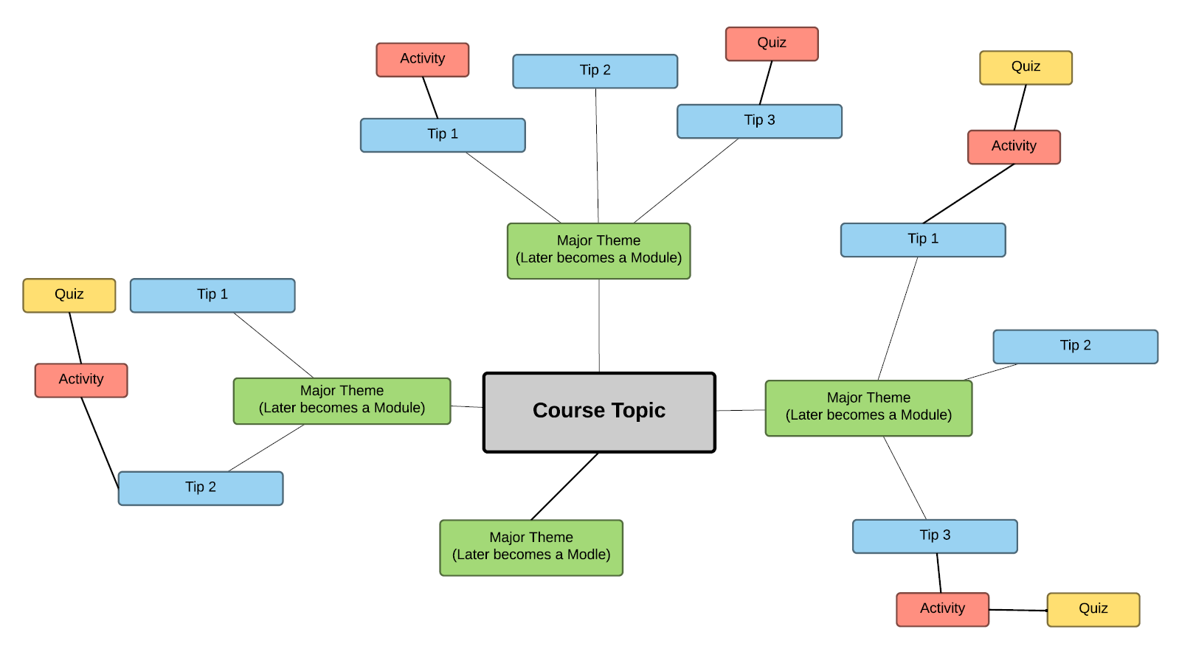
Start planning

