Slide 1
Economics and the Real Estate Market & Contract Law
Mr. Singh

Slide 2
Real Estate market
Real estate market is different than a regular market because no physical marketplace exists
There is no set place where you can go to buy real estate. It’s all over the world
There are other characteristics that are different than a typical sales market

Slide 3
Characteristics
No standard product
Uniqueness of residential and commercial properties
No two houses are ever exactly the same
Fixed Location
Largely fixed in nature; cannot be taken to market
Real estate is one commodity that cannot be taken to the consumer

Slide 4
Characteristics Cont’d
Local Real Estate Market
Immobile, impacted by local market forces
Scarborough prices are different than Pickering prices, etc.
Private Transactions
Buyer/seller transactions are generally private matters
Lacks the immediacy, open bidding and distribution of sale information as found in the stock market

Slide 5
Characteristics Cont’d
Slow supply/demand adjustments
Supply/demand forces impacted by unique market variables (Ex. time to introduce product and deplete available inventory)
In real estate, when demand is high, a lot of building projects are started
If the market changes and demand drops, the projects are completed anyway and this adds to the oversupply

Slide 6
Characteristics Cont’d
Because of the durability of real estate, supply remains and can increase in value
On the other hand, if there is a sudden surge in demand, no quick solution is available given the time required to plan, finance, develop and build

Slide 7
Contract
A binding promise of one person made to another or others
Contracts can have many forms – verbal contracts (word of mouth), contracts made by exchanging letters or contract drawn up as long, detailed documents
A contract requires a meeting of the minds whereby a legal, rather than moral, obligation is created

Slide 8
Essential Elements of a contract
Capacity of the Parties
Lawful object
Consideration
Offer and Acceptance
Genuine Intent
Definite and Clear
*If any elements are missing the contract is void or voidable

Slide 9
Capacity of the Parties
Both parties, at the time of the contract, must have the legal capacity to make the contract
These include:
Mentally incompetent person
Intoxicated person (drugs, alcohol, etc)
Illiterates (unable to read or write)
Minors (those under the age of majority)
Now the contract is still valid, until a person goes to court to void it
If you allow the contract to exist, it may not be voided

Slide 10
Lawful Object
If the object of the contract is illegal by statute or common law, the contract will be void
Examples include:
Criminal activity
Price Fixing
Gambling or wagering

Slide 11
Consideration
Consideration is what each party receives or is to receive in exchange for a promises to act in a certain manner and is something of value that is given by a promisee to a promisor to make the promise binding.
3 types of consideration
Value consideration is what either party receives of some worth

Slide 12
Consideration Cont’d
Lawful Consideration – Consideration under the contract must be lawful
If the buyer and seller knowingly agree to transact business based on stolen money or goods, the contract does not have lawful consideration.
Past Consideration – Old consideration is no consideration.
Discussed in class

Slide 13
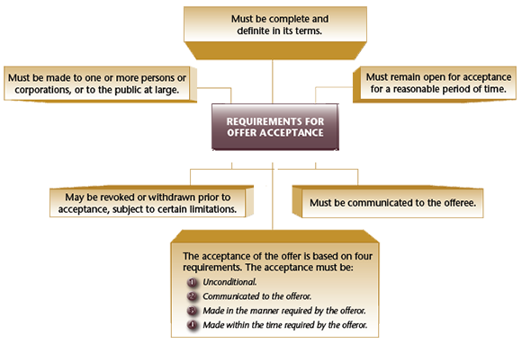
Offer and Acceptance

Slide 14
Offer and Acceptance
A contract is formed when the offer (made by the offeror) is accepted by the other party (the offeree)
Where the communication of acceptance is permitted by mail, telegram or fax, such acceptance is deemed to be completed upon the letter having been mailed, the telegram sent or the fax transmitted.
This means that the contract is binding even if the letter, fax or telegram have not been received

Slide 15
Genuine Intention
Agreement must have genuine intent
One of the parties may have been induced to enter into the agreement by improper means and the document does not express what was intended
Sometimes mistakes are made with contracts but not all mistakes are considered a legal mistake
Only certain types of mistakes give rise to remedy

Slide 16
Genuine Intention
There are 3 types of mistakes:
Common Mistakes – Both parties make the same mistake
Mutual Mistake – Parties misunderstand each other and are at cross purposes
Unilateral Mistake - One of the parties is mistaken concerning a fundamental character of the contract.

Slide 17
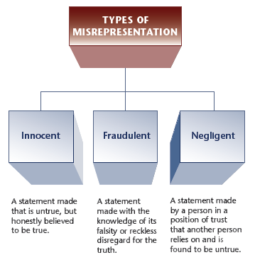
Genuine Intention

Slide 18
Genuine Intention
Duress or Undue influence
Duress involves the threat of violence, force or pressure to coerce a person into an action against his or her will. Duress occurs when a person does not act with his/her free will, but instead through fear of personal suffering.
Undue influence is the improper use of one person’s power over another to induce that person into a contract.

Slide 19
Genuine Intention
Failure to Disclose
In terms of real estate The non-disclosure of material latent defects might invalidate a contract
If you know of something wrong with the property and sell it, that contract is void

Slide 20
Genuine Intention
One party is knowledgeable and experienced while the other is ill-informed and inexperienced.
A gift is made by a child to an adult, guardian or ward; a beneficiary to a trustee; a patient to a doctor; a person to a spiritual advisor; or, a client to a solicitor.
A real estate salesperson purchases property from his/her client.

Slide 21
Definite and Clear
The terms of an agreement must be definite and clear and if the essential terms have not been agreed upon, a binding contract does not exist.
A contract in which no date was specified for possession might be held to be invalid for lack of certainty

