Slide 1
Intro to marketing & Product Launch formula
Mr. Singh

Slide 2
A license to print money: Your List
Your e-mail list – List of people who have asked to subscribe to your e-mails
Typically you have an “opt-in” form on your site
Why would people subscribe?
For your lead magnet – something of value
Free mini course, PDF guide, newsletter, etc.
This is not spam, these people want your e-mails
Notes:
Introduce buying a house and the power of the list – money needed quickly

Slide 3
Your list is not a strategy, it’s the strategy
How responsive is your list?
Open rate of 60% is considered super responsive
A responsive list comes from building a relationship with your subscribers
Social media or e-mail list? Which is better?

Slide 4
Ideal customer avatar
Who your ideal customer is
Where they hang out online
What their challenges are
Your lead magnet will cater predominately to your ICA
Your ads will cater to your ICA
Help you create a product your ICA needs
You can describe your offer in ways that speak to your ICA

Slide 5
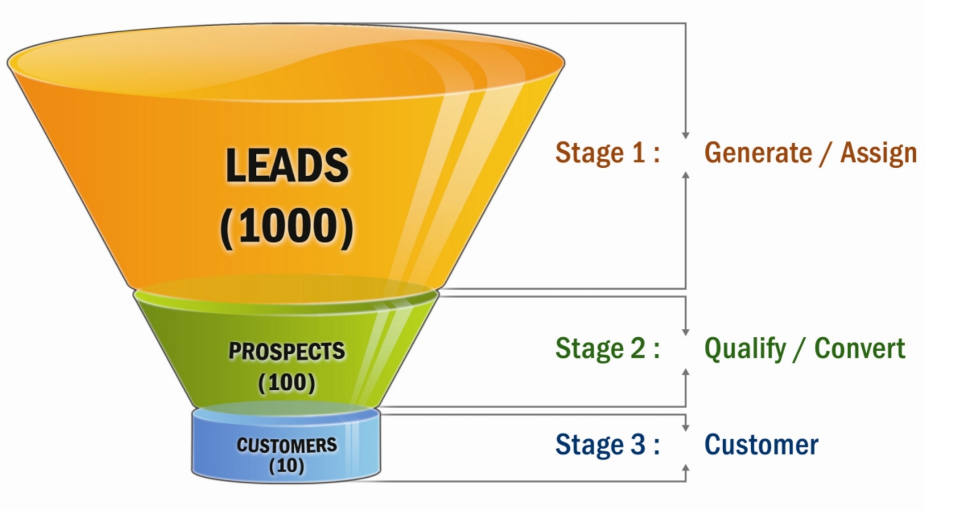
Sales funnel

Slide 6
Driving traffic to your page
Search Engines, Social Media, Paid Searches
Facebook & Instagram Ads
Producing & Posting Content Regularly
Podcasts
Channels
Blogs

Slide 7
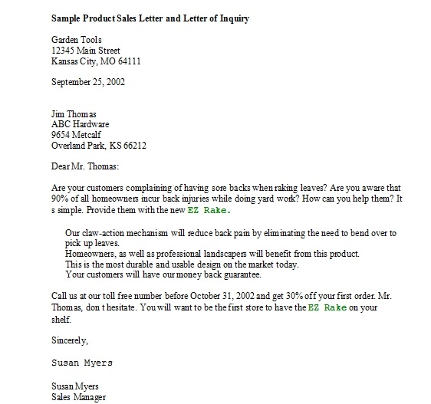
sales letter
This is just a sales letter
Lengthy printed advertisement
Since the internet came along most of these have turned into video
Just 1 ad to sell you product

Slide 8
Sideway sales letter
We flip long page sales letter on its side
Instead of pages, we use days
Instead of a 5 page sales letter, we use a 5 day sequence
Instead of one super long letter, we split it up into a series of contacts over a number of days
Those contacts are called “Prelaunch Content” or PLC
Instead of a long monologue we turn it into a conversation… a launch conversation

Slide 9
Sideway sales letter Cont’d
The Sideway Sales Letter is a sequence of Prelaunch Content followed by a sales message
Typical sequence will have 3 pieces of prelaunch content over a period of 5 days
Content is often online video, but it an take many forms, such as e-mail, blog posts or pdf
At the end of the prelaunch sequence, you “open cart” by sending prospects to sales page
Your PLC needs to be valuable

Slide 10
9 Mental triggers
Things that directly influence how we act and make decisions
Incredibly powerful and they act on a subconscious level
The key in marketing and your launch is to hit these mental triggers

Slide 11
Mental triggers
Authority
People tend to follow others in positions of authority
Doctors, police officers, firefighters, construction workers – what makes them have authority besides their job?
White coat, badge, helmet, etc.
How did I gain authority in my market?

Slide 12
Mental triggers
Reciprocity
The idea that if someone gives something to us, we feel obligated to give them something back in return
Let’s take Christmas for example and gift giving
In business, this is about giving away things for free
Great free content of value in our case

Slide 13
Mental triggers
Trust
If someone you trust tells you something, you’re more likely to believe them because of your relationship with that person
If you want someone to buy from you, it’s much easier if they trust you
Easiest way to create trust is through time
PLF and the sideway sales letter gives you that time

Slide 14
Mental triggers
Anticipation
Looking forward to something in the future
Looking forward to Christmas, your birthday, etc.
How can we create this during our launch?
If you mix anticipation with other mental triggers, the power is magnified

Slide 15
Mental triggers
Likeability
People enjoy doing business with people they know, like and trust
How do we become more likeable?
Be kind, gracious, generous and honest
The more likeable you are the more influence you’ll have
Giving people free content, interacting with them, responding to questions and comments

Slide 16
Mental triggers
Events and Rituals
Turning your marketing into an event
People generally love events and get pulled in by them
This is why sports fans get so caught up in the fate of a team
If people go through an event together, it becomes something of a ritual
Rituals pull people together and create some of the most powerful experiences we can have

Slide 17
Mental triggers
Community
We act in accordance with how we think the people in our community are supposed to act
Social norms need to be considered
Great thing is you can build your own online community in the midst of your launch
Once you get people interacting with you and your content, that’s the beginning

Slide 18
Mental triggers
Scarcity
One of the most powerful mental triggers
When there is less of something, we want more
It’s the perception of scarcity that motivates us
Scarcity forces people to make decisions
If people have choice, they will put off a decision
You need to build scarcity into your launch
Ex – Open & Closed Business Model

Slide 19
Mental triggers
Social Proof
The idea that if we see other people taking action, then we will be inclined to take action as well
Reviews, where people are going, amount of times a product has been downloaded
You can do this during your launch by people seeing results with your PLC or just saying how valuable the information is

