Slide 1
Karl marx
Mr. Singh
CPW4U

Slide 2
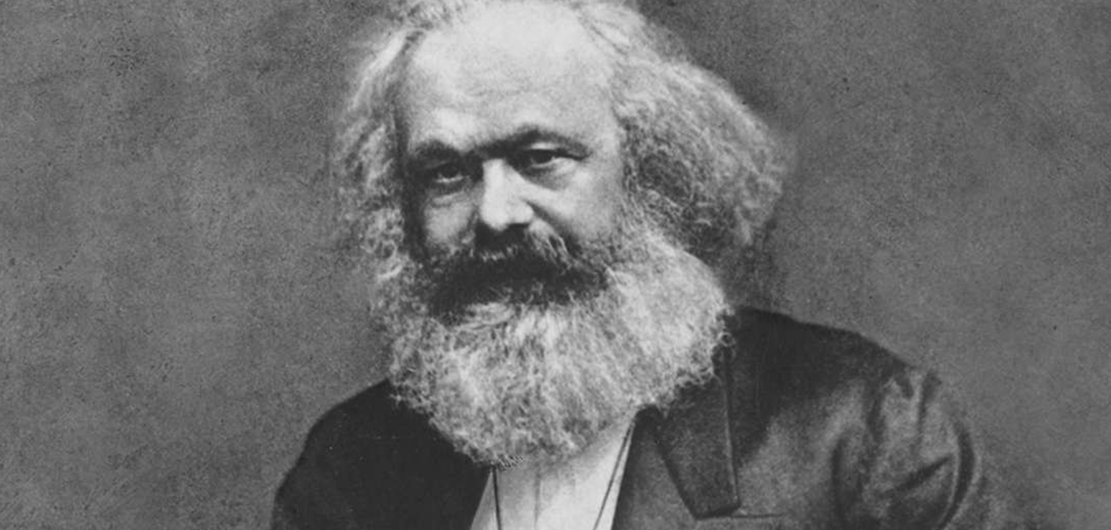
Born in German
Rhineland in 1818
Karl Marx (1818-1883)
Believed capitalism
would
destroy itself

Slide 3
Karl marx (1818-1883): The communist
Argued that economic laws that perpetuate the conflicts between social classes govern all human history
Founded an international workers’ movement intended to overthrow the corrupt ruling class (the bourgeoisie)
In 1848, Marx and Friedrich Engels published the “Communist Manifesto” in which they incited all exploited workers (the proletariat) to rise up against their oppressors
  So was born the international revolutionary socialist movement of communism

Slide 4
Karl marx (1818-1883): The communist
Marx viewed firsthand the ill effects of the Industrial Revolution on the working class in the late 19th century
By the time of his death, England had transformed from an agricultural and artisan-based economy to one in which the dominant mode of production was the steam-powered factory
Workers lived in slums of crowded cities and worked 18-hour days in unsafe and unclean factories

Slide 5
Karl marx (1818-1883): The communist
There were no child labour laws, so working-class children endured the same hardships and had no time for education
Marx believed capitalism, as an economic system, was so morally bankrupt that it would one day destroy itself.

Slide 6
Ideas that advanced economic thought
Marx thought that the laws of economics determined the course of human history and that history was a continuing series of class struggles between exploiters and the exploited
Ex: free citizens against slaves, lords against serfs, industrial capitalists against workers, etc.
Whenever conditions become unbearable, the oppressed rise up in rebellion against their oppressors

Slide 7
Ideas that advanced economic thought
Capitalist exploitation would continually worsen living standards until workers would eventually unite to overthrow the corrupt ruling class

Slide 8
Ideas that advanced economic thought
The Economic Interpretation of history
Marx thought that the laws of economics determined the course of human history and that history was a continuing series of class struggles between exploiters and the exploited
  Ex: free citizens against slaves, lords against serfs, industrial capitalists against workers, etc.
Whenever conditions become unbearable, the oppressed rise up in rebellion against their oppressors

Slide 9
Ideas that advanced economic thought
The Economic Interpretation of history
Capitalist exploitation would continually worsen living standards until workers would eventually unite to overthrow the corrupt ruling class

Slide 10
Ideas that advanced economic thought
The Communist Revolution (Revolutionary Socialism)
This revolution would begin in the most industrialized countries in Western Europe (where capitalism was strongest and exploited workers most severely) and would spread throughout the world
The overthrow of capitalism would lead to international socialism based on the common ownership of land and capital

Slide 11
Ideas that advanced economic thought
The Communist Revolution (Revolutionary Socialism)
It would then evolve into its ideal state of communism: a worker-governed society based on the guiding principle “from each according to ability, and to each according to need”

Slide 12
Ideas that advanced economic thought
The Labour Theory of Value
The value of any item is the value of all labour used in its production (labour value)
  Includes both labour (supplied by workers) and indirect labour (supplied by machinery and buildings involved in manufacturing)
  In a capitalist system, workers receive only a portion of what their labour is worth
  The difference (surplus value) is stolen from the worker in the form of profit for the capitalist

Slide 13
Ideas that advanced economic thought
The Labour Theory of Value
Worker employment is based on the premise that the worker will always produce more for the employer than the employer will have to pay in wages
  Workers are forced to sell their labour to capitalists for less than it is worth because there is a “reserve army of the unemployed”
  Capitalists always have the option of hiring unemployed workers at lower wages, which ensures wages will never rise above the subsistence level

