Slide 1
Malware and Computer Maintenance
Mr. Singh

Slide 2
6 types of Malware
Virus
Worm
Trojans
Rootkit
Spyware
Adware
What is malware? What does it look like? How can you stop it?
What about other threats: Hoax & Chain letters

Slide 3
Types of Malware
Virus:
Attaches itself to existing files and runs the virus code whenever the host is accessed/run
Worm:
A standalone program that deliberately tries to exploit vulnerabilities in order to spread to more machines

Slide 4
Types of Malware
Trojans:
A ‘virus’ that needs to be run in order to do damage
Rootkit:
Usually exists for the sake of hiding itself and possibly opening some back doors
Might work with a trojan in order to help disguise itself and spread

Slide 5
Types of Malware
Spyware:
Software that hides on your computer in order to ‘spy’ on you. Possibly monitor keystrokes, record websites, etc.
Adware:
Similar to spyware but designed to redirect you to certain websites (advertising) or display popups

Slide 6
What do these malware do?
Copy themselves into other files
Execute various ‘payloads’
Delete files
Do something on a particular day
Spread themselves (worm, or e-mail virus)

Slide 7
Prevent Malware
How can you catch one?
USB thumb drive
CD/DVD
Downloaded from the internet
From network (school or work)
In an e-mail
In an instant message

Slide 8
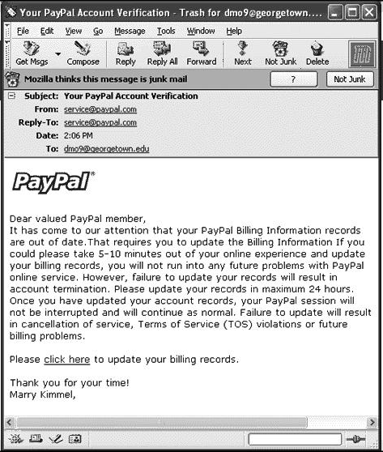
Malware Example

Slide 9
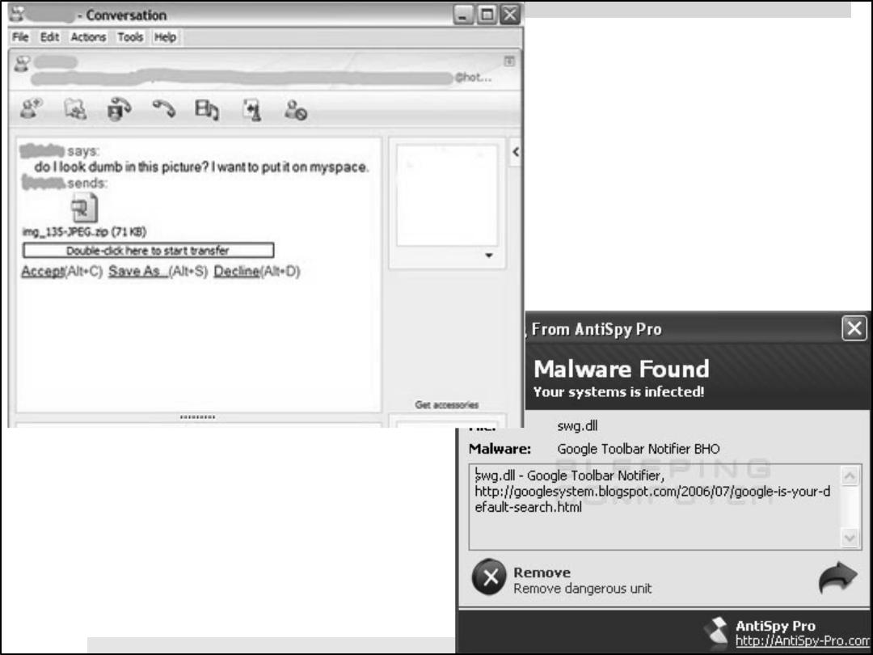
Malware Example

Slide 10
Malware Example

Slide 11
Prevent Malware
Avoid downloading every little installer
Consider what you’re installing
Avoid programs downloaded via P2P networks (Kazaa, limewire, torrents, etc)
Install anti-virus, such as AVG or Norton
Install anti-malware software such as MalwareBytes

Slide 12
Other threats
Hoax:
Usually an e-mail that gets passed along by unsuspecting computer users who receive and forward it on to their friends
Chain Letter:

Slide 13
Hoaxes/Chain letters
Usually an e-mail that gets passed along
Spreads by e-mail just like a virus
No code: it doesn’t replicate itself
Gullible people e-mail it around

Slide 14
Hoaxes & Chain Letters
What does a hoax do?
Makes you look foolish if you forward it
Clogs people’s e-mail
Slows down your network and the internet
Could ask you to do something that will damage your computer
DO NOT forward an e-mail even if it does sound like a real warning

Slide 15
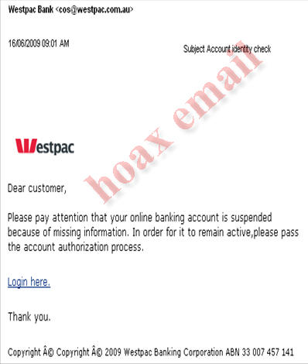
Example of Hoax e-mail

Slide 16
Virus prevention
Antivirus – software designed to detect and destroy viruses
Always make sure you have some kind of antivirus running (especially for windows)
Lots of free good quality software such as AVG and Avast

Slide 17
Virus prevention
Firewall – A part of the computer system or network that blocks unauthorized access (popups, etc) while allowing you to use the internet or communicate
When connected to the internet, there must be a firewall somewhere between you and it
Most home routers have built in firewalls
You can always check your settings on your computer to see if your firewall is active

Slide 18
Prevention and Maintenance
What is one simple way of maintaining your computer?
Keep some free room on your C: Drive
This is your main drive used to store data
Lack of room can make your computer really slow
Try to keep at least 1 GB free

Slide 19
Maintenance
Scandisk – function used to check your hard disk for errors and to correct problems
Sometimes data gets corrupted, or shortcuts get broken and a file no longer points to where it’s suppose to be
Scandisk scans all your files and checks their integrity

Slide 20
Maintenance
Fragmentation – rearranging files and removing any clogs in the system
This puts all the parts of a file together making loading much faster
If you’re ever loading something and its taking a long time, try defragmenting your hard drive

Slide 21
Password Statistics
Number of online accounts that an average user has?
25
Number of passwords that an average user has?
6.5
Number of times an average user logs in per day:
8

Slide 22
Password Statistics
Most commonly used password?
Password1
% of users that use personally meaningful words?
54.9%
% of users who write down their password?
15%

Slide 23
Who wants your password?
You’d be surprised
Friends, family, another teen might try to cause trouble for you or just play a ‘joke’ by impersonating you on social media
Career criminals guess or crack passwords for a living
Once they gain access to your private identity information, they can sell it to the highest bidder

Slide 24
How do people crack them?
There are free programs on the internet that crack passwords by trying every word in the dictionary
Serious hackers write their own password cracking software
Someone you know might try and use information they know about you (name of your pet or your address)

Slide 25
How are they stolen?
No matter how strong your password is, it can still be stolen or copied
Someone can look over your shoulder when you’re at school or at the library and see keys you type
There are programs that keep track of which keys you used when you type last on a computer in a public place (library).

Slide 26
What makes a good password?
Class discussion

