Slide 1
Chapter 7- Marketing
Mr. Singh

Slide 2
Compare and contrast various ads
Best viral video ads: https://www.branded3.com/blog/the-top-10-viral-marketing-campaigns-of-all-time/
Great traditional Marketing:
http://www.bspcn.com/2007/11/21/6-brilliant-marketing-campaigns/

Slide 3
What is Marketing?
All activities involved in getting goods and services from the business that produces them to the consumer
Two fundamental Roles:
To sell what a business makes
To manage the brand(s)

Slide 4
Marketing Activities
research
development
sales
distribution
advertising
promotion
Notes:
Marketing does not include the production of goods and services.

Slide 5
Branding
What is branding?
What are the different parts of a brand?
How are brands developed?
Rate on a scale 1 – 4, #1 being highest, as a consumer what is important to you
Brand, Price, Quality, Convenience
What if branding didn’t exist?

Slide 6
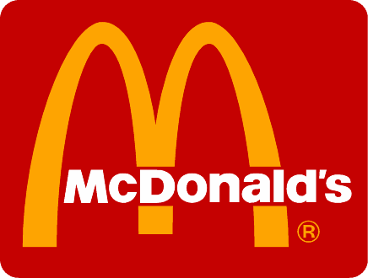
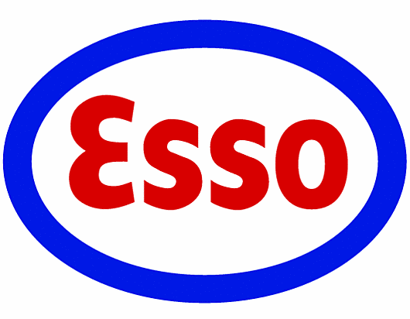
Branding
Creating an image for products and services
Brand Name
word(s) a business uses to distinguish its products from that of the competition
How the company is identified
Notes:
BRANDING
Brand Name
Businesses can spend millions
A brand name is how a product and company are identified and it is important to organizational success.
When people talk with others about brand preference this is free publicity for the company.
should be distinctive, stand out, and memorable.
Logo or Trademark
A logo or trademark helps a product compete for consumer awareness.
Monogram: a stylized rendering of a company’s initials or a combination of initials and numbers.
Examples include IBM (International Business Machines) who wanted to consumers to associate them with computers not adding machines, and KFC (Kentucky Fried Chicken) who did not want consumers seeing the work “Fried”, etc.
Visual symbol: These are line drawings of people, animals, or things such as Apple Computer’s apple and Kellogg’s Frosted Flakes’ Tony the Tiger.
Abstract symbol: These are shapes that carry a visual message but are not representative of actual things.
The Nike “swoosh” is an example and one of the world’s most well recognized logos.

Slide 7
Branding
Brand Name- Businesses can spend millions
A brand name is how a product and company are identified and it is important to organizational success.
When people talk with others about brand preference this is free publicity for the company.
should be distinctive, stand out, and memorable.

Slide 8
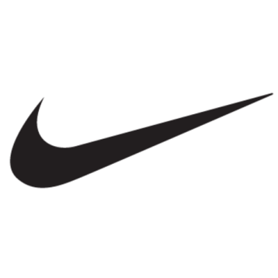
Branding
Logo
symbol that is associated with the company or product
Logo forms:
Monogram Visual symbol Abstract symbol
Stylized writing Represents Not representative something of actual things
HELPS PRODUCT COMPETE FOR CONSUMER AWARENESS
Notes:
BRANDING
Brand Name
A brand name is how a product and company are identified and it is important to organizational success.
When people talk with others about brand preference this is free publicity for the company.
Logo or Trademark
A logo or trademark helps a product compete for consumer awareness.
Monogram: a stylized rendering of a company’s initials or a combination of initials and numbers.
Examples include IBM (International Business Machines) who wanted to consumers to associate them with computers not adding machines, and KFC (Kentucky Fried Chicken) who did not want consumers seeing the work “Fried”, etc.
Visual symbol: These are line drawings of people, animals, or things such as Apple Computer’s apple and Kellogg’s Frosted Flakes’ Tony the Tiger.
Abstract symbol: These are shapes that carry a visual message but are not representative of actual things.
The Nike “swoosh” is an example and one of the world’s most well recognized logos.

Slide 9
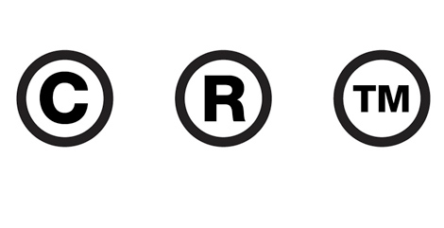
Branding
Trademark
A recognizable sign, design or expression that identifies products or services and gives the owner exclusive rights
Logo or Trademark
A logo or trademark helps a product compete for consumer awareness.
Notes:
BRANDING
Brand Name
A brand name is how a product and company are identified and it is important to organizational success.
When people talk with others about brand preference this is free publicity for the company.
Logo or Trademark
A logo or trademark helps a product compete for consumer awareness.
Monogram: a stylized rendering of a company’s initials or a combination of initials and numbers.
Examples include IBM (International Business Machines) who wanted to consumers to associate them with computers not adding machines, and KFC (Kentucky Fried Chicken) who did not want consumers seeing the work “Fried”, etc.
Visual symbol: These are line drawings of people, animals, or things such as Apple Computer’s apple and Kellogg’s Frosted Flakes’ Tony the Tiger.
Abstract symbol: These are shapes that carry a visual message but are not representative of actual things.
The Nike “swoosh” is an example and one of the world’s most well recognized logos.

Slide 10
Logo or Trademark
Monogram: a stylized rendering of a company’s initials or a combination of initials and numbers.
Examples include IBM (International Business Machines) who wanted to consumers to associate them with computers not adding machines, and KFC

Slide 11
Logo or Trademark
Visual symbol: These are line drawings of people, animals, or things such as Apple Computer’s apple and Kellogg’s Frosted Flakes’ Tony the Tiger.
Abstract symbol: These are shapes that carry a visual message but are not representative of actual things.
The Nike “swoosh” is an example and one of the world’s most well recognized logos.

Slide 12
Branding
Slogan
Short or catchy advertising phrase associated with a company or product
Brand Identification
Everything associated with a product
slogan
name
logo
Notes:
BRANDING
Slogan
Slogans are taglines for both print and broadcast advertisements.
Examples include; MasterCard’s “Priceless,” Canadian Blood Services’ “It’s in You to Give,” and Sprite’s “Obey Your Thirst”.
Brand Identification
The writing, the colours used, the design of the package should always be used in association with the product, this way it is always clear to the consumer that they are getting the product they desire.
THE PRODUCT LIFE CYCLE
Successful marketing efforts created brand awareness; customers can name you brand as part of a specific category.
Brand loyalty is when customers prefer your brand and support it.
Brand insistence is when customers will not accept a substitute for a particular brand.
Brands that have reached brand insistence have enormous equity.

Slide 13
Slogans
Slogans are taglines for both print and broadcast advertisements.
Examples include; Nike’s “Just do it!,” Canadian Blood Services’ “It’s in You to Give,” and Sprite’s “Obey Your Thirst”.

Slide 14
Slogans
Brand Identification
The writing, the colours used, the design of the package should always be used in association with the product, this way it is always clear to the consumer that they are getting the product they desire.

Slide 15
In class Activity/Assignment
Find 3 examples of each of the three types of logos
Monogram
Visual Symbol
Abstract Symbol
2. Create your own logo that represents you! Be creative! (If you are not artistic , like Mr. Singh, find a logo that represents you, and explain why that logo represents you)

Slide 16
How to hand in?
Submit your assignment in our google classroom – code: xftlsg
Only submit ONE document
Copy and paste your logo’s onto one document as well as your own logo and explanation
If you create your own logo – take a photo and paste it onto your document

Slide 17
The product Life Cycle
Impact of Marketing
2 ways to measure the impact of marketing:
1. Sales 2. Consumer reaction to the brand
Effective Marketing increases Brand Equity
Brand Equity - the value of the brand in the marketplace.

Slide 18
The product Life Cycle
Successful marketing efforts created brand awareness; customers can name you brand as part of a specific category.
Brand loyalty is when customers prefer your brand and support it.
The best marketing develops brand insistence - when customers will not accept a substitute for a particular brand.
Brands that have reached brand insistence have enormous equity. (Some people will only buy PS4 instead of XBOX)

Slide 19
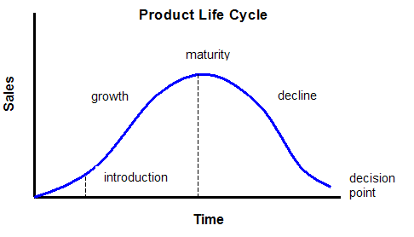
The Product Life Cycle
The Product Life Cycle
The changes in popularity or sales of a product over time
Charts the progress of the brand

Slide 20
The Product Life Cycle
1. Introduction:
Product Launch
Curious/adventurous consumers buy product first – market to them
Marketers might look for trendsetters such as celebrities, sports heroes etc.
2. Growth:
Word spreads, sales increase rapidly
Competitors enter market, battle for dominance
Marketers manage products carefully

Slide 21
The Product Life Cycle
3. Maturity:
Constant sales, Brand equity highest
Most profitable, paid off early costs
Continued advertising as reminder
Coca-Cola, Tide are examples of companies that are at Maturity
By the time product reaches maturity, the manufacturer has paid for all major costs
Products at maturity stage usually make large profits. Businesses can use profits to fund new products

Slide 22
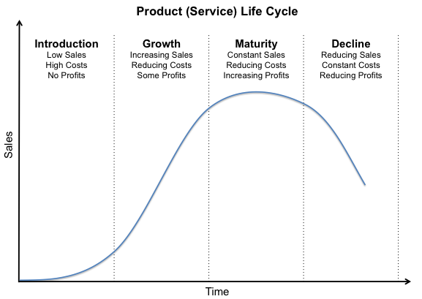
Product Life Cycle

Slide 23
The Product Life Cycle
4. Decline:
Sales decrease, inevitable
5. Decision point:
Try to reposition brand (reformulate, re-package, re-introduce)
New promotion and pricing
Or discontinue
Ex. Walkman was targeted to senior citizens

Slide 24
Non-Traditional Product Life Cycles
Fads
a product that is extremely popular with a select market for a short time
Can you think of some examples?
Trends are not fads, trends last longer and influences other areas.
Some well-known fads are hula hoops, yo-yos, Pogs, and Tamagotchis.

Slide 25
Non-Traditional Product Life Cycles
Businesses who plan well, and sell most of its stock and get out of the market just before the fad reaches its peak, can make an excellent profit.
Some companies market knock-offs of fads, often a cheaper version. If they do not sell off their inventories before the fad quickly dies off they can stand to lose money.

Slide 26
Non-Traditional Product Life Cycles
Niches
Very specific market, few competitors
A niche product tends to have a short growth stage and leads to a solid, but not financially spectacular, maturity stage.
Niche marketers usually invent their products and hold exclusive patents or formulas.

Slide 27
Non-Traditional Product Life Cycles
By the time the competition can produce a competitive product the niche marketers have cornered that market.
Barriers to entry include the small market size, the cost of R&D, advertising expenses, factory and equipment costs, design costs, lack of distribution channels, and the cost of raw materials.

Slide 28
Non-Traditional Product Life Cycles
Seasonal
Some products are popular during a specific time or season
Inventory Management important
Can you think of some examples?
Christmas and summer are seasonal time frames within which certain products are marketed.
Inventory management is the balancing of product quantity with sales.

Slide 29
Different Product Life Cycles

Slide 30
Activity & Homework
Activity!
Create a product life cycle and place products, or people (singers, actors) where they would fit
Explain why they were placed there
Complete Review Questions #1-4 pg. 238

