Slide 1
Need for Competitive Advantage
Mr. Singh

Slide 2
The idea? Good or Bad
There are a few fundamentals that exist to judge whether a new business idea is a good investment
1. Market factors – Product or service must meet a clearly defined market need, and the timing must be right
2. Competitive Advantage – Exists when a firm offers a product or service that customers perceive to be superior to those of its competitors

Slide 3
Competitive Advantage
One of the most critical success factors in business is finding and sustaining an advantage over competing businesses
You need to consider what your firm’s mission is and the strategy and positioning that will achieve that mission
Many small business owners are not familiar with the kind of systematic analysis that is required to define a real competitive advantage and therefore have difficulty in describing their strategy

Slide 4
The idea? Good or Bad
3. Economics – The venture needs to be financially rewarding, allowing for profit and growth potential
4. Managerial Capability – Must be a good fit between the entrepreneur and the opportunity*
  Must have the appropriate skills and experience to operate the venture
5. Fatal Flaws – No fatal flaw in the venture

Slide 5
Competitive Advantage Cont’d
A business owner must - after examining opportunities, risks, and resources – chart a basic strategy that leads to competitive advantage
Think about how you can incorporate this into your report
To establish a competitive advantage, you need to understand the nature of the environment in which you’ll operate

Slide 6
Competitive Advantage Cont’d
Studying general trends and the dynamics of competition in an industry may highlight opportunities for you
You can use this to block the effects of a competitive response

Slide 7
The industry environment
5 forces determine the nature and degree of competition in an industry
1. Bargaining power of buyers – Are industry customers so powerful that they will force companies to charge low prices, thereby reducing profits?

Slide 8
The Industry environment cont’d
2. Threat of substitute products or services – Can customers turn to other products/services to replace those that the industry offers?
3. Bargaining power of suppliers – Are industry suppliers so powerful that they will demand high prices for inputs, thereby increasing the company’s cost and reducing its profits?

Slide 9
The industry environment cont’d
4. Rivalry among existing competitors – How intense is the rivalry among existing competitors in the industry
5. Threat of new competitors – How easy is it for new competitors to enter the industry
The better you understand competitive pressure, the better you will be able to asses the market opportunities as well as threats

Slide 10
Macroenvironment
You want to look at the market as a whole as well.
Factors such as
  emerging technologies that can be exploited
  Changes in lifestyle that clear the way for new products or services
  Geographical shifts that open new market opportunities
Lulu Lemon is a retail outlet that recognized a trend and now dominates the market

Slide 11
Factors contributing to competitive advantage
1. Price/value – If you can find a way to make your customer more successful on their terms, why wouldn’t they buy from you?
You must supply your product/service to customers at the right time, in the right amount, and at the right value

Slide 12
Factors contributing to competitive advantage Cont’d
2. Unique service features – How unique is your service compared to others?
Is it unique enough?
Can someone replicate it?

Slide 13
Factors contributing to competitive advantage Cont’d
3. Notable product attributes – You’ve got to have a product that’s significantly different than any other product on the market
It also helps to associate an individual with the product
“It tastes awful. But it works”
This famous slogan has made Buckley’s a top selling cough syrup. But it does work! They can back that slogan!

Slide 14
Factors contributing to competitive advantage Cont’d
4. Customer service – Don’t take this lightly. People will come back to your store if your service is not just adequate but above expectations
You need to go the extra mile
Canadian Tire faced a big threat when Walmart came to Canada
They spent millions in retraining staff and now you can push a button, staff will come and help you and show you where the item is

Slide 15
Factors contributing to competitive advantage Cont’d
5. Accessibility – How convenient do you make it for the customer? Less work for customer, the better your business!
Example: Shred-it → mobile document shredding company created in 1989.

Slide 16
Strategies to gain Competitive Advantage
Strategy – An action plan that guides resource investments to capitalize on potential business opportunity
2 Main strategy options - Cost Advantage strategy and marketing advantage strategy

Slide 17
Cost Advantage Strategy
This means you are the lowest-cost producer within the market
These advantages vary from low cost labour to efficiency in operations
How long can you be the lowest cost for?
Sometimes this approach might create a price war
Normally this strategy works for big corporations
Ex. West Jet

Slide 18
Marketing Advantage Strategy
Differentiating your firms product or service along some other dimension besides cost.
Can you create and sustain an attractive differential position?
The consumer must be convinced of the uniqueness and desirability of the product or service
Can you accomplish this through operational and marketing tactitics?

Slide 19
Competitive advantage
Big Box stores have seen to be taking over the market and clientele
1990 there were 93 mega stores. By 2002 there are 614
A study confirmed that small retailers suffered lower sales and clientele when big stores took over
16 small stores or about 21% of the sample succeeded against the big stores with certain strategies

Slide 20
Competitive Advantage
They used differentiation and niche marketing
They had exceptional customer service through time savings, individual customization of service delivery, and problem solving
Ex. A building supplier offered many unique delivery services that the big stores weren’t doing

Slide 21
Competitive Advantage
No competitive advantage lasts forever therefore you need a sustainable competitive advantage
You need to plan sustainability into your strategy by leveraging unique capabilities of the firm in a way than competitors will find difficult to imitate
In order for you to maintain performance over time, it is essential that the business owner be forward-thinking

Slide 22
Competitive Advantage
You must maintain a continuous stream of competitive advantages in order to avoid dramatic shifts in performance
The reinvestment of performance results and profits is the foundation of competitive advantage
It is tempting to ride the wave of success, relax and enjoy the fruits of previous efforts
Tomorrow’s performance can be maintained only when supported by today’s surpluss resources

Slide 23
Apple Inc. – Sustainable Competitive Advantage
2 key strengths – Protected ecosystem and brand appeal
A protected ecosystem – Only apple devices run iOS.
This means if customers want to remain within Apple’s ecosystem and keep their digital purchases, they must continue buying iOS devices

Slide 24
Apple Inc. – Sustainable Competitive Advantage
Last year, 78% of iPhone owners couldn’t imagine owning a different phone
59% confessed a “blind loyalty” to apple
Also, they come out with a bang almost every year
Tablet, and then everyone came out with a tablet
iWatch – people started replicating it

Slide 25
Market segmentation and it’s variables
You might want to consider market segmentation
This is when you break your market into segments such as kids, teens, adults, elderly etc.
The computer industry first launched their marketing directed towards corporations
Now they’ve understood multiple segments such as schools, and regular customers and cater accordingly

Slide 26
Market segmentation and it’s variables Cont’d
Competition leads owners to market segmentation
If you can find an area or segment where it dominates your sales, then you can focus a marketing blitz towards that segment
This is a great tool to maximize your profits

Slide 27
Multisegmentation Strategy
Once you’ve recognized that there are individual segments with different preferences, you can tailor to various segments
If you have 2 or more market segments and you’re gong to develop a marketing strategy for each one you have a multisegmentation strategy
This strategy is normally used by big corporations and not small businesses

Slide 28
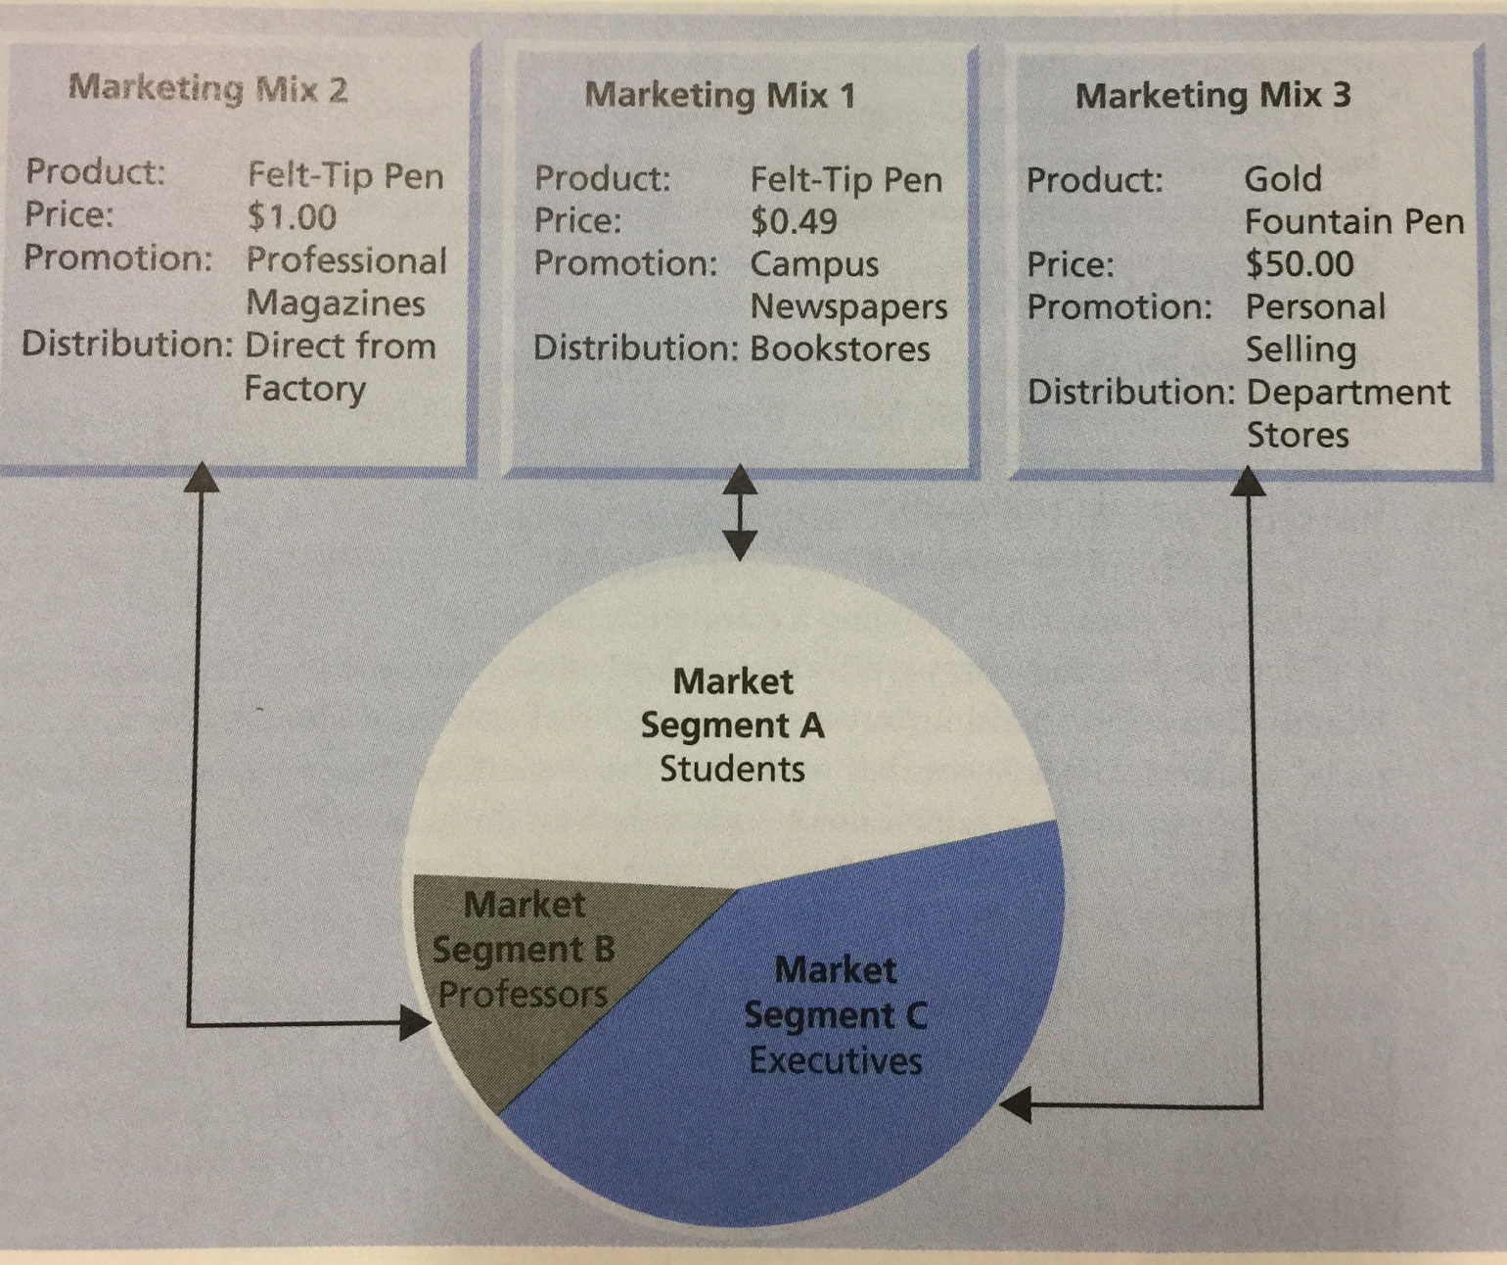
Multisegmentation Strategy – Pencil Manufacturer

Slide 29
Single-Segmentation Strategy
If you recognize that several distinct market segments exist but choose to focus on one
The one you select should offer the greatest profitability
With the pencil manufacturer, which strategy would you take?
Marketing Mix 1
Single – Segmentation strategy is probably the wisest strategy for small businesses to use during marketing efforts

Slide 30
Niche Marketing
A service or product that is in a market segment not adequately serviced by competitors
This is attractive to small firms who try and escape direct competition
Owners should consider the benefits of exploiting gaps in the market
There are many ways of implementing a niche marketing strategy

Slide 31
Niche Marketing Cont’d
You can follow these strategies for Niche Marketing
1. Restricting focus to a single market segment
2. Limiting sales to a single geographical area
3. Emphasizing a single product or service
4. Concentrating on the superiority of the product or service

Slide 32
Niche Marketing Cont’d
Owners in a niche market tread a narrow line between maintaining a protected market and attracting competition
Your business can be in trouble if
1. The focus strategy is imitated
2. The target segment becomes unattractive or demand simply disappears
3. New firms subsegment the industry

Slide 33
Success stories
SendApackage.com – one-stop-shop for sending care packages to family and friends located in New York state prisons
Under Armour – began as a niche market
It only took $17 000 to launch the company
Football player Kevin Plank needed to solve the problem of t-shirts getting drenched in sweat
He came up with a compression shirt that remained dry at all times.

Slide 34
Under Armour Cont’d
With his $17 000, he made 500 shirts
Gave some to his former teammates and they loved it
One thing led to another and the rest is history

