Slide 1
Online business & COURSE PRODUCTION
Mr. Singh

Slide 2
Filming equipment and tech
*Note: You do not need everything here
Phone* (You could do everything on your phone) – Everything else below is optional
Editing software (iMovie, windows movie marker, open shot, etc. ALL FREE)
Mic – headphones, AirPods or wireless Lavalier mic, many wireless mics for cell phones, desktop microphone
Lighting – Selfie Ring Light (many come with a cell phone holder, general lamps, etc
Green Screen – Pop up screens, a blanket, etc.

Slide 3
Content delivery methods
Content is what you teach, Delivery is how you teach it (Tip: Use Canva for professional templates)
Video*
Audio
Text or PDF
Multimedia
Presentation (PPT, Google slides, etc.)
Downloads
Discussions
Quizzes, Assignments, Exams, etc.

Slide 4
Content delivery methods
The platform you’re going to use to create your online program/course is Thinkific
Let’s take a look… go to www.thinkific.com
Let’s take a look at www.canva.com
Optional – connect Stripe and/or PayPal to your Thinkific account to start receiving payments
www.stripe.com and/or www.paypal.com

Slide 5
LANDING PAGE/SALES PAGE
This is the webpage people go to when they want to find out and buy your product
This page needs to be informative and persuasive
Include a headline in every section
Include many visuals
Sales video is always optimal
Can include FAQ, Reviews, etc.

Slide 6
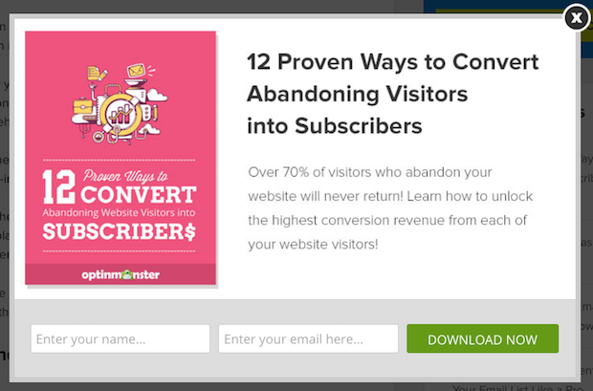
LEAD MAGNET
This is some form of valuable content or resource that you give your buyer for FREE in exchange for their e-mail

