Slide 1
Preparing for New Fiscal Years – 8.3
Mr. Singh

Slide 2
8.3 Preparing for New Fiscal Years
REAL ACCOUNTS – balances that continue into the next fiscal period
ex. Bank, trucks, accounts payable etc.
NOMINAL ACCOUNTS – have balances that do not continue into the next fiscal period
ONLY Expenses, drawing and revenue

Slide 3
8.3 Preparing for New Fiscal Years
CLOSING OUT AN ACCOUNT – means to make it have no balance. Nominal accounts are closed out at the end of the fiscal period.
INCOME SUMMARY ACCOUNT –
summarizes the revenues and expenses of the period. Represents either the net income or net loss for the fiscal period

Slide 4
8.3 Preparing for New Fiscal Years
WHY DO WE CLOSE OUT ACCOUNTS?
Closing these accounts allows us to plainly observe the previous year's effect on our revenue, expense, and drawings accounts. You can well imagine that if we did not close these accounts, their balances would build to outrageous amounts.

Slide 5
8.3 Preparing for New Fiscal Years
HOW DO WE DO THIS?
The Order in Which we Close Out Accounts
Close out the revenue account(s) to the Income Summary account
Close out the expense account(s) to the Income Summary account
Close out the Income Summary account to the Capital account
Close out the Drawing account to the Capital account

Slide 6
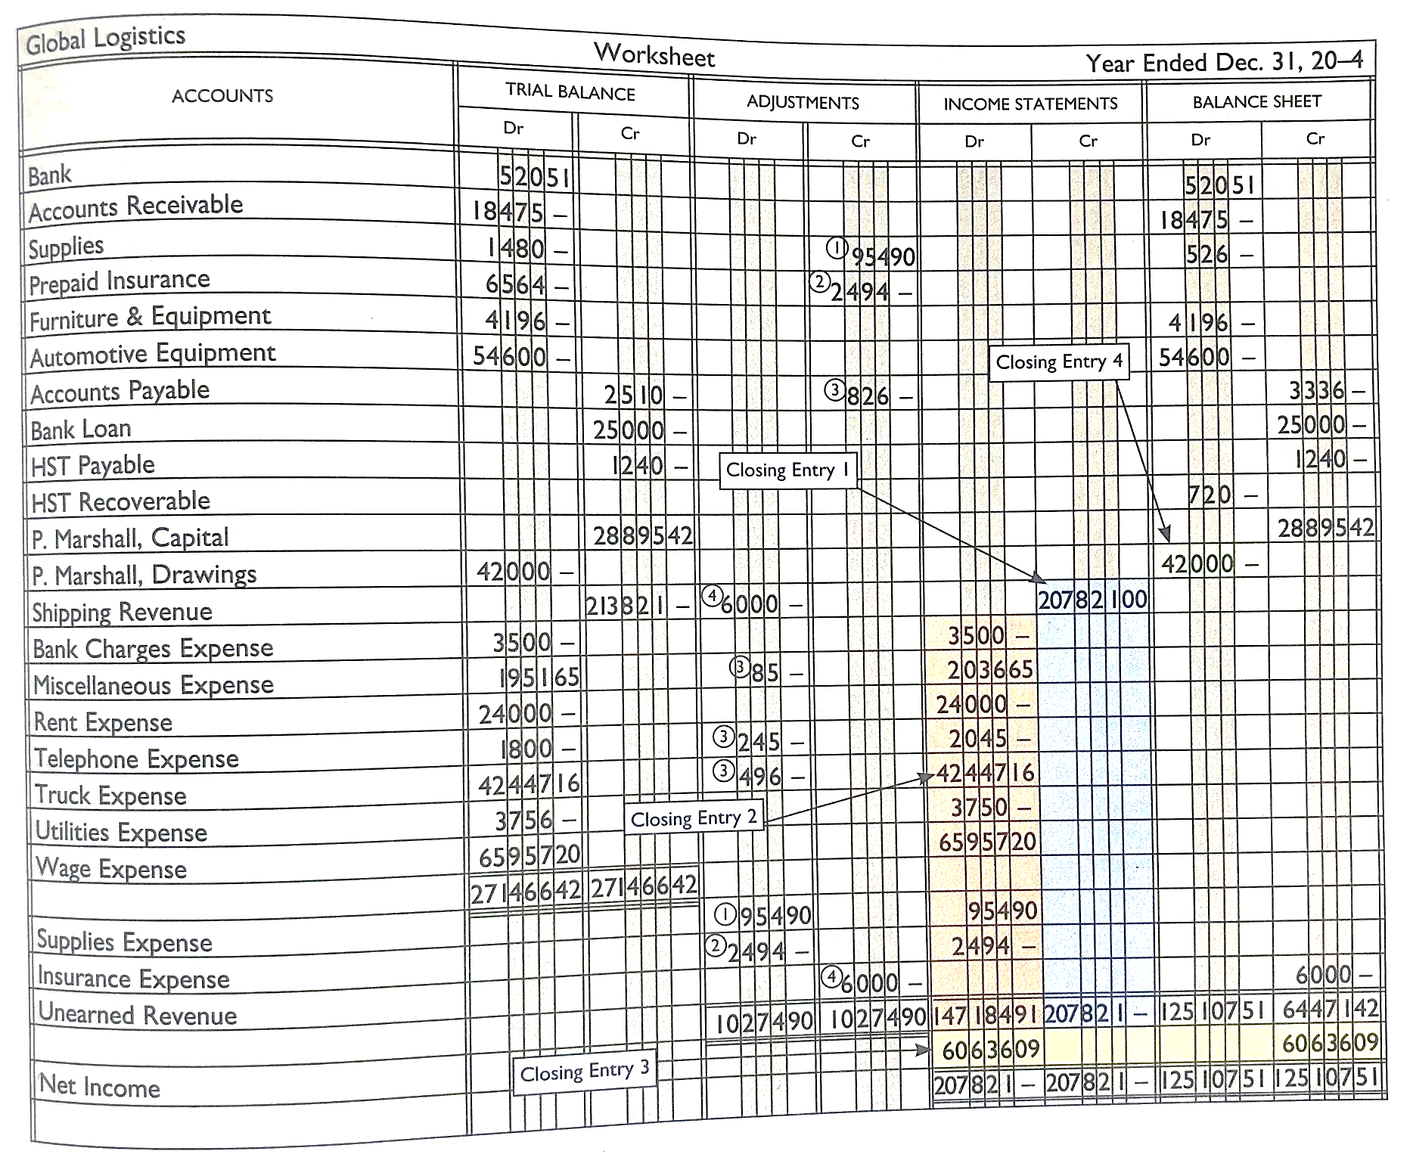

Slide 7
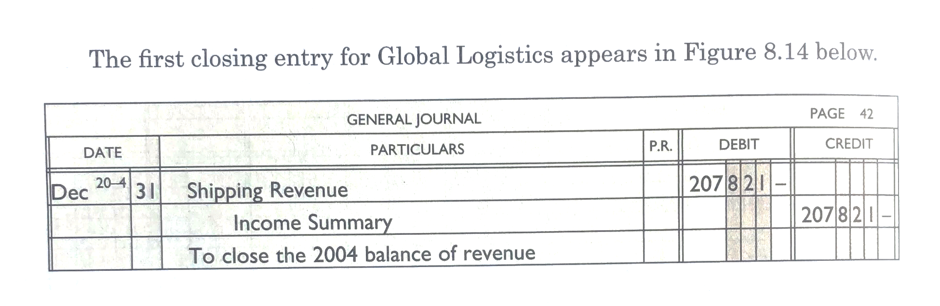
8.3 Preparing for New Fiscal Years
Closing Entry #1: Close out the revenue account(s) to the Income Summary account
Because revenue is a CR balance account, a DR entry is needed to close it off

Slide 8
8.3 Preparing for New Fiscal Years
Closing Entry #2: Close out the expense account(s) to the Income Summary account
Journal
  Dec 31 Income Summary 147184.91
  Bank Charges Exp 3500
  …(all exp listed here)
  Insurance Exp 2494
Because expenses are a DR balance account, a CR entry is needed to close them off

Slide 9
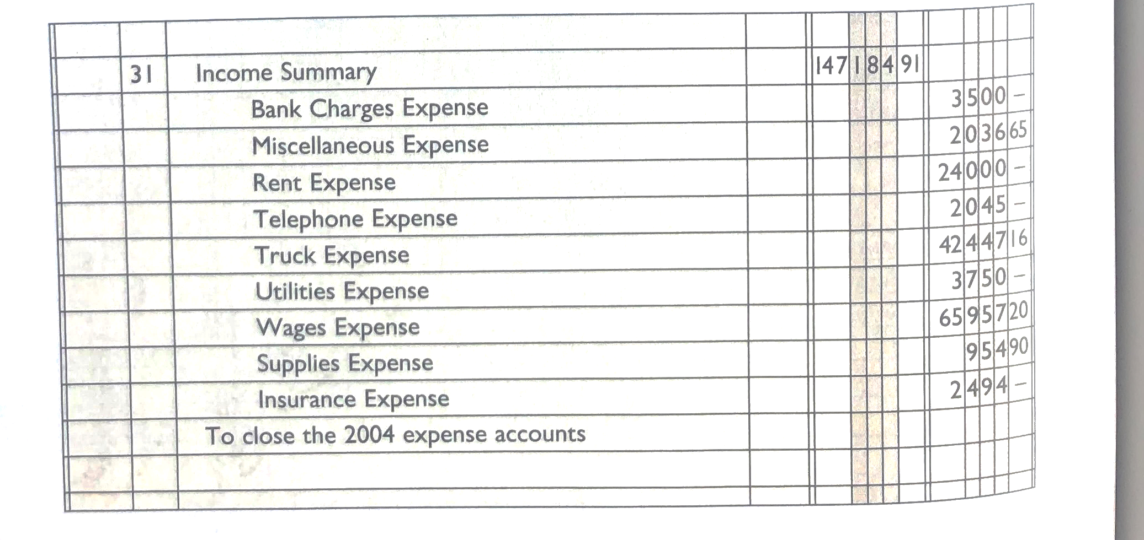

Slide 10
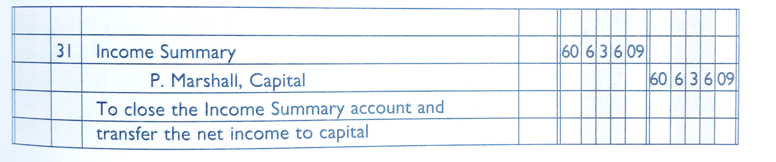
8.3 Preparing for New Fiscal Years
Closing Entry #3: Close out the Income Summary account to the Capital account
If the Income Summary account has a CR balance, then a DR entry is needed to close it. (profit → capital increases)
If the Income Summary account has a DR balance, then a CR entry is needed to close it. (loss → capital decreases)

Slide 11
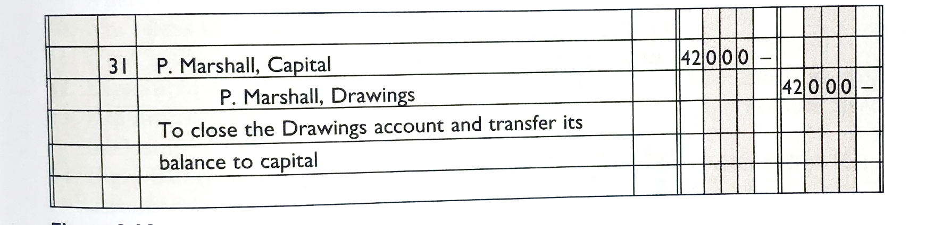
8.3 Preparing for New Fiscal Years
Closing Entry #4: Close out the Drawing account to the Capital account
Because Drawings is a DR balance account, a CR entry is needed to close it

Slide 12
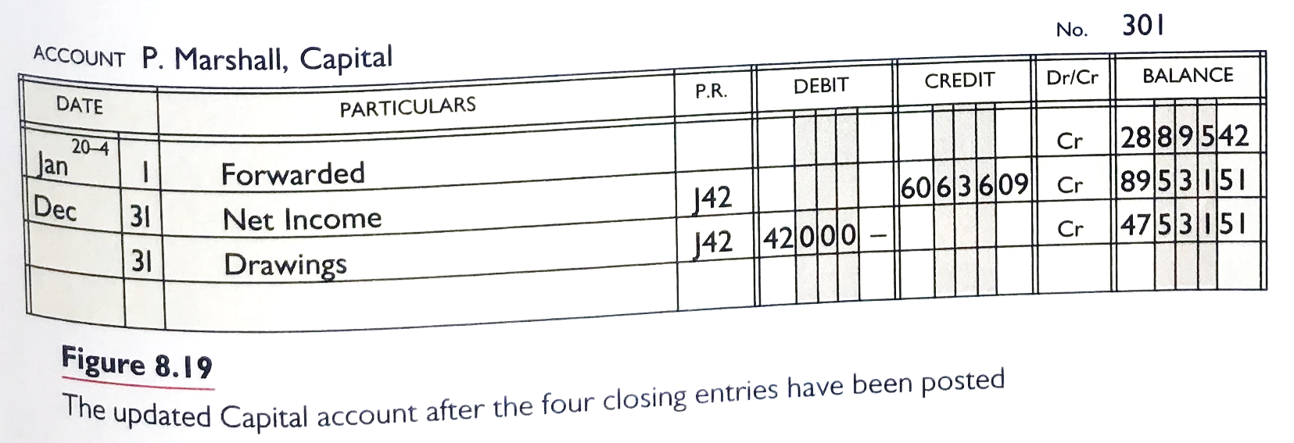
8.3 Preparing for New Fiscal Year
Updated capital account showing a balance of $47 531.51

Slide 13
8.3 Preparing for New Fiscal Years
Post-Closing Trial Balance
  Checks the accuracy of the ledger after the adjusting and closing entries have been done
  Example shown in Fig 8-10, Page 290

