Slide 1
Software
Mr. Singh

Slide 2
Software terms
Operating Software
Managing files (File management)
User Interface
Different types of OS
Device Driver
Computer Networking
History of the internet

Slide 3
Application software
Application – any program, or group of programs designed for the end user
2 different general classes – 1. Application software 2. system software
Application Software – include data base programs, word processors, web browsers and spreadsheets
System software – low level programs that interact with the computer at a basic level
Eg. Operating systems, compilers etc.

Slide 4
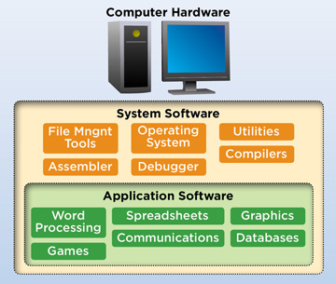
Software

Slide 5
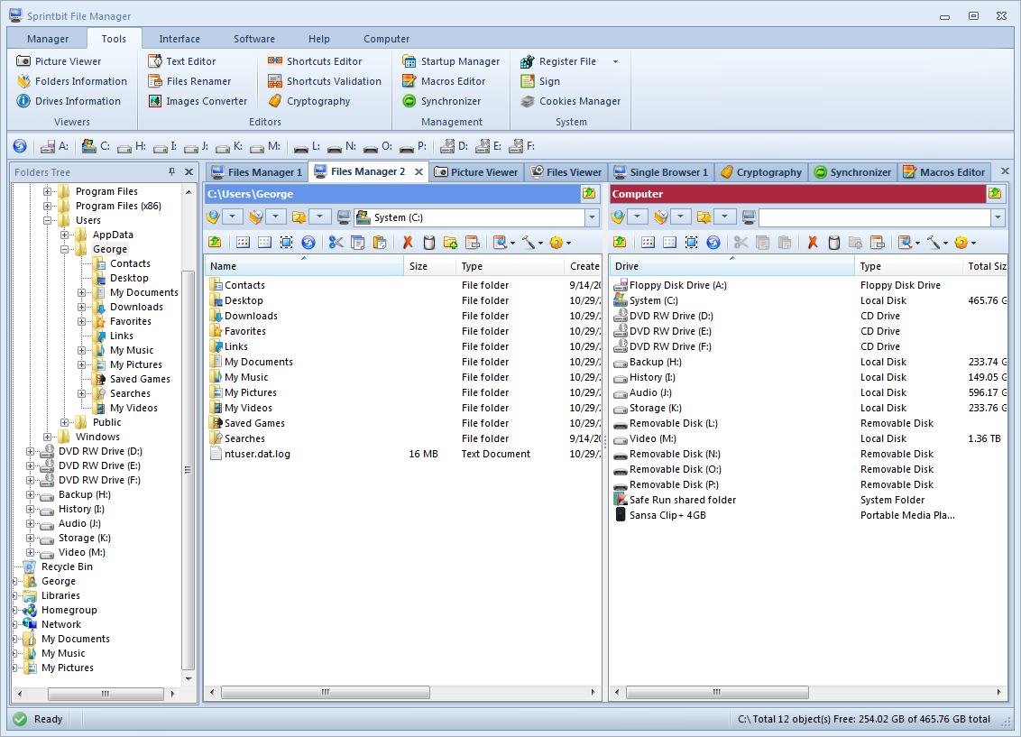
System Software
File Manager – computer program that provides a user interface to manage files and folders

Slide 6
Operating system
Almost all computers use an operating system
Including:
- Handheld computers, desktop computers, supercomputers, video game consoles
- Robotics, domestic appliances
- Dishwashers, washing machines
- Portable media players

Slide 7
What is an operating system?
Often called an O/S or OS
An interface between the hardware and the user
Shares resources and manages activities
Acts as a host for applications to run
What are different types of OS (eg. Time sharing?)

Slide 8
Different types of O/S
Real- Time Operating System (RTOS)
For control machinery, scientific/industrial equipment
Little (if any) user interface
Good at doing something specific

Slide 9
Different types of O/S
Single-User, Single-Task
More features but simple
Just one thing at a time
iPhone (not always true anymore), Palm OS,
Single-User, Multi-Task
The type most people have today
Designed for one person to do a variety of tasks, possibly at the same time
Ex: Windows, Mac OS, Linux

Slide 10
Different types of O/S
Multi-User, Multi-Task
Allows many users to make full use of the computers resources simultaneously
Must make sure to balance each user to make sure they don’t affect each other
Ex. Mainframes, large UNIX systems, VMS, etc.

Slide 11
Device Driver
All devices need a driver
A “translator”
Allows the operating system to talk to any specific device
Why don’t your USB keys work right away?
You need a driver

Slide 12
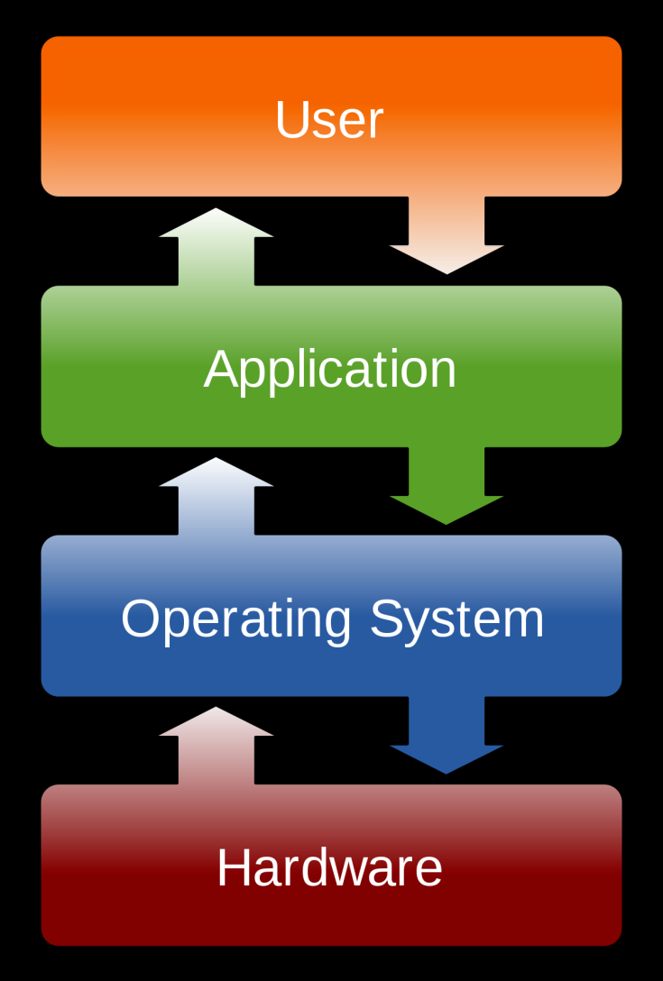
Operating System

Slide 13
User Interface
Brings structure to the interaction between the user and computer
A program or set of programs that sits as a layer above the operating system itself
Almost always a graphical user interface
Text-based interfaces are often called ‘shells’

Slide 14
Networks
What is computer networking?
The practice of linking two or more computing devices together for the purpose of sharing data
How do they connect?

Slide 15
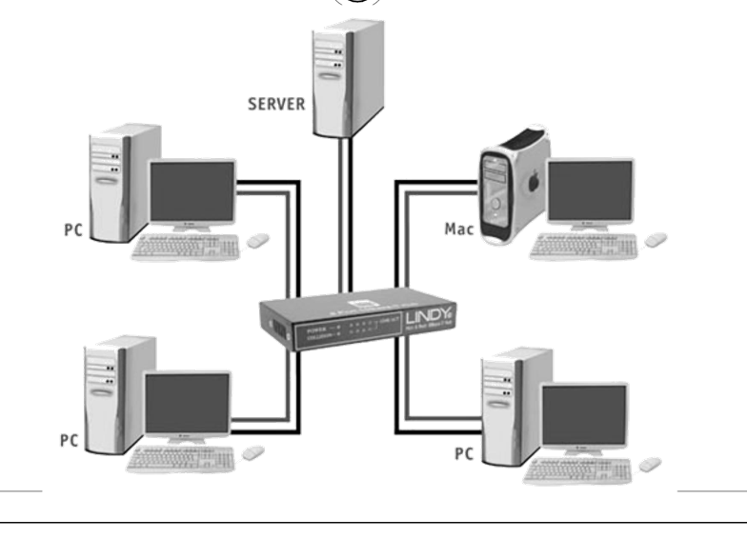
Networks

Slide 16
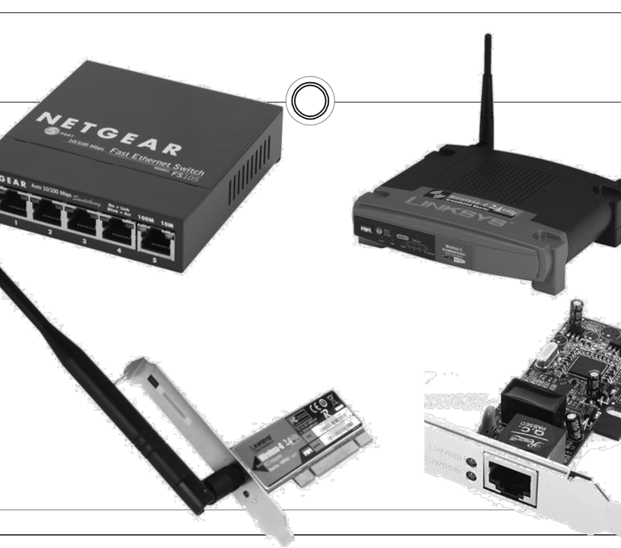
Components

Slide 17
Networks
Area networks
Local Area Network (LAN)
Typically the network at a single location (home, business, etc)
Wide Area Network (WAN)
Typically a place where LAN’s connect
The internet is the world’s largest WAN

Slide 18
How are they communicating
Computers communicate by sending individual parcels of data called ‘packets’
These packets conform certain protocols (think of having different languages)

Slide 19
Networking Cont’d
The internet protocol (IP)
Works by having numeric addresses for all machines ex. 192.168.1.10
In order to make good use of these numbers, we have servers that turn something…
www.google.ca into 208.69.36.230
These are called Domain Name Servers (DNS)

Slide 20
Links to videos
https://www.youtube.com/watch?v=ueVnSz_lXEs
Important topics from videos include:
Computer Network
LAN
WAN
Servers
Binary (How to convert numbers to binary)
IP addresses

