Slide 1
The adjustment process
Mr. Singh

Slide 2
Process
At the end of the fiscal year or year end companies need to prepare financial statements – We must ensure that all
1. Accounts are brought up to date
2. Late transactions are taken into account
3. Calculations have been made correctly
4. Accounting principles and standards have been followed

Slide 3
Accrual Accounting
When do we revenue?
Ex: If I have a tutoring service and I tutor a student for 1 hour and make $50, but he will pay me later, do I recognize revenue?
Accrual Accounting means attempting to record revenues and expenses when they happen, regardless of whether cash was received or paid

Slide 4
Accrual Accounting Cont’d
We need to consider “time” when doing accrual accounting
Example – office supplies might be used daily but the clerk will be unable to attach a dollar figure to the usage
At a certain point in time, we need to financially measure, and be aware of revenue and expenses amounts.
This is called the time period concept

Slide 5
Adjusting the Accounts
At the end of the fiscal period we adjust accounts by making adjusting entries
These are journal entries that assigns an amount of revenue or expense to the appropriate account to its true value

Slide 6
8.1 The Adjustment Process
We will look at the adjusting entries for four main areas
Supplies
Prepaid Expenses
Late Arriving Invoices
Unearned Revenue

Slide 7
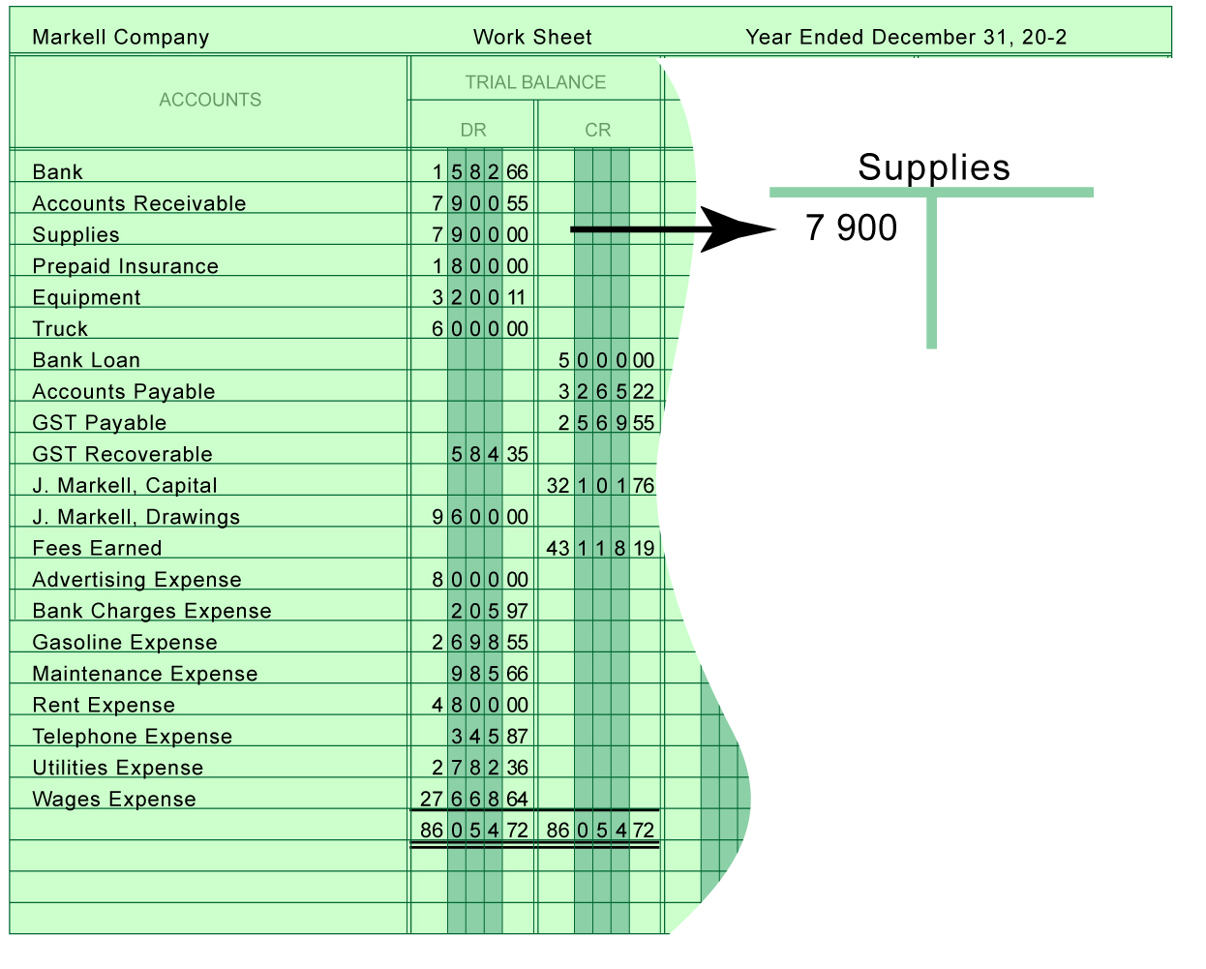
Adjustment #1: Supplies
The Supplies balance shows the total supplies purchased in the year
Adjusting Entries

Slide 8
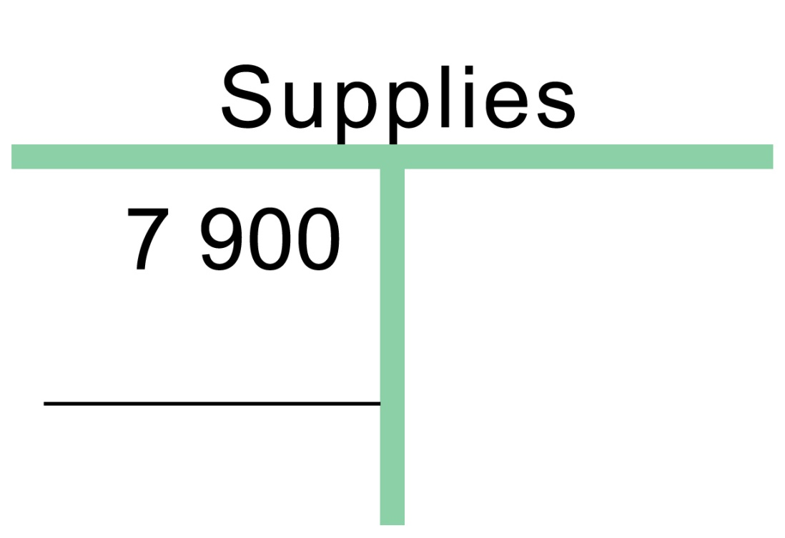
What is the Balance?
What the balance is

Slide 9
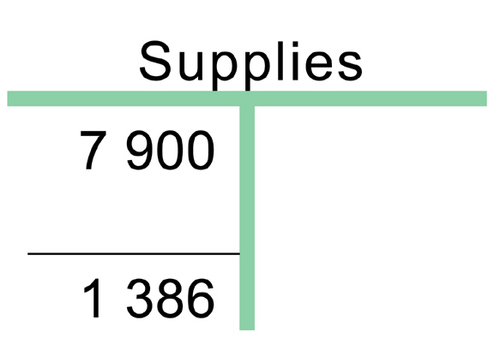
What Should The Balance Be?
What the balance should be?
What the balance “should be” is determined from someone counting the supplies that remain in the business at the end of the year

Slide 10
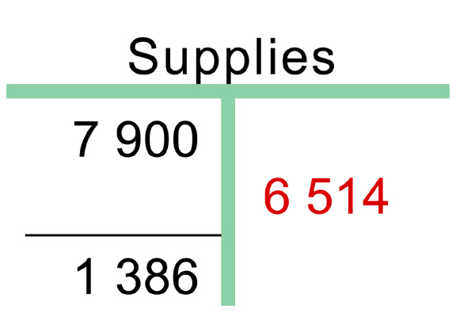
The Adjustment
The required adjustment

Slide 11
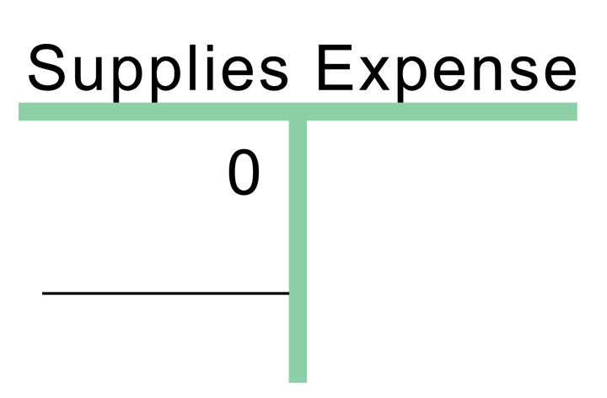
Introducing a New Account
What the balance is
The income statement account related to Supplies is shown above
The accounting clerk has not used this account during the year
Notes:
- they haven’t used it yet because no one was went and physically taken an inventory of the expenses to see what has been used

Slide 12
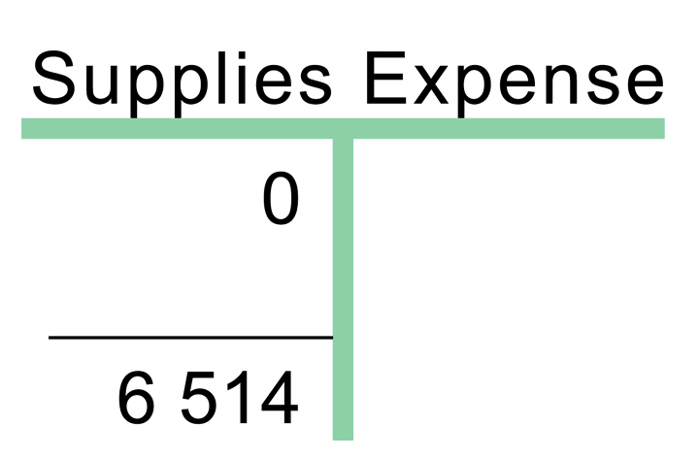
Expense: What Should the Balance Be?
What the balance should be
What the balance “should be” is equal to the amount of supplies “used up” during the year

Slide 13
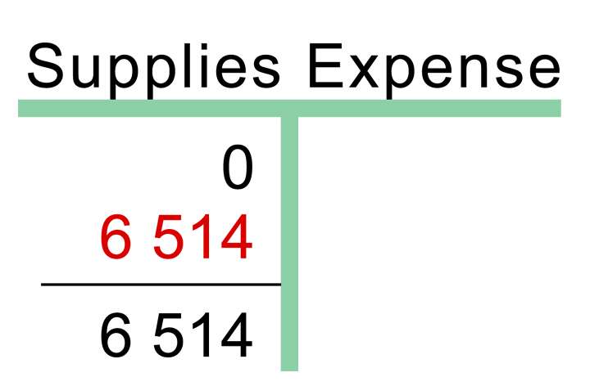
What the Adjustment Would Be
The required adjustment

Slide 14
What that Looks Like in the Journal
The adjusting entry as it would appear in the general journal

Slide 15
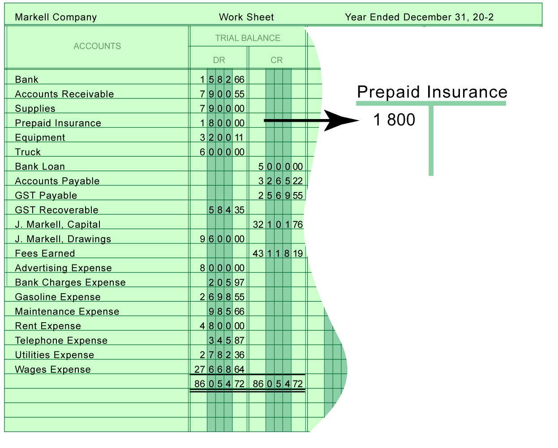
Adjustment #2: Prepaid Expenses
The Prepaid Insurance balance shows the total cost of insurance bought in the year
Adjusting Entries

Slide 16
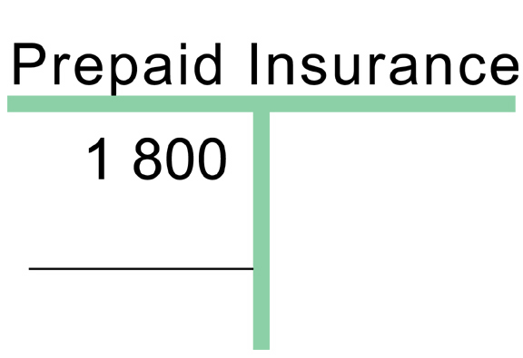
What is the Balance?
What the balance is
Prepaid Insurance – item paid for in advance, but one where the benefits extend into the future

Slide 17
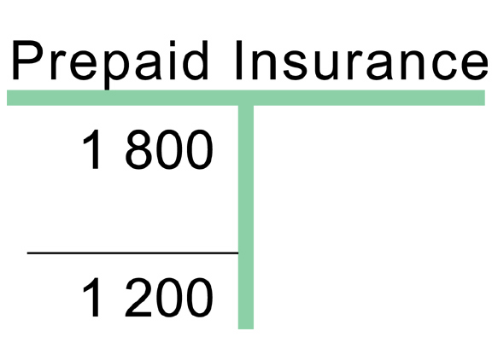
What Should the Balance Be?
What the balance should be
What the balance “should be” is determined from someone calculating the portion of the insurance policy that is “unexpired” or “not used up yet, but paid for”

Slide 18
How did you Get $1200?
An Insurance policy was purchased on September 1st for one year. The fiscal period expires Dec. 31.
As of Dec. 31, how many months of insurance have been used ?
- 4 months have been used
Each month costs:
$1800 / 12mo. = $150
4 months have been used:
$150*4 = $600

Slide 19
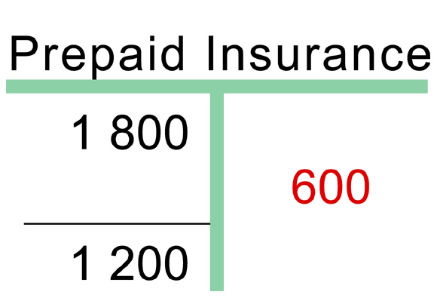
The Adjustment
The required adjustment

Slide 20
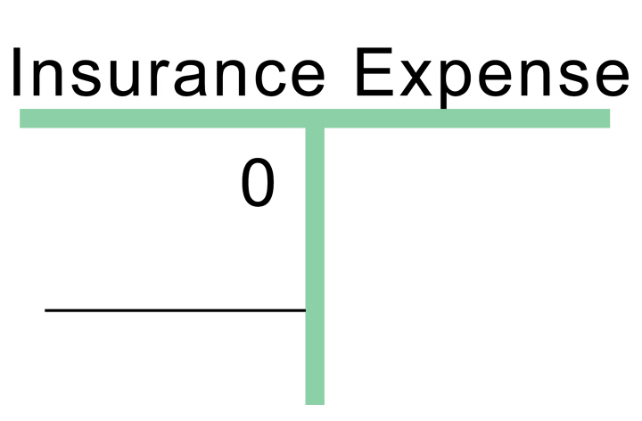
Introducing Your 2nd New Account
What the balance is
The income statement account related to Prepaid Insurance is shown above
The accounting clerk has not used this account during the year

Slide 21
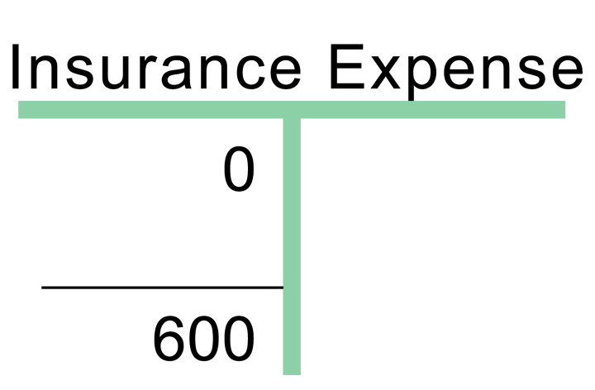
Expense: What Should the Balance Be?
What the balance should be
What the balance “should be” is the amount of the insurance policy that has expired at year’s end

Slide 22
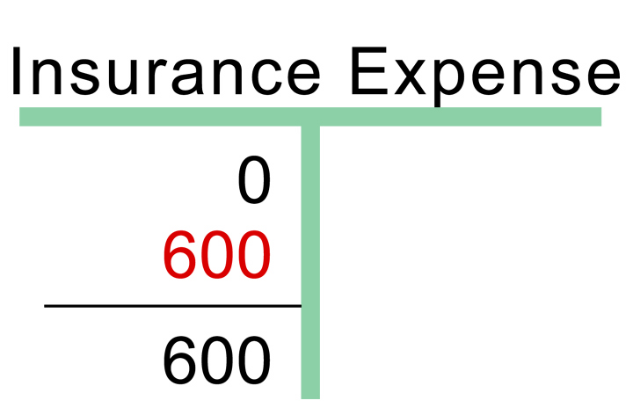
What the Adjustment Should Be?
The required adjustment

Slide 23
What it Looks Like in the Journal
The adjusting entry for insurance as it would appear in the general journal

Slide 24
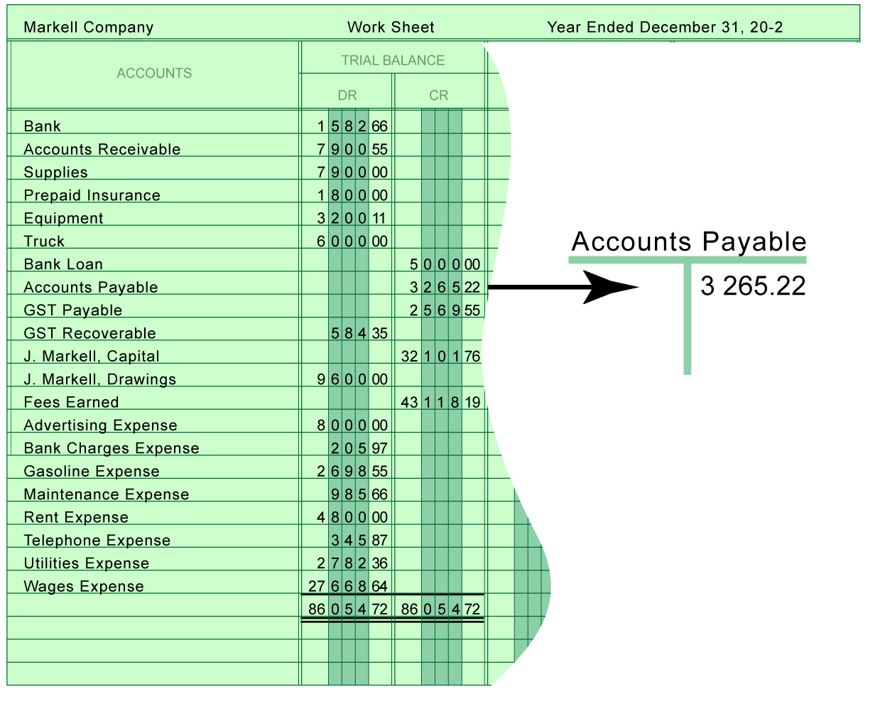
Adjustment #3: Late Arriving Invoices
The Accounts Payable balance does not include two invoices that arrived late
Adjusting Entries

Slide 25
Two late invoices have arrived
$212 for the Telephone Bill
$315 for the Utilities Bill

Slide 26
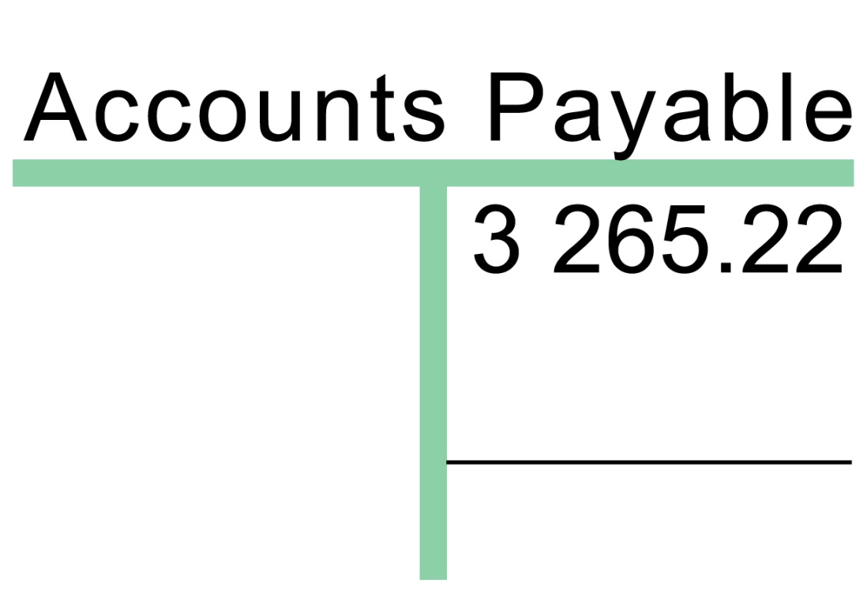
What is the Balance?
Little analysis is needed for this adjustment

Slide 27
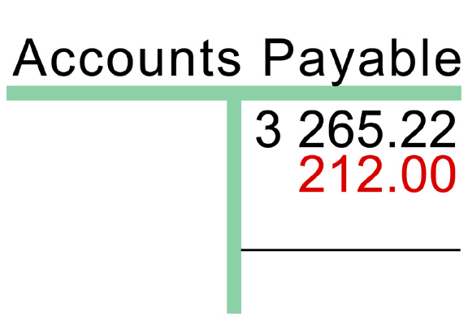
The Adjustment
Simply enter the late invoices

Slide 28
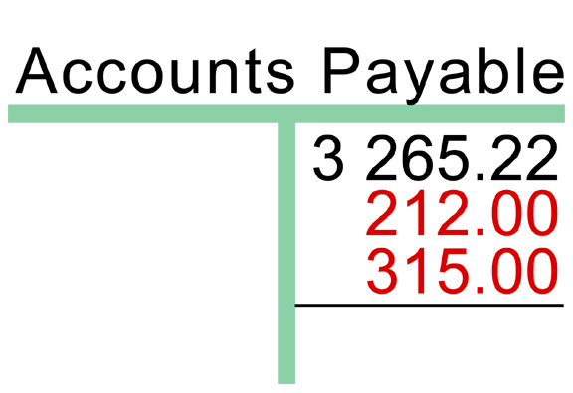
The Adjustment contd.
Simply enter the late invoices

Slide 29
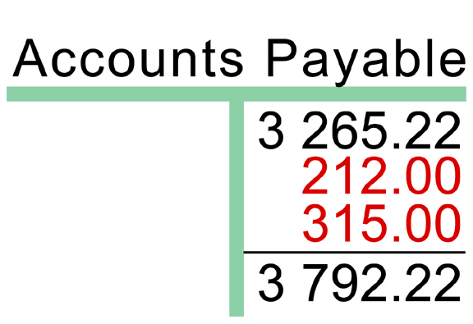
What Should the Balance Be?
And calculate the adjusted balance

Slide 30
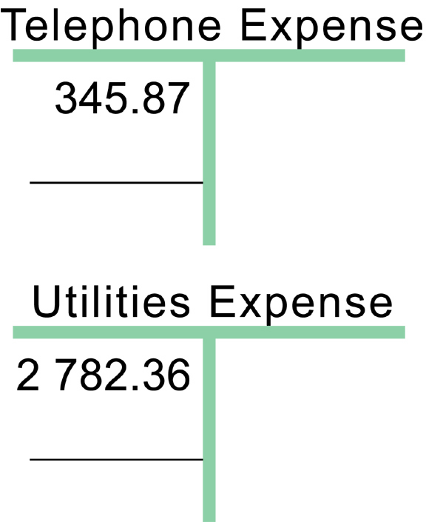
Expense: What is the Balance?

Slide 31
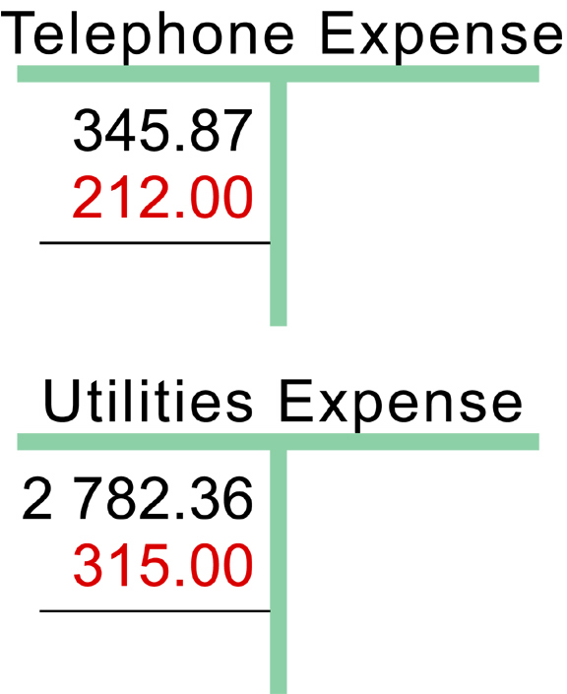
The Adjustments

Slide 32
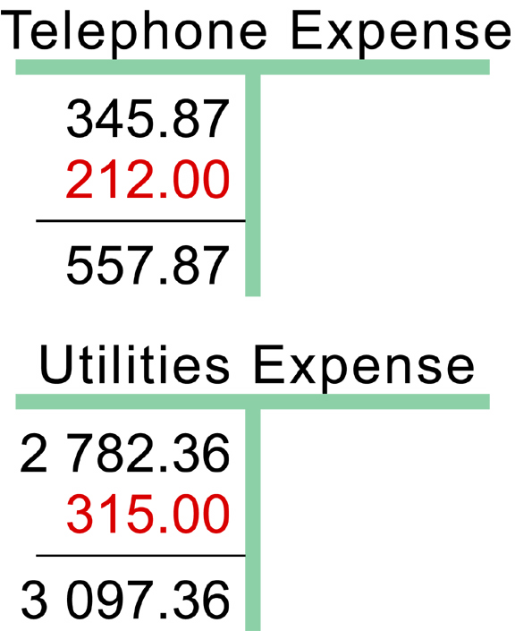
The What Should the Balance Be?

Slide 33
What that Looks Like in the Journal
The adjusting entry for late invoices as it would appear in the general journal

Slide 34
Summary 1
Adjusting Entries—Summary
Balance Sheet
The adjusting entries have brought balance sheet accounts up to date

Slide 35
Summary 2
Adjusting Entries—Summary
Balance Sheet
Income Statement
And have recorded expenses in related accounts on the income statement

Slide 36
Adjusting for Unearned Revenue
Unearned Revenue is a liability – it occurs when you are paid in advance of providing a service.
If the accounting department puts advance payments into Revenue, this is an error that needs to be corrected:
DR Revenue (to reduce it); CR Unearned Revenue (to increase it)

Slide 37
Unearned Revenue
Suppose you were going to tutor a student next month but they paid you today or put a deposit down for $5000
Do you recognize revenue?
If you recognize revenue, doesn’t it go against the revenue recognition principle?
This principle says revenue must be recognized when the service is done
So we would need to take it out of Fees earned and create a new account called???

Slide 38
Unearned Revenue
$5000 is debited to fees earned and credited to unearned revenue

