Slide 1
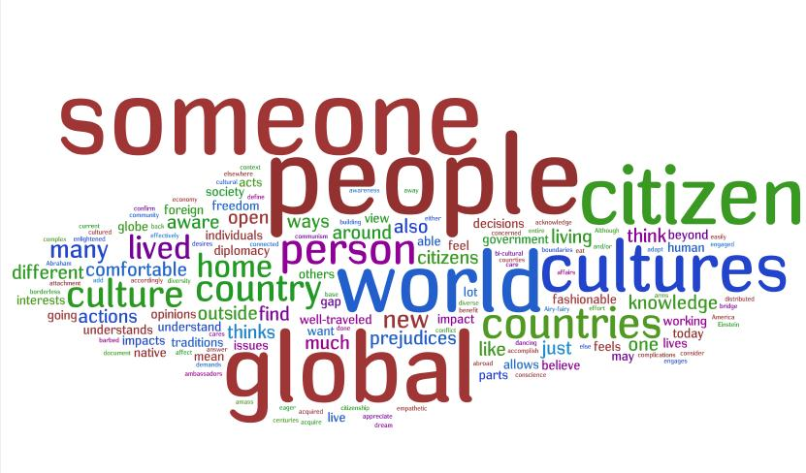
We are all connected!!! Unit #3
What is Global Citizenship? CHV20
http://www.youtube.com/watch?v=YmwwrGV_aiE&feature=fvwrel

Slide 2
We rely on the world’s population every day!
For example:
While sleeping in your bed that is made in the United States, you wake up to your alarm clock that is made by an electronic company such as Sony. Parts for your are clock are produced in Brazil, Japan, Germany and Mexico. Your alarm clock is assembled in Brazil, then shipped to Canada and staffed by a French crew. Now it is time to do your daily work out routine. You put on a pair of running shoes that are perhaps made by a company such as Nike or Fila which are companies originating in the United States. The materials for your are produced in Taiwan. The female employees (or young children) are working in a shoe factory in Japan that might disregard the United Nations Declaration of Human Rights. The tshirt that you are wearing is made from cotton which is grown in Egypt, designed in France, and manufactured in Israel.

Slide 3
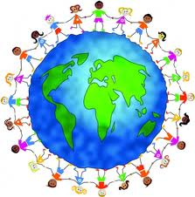
Take a minute to work with a partner and check out how closely we are intertwined
Write a list of 20 items (could be clothing, items in your knapsack, in the classroom etc)
For each item, record the country the item was made in

Slide 4
So, what is Global Citizenship?
Varied interpretations!
Involvement in global trade or investment
Ex. Multi National Corporations (MNC’s) such as McDonalds. This company uses resources from around the world, produce their products in several countries and therefore sell their product on a global level.

Slide 5
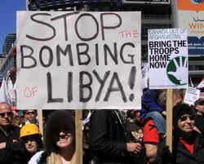
Global Citizenship Cont’d
2. Responsibility for our planet Earth. This includes the Earth’s resources and its people.
Examining threats to the environment (i.e climate change, clear cutting, pollution etc) as a threat to all citizens in the world.
Threats to all people. (i.e War, Terrorism etc)

Slide 6
OXFAM
Oxfam is an international organization who is well known for their international efforts to terminate worldwide poverty.
This organization is famous for their definition of global citizenship.

Slide 7
OXFAM sees Global Citizenship as the following:
Someone who...
is aware of the wider world and has a sense of their own role as a world citizen;
respects and values diversity;
has an understanding of how the world works economically, politically, socially, culturally, technologically and environmentally;
is outraged by social injustice;
participates in and contributes to the community at a range of levels from local to global;
is willing to act to make the world a more sustainable place;
takes responsibility for their actions.

Slide 8
We have become MORE connected!
Why?
In the past, people had very little opportunity to move from their country of birth.
In the past, citizenship was generally linked to one particular country or nation.
Multiple citizenship is possible as a result of world migration.
The occurrence of natural disasters changes our global focus.
Technology allows for us to make educated choices!

Slide 9
Globalization and Social Media
http://www.youtube.com/watch?v=Vyfv2iXylkI&feature=related

Slide 10
Do I have Universal Human Rights?
How would you be protected if you travelled outside of Canada?
Legal rights differ from country to country
Human rights: are rights based on MORALITY and apply to everyone, regardless of the country you are in.

Slide 11
How are Human Rights Upheld?
Several countries and international organizations have created documents to protect human rights.
They were created to help define human rights and carry a moral authority for government to sign and become law.
The two most significant documents written to protect human rights are The Universal Declaration of Human Rights and The Declaration of the Rights of the Child.
The two documents were created with the aid and support from the United Nations.

Slide 12
Universal Declaration of Human Rights
Announced by the UN on Dec 10, 1948.
It is not binding by law.
Contains 30 articles that define citizen’s universal rights.
http://www.youtube.com/watch?v=hTlrSYbCbHE

Slide 13
What is most important to you? Homework!!!
Go to the Universal Declaration of Human Rights official Website-
http://www.un.org/Overview/rights.html
List 7 rights you believe are THE MOST IMPORTANT
How is this document similar to our Canadian Charter of Rights and Freedoms? How does it differ?
Do you think this document is necessary?

Slide 14
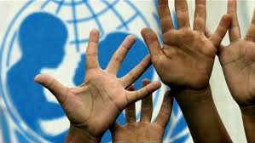
Declaration of the Rights of a Child
CHV20

Slide 15
About:
Was adopted in 1959 by the UN
Several years later in 1989 the UN passed a document of legal rights
54 articles
“The Convention on the Rights of the Child”
This step added legal weight to the concept
1st legally binding international document to incorporate all human rights, civil, political, economic, social and cultural for children
http://www.youtube.com/watch?v=A-icxE5qrNg

Slide 16
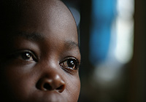
UNICEF
http://www.youtube.com/watch?v=iQ27pBH4hqc&feature=relmfu
What is UNICEF’s mission?

Slide 17
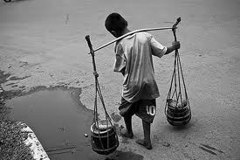
Child Slaves
http://www.youtube.com/watch?v=xVo2TabkW8I

Slide 18
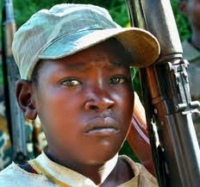
Child Soldiers
http://www.youtube.com/watch?v=_6IMjnwztTo

Slide 19
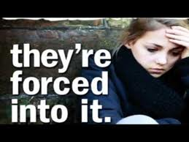
Human trafficking
http://www.youtube.com/watch?v=fFRZ1NDR0Rc

