Slide 1
Unit 1: The Nature of Economics and the Economy
Chapter 1: Basic Principles of Economics
Chapter 2: Productive Resources and Economic Systems
Chapter 3: The Evolution of Economic Thought

Slide 2
Chapter 3: The Evolution of Economic Thought
Overview

Slide 3
Changing the World
In this chapter, we will trace the evolution of economic thought
Ideas that change the world usually emerge during times of serious trouble
People are most willing to listen to radically different ideas
We will focus on seven visionaries whose ideas greatly advanced economic thought For each visionaries, we will go over:
A brief biography
An account of the historical context in which the ideas developed
An explanation of some of the economist’s major ideas and their political and economic impacts

Slide 4
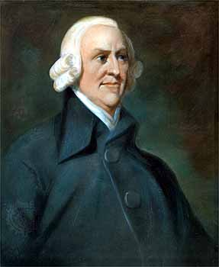
Adam Smith (1723-1790): The Pioneer
Known as the “father of modern economics” and the “founder of capitalism”
He outlined the characteristics and benefits of a complete economic system in his book “The Inquiry into the Name and Causes of the Wealth of Nations”
Recognized as the foundation of modern economic theory

Slide 5
Biography
Born into a middle-class family in a fishing village near Edinburgh, Scotland
He worked at the University of Glasgow, first as a professor, then as dean
He eventually moved to France to become a private tutor to an aristocrat
He became acquainted with a new school of thought whose leaders were known as physiocrats

Slide 6
Biography
Physiocrats believed that if unchangeable laws govern the physical world, then they also govern human behaviour, and therefore the social, economic, and political worlds
Since people naturally tend to serve their own interests and acquire wealth, the pursuit of self-interest would ultimately benefit all individuals if they were left alone to create more wealth
This doctrine of non-interference became known by the French term laissez-faire, which means literally “leave to do”, or leave things alone so that matters can work out naturally
While travelling, Smith began work on his novel “The Wealth of Nations” which took him 12 years to complete.

Slide 7
The Times
Mercantilism was the prevailing economic system
Emphasizes state control of trade, with the goal of exporting as many goods as possible and importing as few foreign goods as possible
Gold and silver from abroad is flowing into the country and increasing the “real wealth” of the nation.
To limit the import of foreign goods, the government adopted a protectionist policy that involved tariffs, or strict taxes, on imported goods to make them more expensive than the goods produced in the country
If more and more nations adopt this strategy, trade decreases and the prices of domestic goods increase. This did not sit well with the general public

Slide 8
The Times
Laissez-faire philosophy argued for the replacement of state control with a reliance on natural laws to regulate the economy
This idea contributed to the political ferment in France that led to the French Revolution
The growing mood of rebellion in the American colonies was a direct reaction to the British government’s taxes and regulations
This led to the American Revolution and the Declaration of Independence in 1776
Many of Smith’s ideas developed in response to the rapid economic changes in Great Britain, which came to be know as the Industrial Revolution
This period of technological innovation changed the economy from agricultural and rural to industrial and urban

Slide 9
Ideas that Advanced Economic Thought
Self-interest
Human beings are motivated primarily by self-interest, or the desire to better one’s condition in life
Economic growth is stimulated by the motive of profit
Must ensure that the desire for greater profits doesn’t overwhelm a producer’s sense of obligation to the rest of society
There is competition between producers, none of whom can raise their prices too high without losing customers
Government regulation is not necessary to control the economy because the forces of market competition will serve as an invisible hand, or a natural control

Slide 10
Ideas that Advanced Economic Thought
Ongoing progress and prosperity
Three reasons for Britain’s economic growth and increasing productivity throughout the 18th century:
Division of labour
Specialization of workers in production processes, which lead to increased level of production
Resulted in greater profits for investors, more consumer goods for workers, and greater economic efficiency for society

Slide 11
Ideas that Advanced Economic Thought
Law of accumulation
Industrialists invested accumulated profits in additional capital goods, which permitted increases in total production and efficiency for the economy
These increases led to greater profits for investing industrialists
The increased profits could then be reinvested in additional capital goods, stimulating for further rounds of economic growth

Slide 12
Ideas that Advanced Economic Thought
Law of population
The accumulation of capital increases the demand for labour to operate the additional machinery that the industrialist purchase
In order to attract workers, competing industrialists offer higher wages
Wage increases lead to improved living conditions for the workers, which reduces mortality rates
This leads to a natural increase in the population, and therefore in the labour force
Increases in labour force mean workers must compete with each other for jobs, when keeps wages from increasing
Thus, the industrialists continue to make healthy profits, which allows them to buy more machinery, which starts the cycle over again

Slide 13
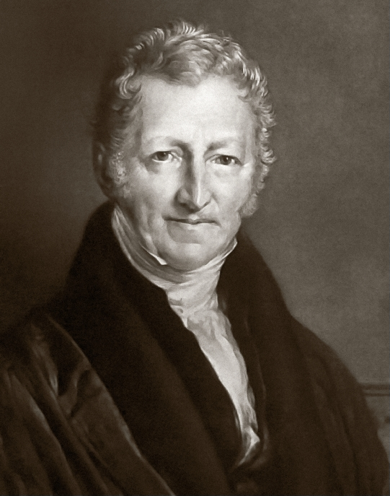
Thomas Robert Malthus (1766-1834): The Pessimist
Recognized as the first professional economist
Challenged Adam Smith’s views of a economy governed by natural laws leading to ever-increasing prosperity
Malthus predicted inevitable poverty and famine for the masses
Published his pessimistic views in a book called “An Essay on the Principle of Population As Its Affects the Future Improvement of Society” in 1798

Slide 14
Biography
Born into an English upper-middle-class family in 1766
Attended Cambridge University, where he earned a Masters of Arts degree
Went on to take holy orders in the Anglican Church and pursued the quiet life of a country curate
In 1805 he became professor of history and political economy at the East India Company’s college
This was the first time “political economy” was used to designate an academic office, so he can be identified as the first professional economist

Slide 15
The Times
Lived during the Industrial Revolution, when workers moved from their rural farms into urban centers to try to get jobs in factories
Workers lived in congested and unsanitary quarters, struggling to survive on minimal wages
A prolonged, expensive, and bloody war against Napoleon Bonaparte’s France also added to their misery
Poor crop yields and a simultaneous population boom further aggravated the situation
It began to look as if Britain’s once-rich farmlands could no longer feed the country’s people.

Slide 16
Ideas that Advanced Economic Thought
Population and food production
Based his ideas on population and food production on two premises:
Food is necessary to sustain human life
Human sexual instinct is constant
He predicted that the population would double every 25 years (about one generation)
This doubling effect is what statisticians call geometrical progression

Slide 17
Ideas that Advanced Economic Thought
Food production can only grow in an arithmetical progression
Each generation’s food production increases by an amount equal to the original quantity
As more land is required for food production, less-fertile land will be used, which will yield fewer crops
As more workers cultivate the land more intensely, the productivity of the added workers also declines

Slide 18
Ideas that Advanced Economic Thought
Malthus’ shared Adam Smith’s views that as wages increase, the population would increase
But he believed that the population growth would quickly outrun the means of subsistence
Therefore, wages and the standard of living should hover around the subsistence level to keep the population in check
Malthus acknowledged two types of population control, but he didn’t think they were strong enough to check the geometric progression of the world’s population
Positive checks increase the death rate and include war, famine, disease, and epidemics
Preventive checks reduce the birth rate and include moral restraints such as late marriage and sexual abstinence

Slide 19
Ideas that Advanced Economic Thought
In the end, Malthus failed to predict two major developments that had major impacts on his theories of population
In the 20th century, a series of technological breakthroughs in agriculture, known as the Green Age, increased food production rates beyond anything Malthus could have predicted
Continued urbanization had a negative effect on birth rates

Slide 20
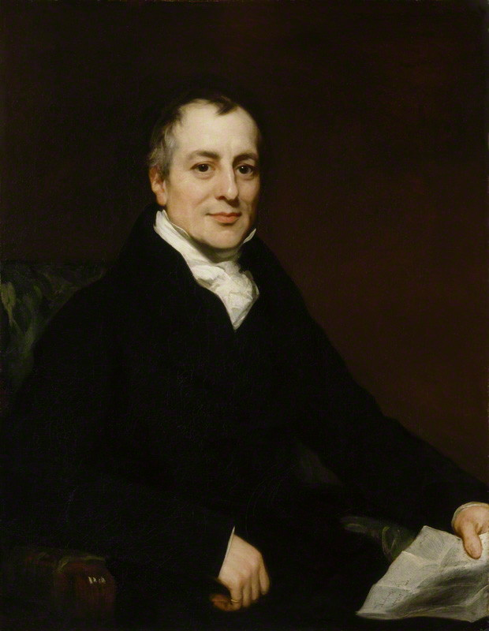
David Ricardo (1772-1823): The Industrial Politician
Adam Smith’s vision of a world governed by natural laws was most effectively refuted by David Ricardo, the son of a Dutch banker who had immigrated to Britain and made a fortune on the London stock exchange

Slide 21
Biography
David Ricardo was born into a prosperous London family in 1772
At 14 he went to work in his father’s investment business
By 22 he had established his own business with a capital base of £800
At 42 he retired with over £1 million.
His most famous book “The Principles of Political Economy and Taxation” challenged the power of the aristocratic landlord class by questioning their contributions to society
Hailed by the rising industrialist class and became an influential document of political reform
Elected into the House of Commons in 1819
Argued on the behalf of free trade
Continued to challenge the landlord classes by outlining the land rent laws that allowed them to exploit land, labour, and capital

Slide 22
The Times
A period of great social conflict and political unrest in Britain
The rapid growth of the British population, the Napoleonic Wars, and years of poor crops were straining food supplies
Ricardo identified three conflicting groups:
Working class, who lived on modest wages
Industrialist class, who made healthy profits by operating factories they owned
Aristocratic landlord class, who received substantial rent from the land titles they held

Slide 23
The Times
One group could prosper only at the expense of the others
Ricardo identified that group as the aristocratic landlords
The working class struggled to live at subsistence levels
The industrialists enjoyed rising profits but lacked sufficient representation in Parliament
The powerful and entrenched landed aristocracy always prevailed

Slide 24
The Time
To illustrate his case, Ricardo referred to the Corn Laws, legislation that was pushed through by the landlord-dominated Parliament
Instituted stiff taxes on grains imported from other countries
Grain in England was in short supply, which caused the price of grain to skyrocket
This forced the industrialists to pay the workers higher wages (in order to ensure their survival) and cut into their profits
High grain prices, however, guaranteed the payment of high rent to landlords
The industrialists were able to repeal the Corn Laws in the 1840s, breaking the power of the aristocrats, and slowly began replacing them as the dominant class in British society

Slide 25
Ideas that Advanced Economic Thought
The iron law of wages
Ricardo believed that wages would always remain at the subsistence level due to the working class’s unchecked rate of reproduction
Higher wages would increase the population by decreasing infant mortality rates, but would not raise the standard of living because higher wages would have to be distributed among larger families
Greedy industrialists used this economic principle to justify paying their workers the lowest possible wages, claiming they were performing a public service
This was never Ricardo’s intent, who believed that wages should be determined by free-market conditions

Slide 26
Ideas that Advanced Economic Thought
The theory of the comparative advantage of trade
Communities vary in the resources they are more efficient at producing (ex: some grain, others wool)
Therefore, trade will be of absolute advantage to both communities
Ricardo was the first to explain that even when a community can produce both grain and wool efficiently, there is still a comparative advantage to be shared when both communities trade the products they can each produce most efficiently

Slide 27
Ideas that Advanced Economic Thought
Ricardo advocated for free trade at a time when Britain was imposing high tariffs on imported goods to discourage trade
These taxes protected the earnings of the landlords, but hurt the industrialists and working class
Ricardo argued that the interests of the landlords ran counter to the interests of the rest of the economy and he quickly became the parliamentary champion for the underrepresented industrial capitalists.

Slide 28
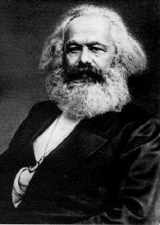
Karl Marx (1818-1883): The Communist
Argued that economic laws that perpetuate the conflicts between social classes govern all human history
Founded an international workers’ movement intended to overthrow the corrupt ruling class (the bourgeoisie)
In 1848, Marx and Friedrich Engels published the “Communist Manifesto” in which they incited all exploited workers (the proletariat) to rise up against their oppressors
So was born the international revolutionary socialist movement of communism

Slide 29
Biography
Born in the German Rhineland in 1818
Studied philosophy at Bonn University and later became the editor of a small middle-class liberal newspaper
He got in trouble with the government by writing an editorial denouncing a new law
He became more and more outspoken as, one by one, the papers he edited were suppressed by the state
Marx and his family eventually had to flee Germany
Their troubles with the state followed them until they moved to London in 1849
His most comprehensive work, “Capital” was published in 3 volumes in 1867, 1885, and 1894
In this cold and complex critique of economics, he explained why capitalism would ultimately destroy itself.

Slide 30
The Times
Marx viewed firsthand the ill effects of the Industrial Revolution on the working class in the late 19th century
By the time of his death, England had transformed from an agricultural and artisan-based economy to one in which the dominant mode of production was the steam-powered factory
Workers lived in slums of crowded cities and worked 18-hour days in unsafe and unclean factories
There were no child labour laws, so working-class children endured the same hardships and had no time for education
Marx believed capitalism, as an economic system, was so morally bankrupt that it would one day destroy itself.

Slide 31
Ideas that Advanced Economic Thought
The economic interpretation of history
Marx thought that the laws of economics determined the course of human history and that history was a continuing series of class struggles between exploiters and the exploited
Ex: free citizens against slaves, lords against serfs, industrial capitalists against workers, etc.
Whenever conditions become unbearable, the oppressed rise up in rebellion against their oppressors
Capitalist exploitation would continually worsen living standards until workers would eventually unite to overthrow the corrupt ruling class

Slide 32
Ideas that Advanced Economic Thought
The Communist revolution (revolutionary socialism)
This revolution would begin in the most industrialized countries in Western Europe (where capitalism was strongest and exploited workers most severely) and would spread throughout the world
The overthrow of capitalism would lead to international socialism based on the common ownership of land and capital
It would then evolve into its ideal state of communism: a worker-governed society based on the guiding principle “from each according to ability, and to each according to need”

Slide 33
Ideas that Advanced Economic Thought
The labour theory of value
The value of any item is the value of all labour used in its production (labour value)
Includes both labour (supplied by workers) and indirect labour (supplied by machinery and buildings involved in manufacturing)
In a capitalist system, workers receive only a portion of what their labour is worth
The difference (surplus value) is stolen from the worker in the form of profit for the capitalist
Worker employment is based on the premise that the worker will always produce more for the employer than the employer will have to pay in wages
Workers are forced to sell their labour to capitalists for less than it is worth because there is a “reserve army of the unemployed”
Capitalists always have the option of hiring unemployed workers at lower wages, which ensures wages will never rise above the subsistence level

Slide 34
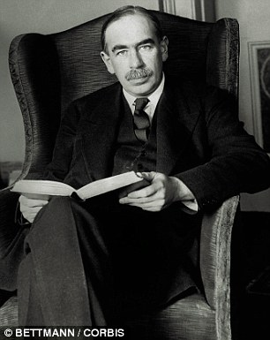
John Maynard Keynes (1883-1946): The Advisor
His book “The General Theory of Employment, Interest, and Money” explained how government intervention could save a country from widespread unemployment and economic stagnation
He helped rescue the capitalist system from self-destruction and international communism
“Keynesian economics” analyzes relationships between demand, production, and unemployment, and focuses on government’s role in sustaining economic activity

Slide 35
Biography
Keynes was the definition of an overachiever. Here is a list of his achievements:
Taught economics at Cambridge University
Served as economic advisor to the British treasury during both World Wars
Attended post-war international peace conferences as a representative of the British government
Appointed as director of the Bank of England
Editor of a major economics journal
Chair of an insurance company
Manager of an extremely successful investment trust
Early supporter of women’s right to vote
Chief British representative at the Bretton Woods Conference in 1944, which established the International Monetary Fund and the World Bank
Performed a brilliant negotiation in 1945 of a multi-billion-dollar post-war reconstruction loan from the US to great Britain

Slide 36
The Times
Keynes’s career spanned the two World Wars and the Great Depression
At the beginning of the Depression, capitalists believed the skyrocketing unemployment rates were only temporary and that economic conditions would improve
Instead of attempting to initiate economic improvements, they simply told unemployed workers to make due with less and ride out this period
The government’s lack of initiative, combined with their attempts to cut spending and pay back war debts largely contributed to a decline in the amount of money in circulation

Slide 37
Ideas that Advanced Economic Thought
War and sustainable peace
Keynes predicted that the Treaty of Versailles would ruin the Germany economy by forcing the country to pay the Allies more than they could afford
While serving as an economic advisor to the British government during the Second World War, Keynes recommended using “deferred savings” as the principal means of financing the war effort
A portion of every worker’s pay would be automatically invested in the government war bonds that could not be cashed until after the war
Keynes hypothesized that consumer spending during the war would interfere with the war effort, so the bonds would prevent this from happening
After the war, consumer buying power would help to stimulate investment, permit increased production of consumer goods, and maintain employment levels

Slide 38
Ideas that Advanced Economic Thought
Keynes heavily influenced the 1945 peace treaty and post-war reconstruction plans
He argued that defeated countries should be helped rather than punished
As former enemies became business associates, economic cooperation replaced military intervention in Western Europe
With developments such as the European Union, history appears to have proven Keynes right.

Slide 39
Ideas that Advanced Economic Thought
Combating the Great Depression
In his book Keynes presented an unconventional idea:
Governments bore a large part of the responsibility for the high unemployment rates of the Great Depression
He believed these rates could be lowered by government intervention, especially by sponsoring public works projects that would give jobs to idle workers
By controlling interest rates and increasing public spending, a government could stimulate consumer spending, raise the demand for consumer goods, and bring more people back into the workforce
As newly employed workers spent their wages, the money would be re-spent by those receiving it
Increased employment would trigger additional rounds of consumption, investment, and employment increases, as the economy continued to put idle resources to work
The resulting economic growth would fix the problem of high unemployment rates.

Slide 40
Ideas that Advanced Economic Thought
Since consumers are limited in their spending by the size of their incomes, they are not the source of depressions or any other cyclical business shifts
Business investors and governments are the primary forces behind business cycles
The Great Depression was ultimately a problem of too little investment
If investors were given a reason to invest and favorable interest rates, the economy would recover, but government intervention was required
Critics of Keynesian economics point to his “General Theory” as the leading cause of high inflation rates and massive public debts that Western nations accumulated over the second half of the 20th century
But the national unemployment rates have never returned to the levels witnessed during the 1930s

Slide 41
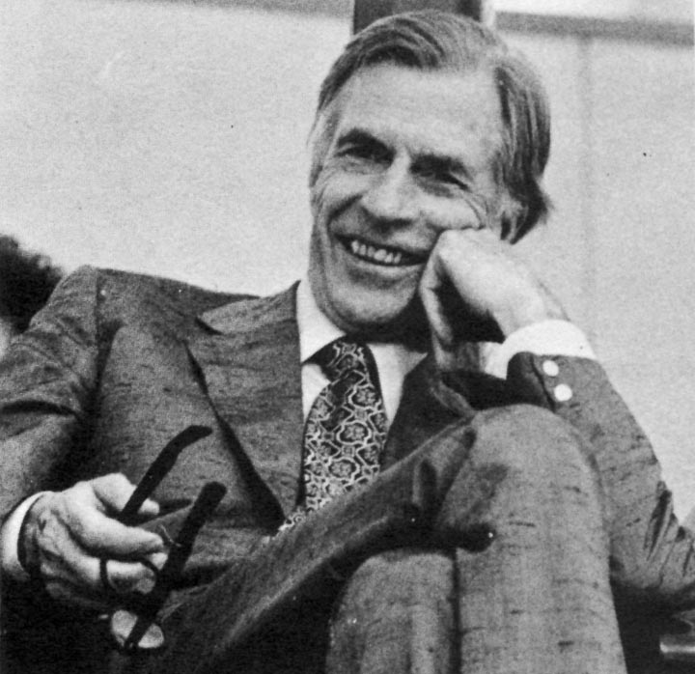
John Kenneth Galbraith (1908-2006): The Liberal
Called one of Canada’s most notable exports to the United States
In his book “The Affluent Society” he coined a term (affluent society) that summed up the remarkable increase in wealth that the US and Canada had been enjoying since the end of the Second World War
The book also set out a devastating criticism of government economic policies that did not pay sufficient attention to providing and maintaining public services

Slide 42
Biography
Born in Iona, Ontario
He graduated from the University of Toronto with a degree in agricultural economics, and went on to earn a doctorate at the University of California in Berkley
He taught economics at Harvard and Princeton until the US entered the Second World War
During the war he worked in the federal Office of Price Administration and after the war, he became director of the US Strategic Bombing Survey, which studied the effects of air raids on Japan and Germany
He also served as an editor of Fortune magazine from 1943 – 1948, but in 1949 returned to teaching economics at Harvard, where he stayed until his retirement

Slide 43
The Times
Galbraith rose to prominence during the period of economic prosperity that followed the Second World War
Despite the Cold War, high levels of employment and consumer spending produced an unparalleled degree of prosperity in Canada and the US
But this affluence did not diminish the amount of poverty in these prosperous societies
At the same time, large international corporations were emerging as a new influence in economic decision-making

Slide 44
Ideas that Advanced Economic Thought
Social balance
Galbraith argued that the post-war emphasis on private-sector production had produced a state of private affluence and public squalor
Consumer goods were in abundance, but public goods were in short supply
The real need was for the production of public goods serving the common good
National production should be shifted to serve these public priorities
He popularized the view that with the rise of international corporations, corporate managers (not shareholders or consumers) held the real decision-making power in the economy
He believed that more government involvement and regulation of the economy would help improve society

Slide 45
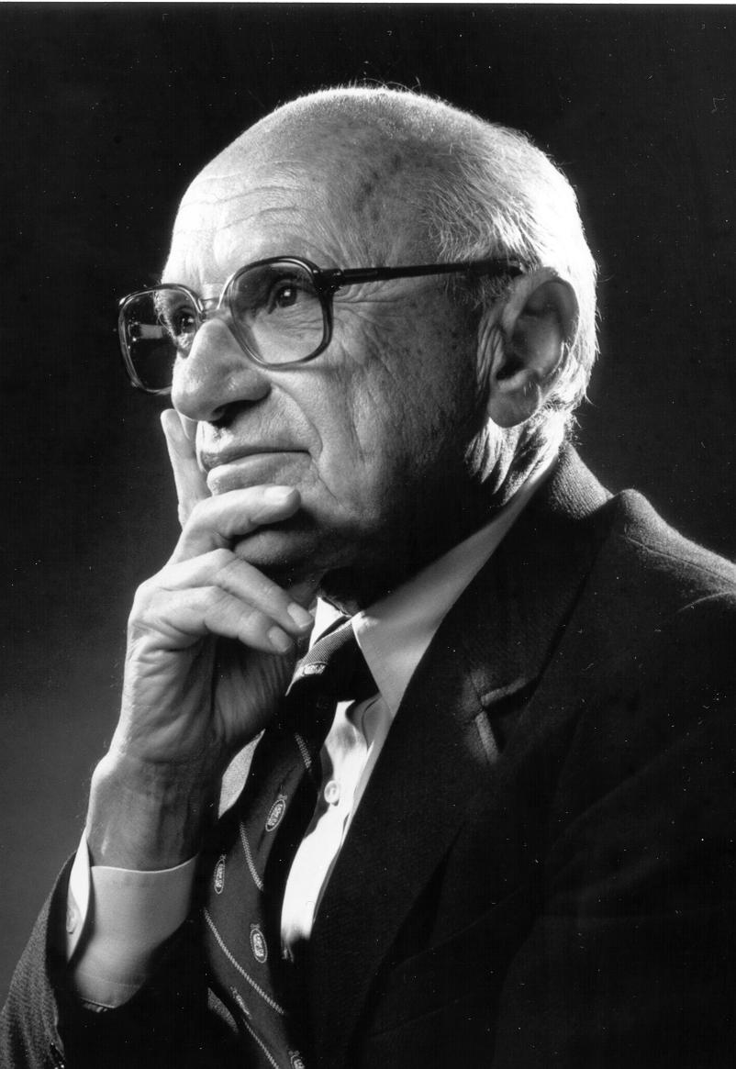
Milton Friedman (1912-2006): The Conservative
Regarded as the champion of the conservative view
He was an influential adviser to Richard Nixon and other US presidents

Slide 46
Biography
Born in Brooklyn, New York in 1912
He studied at Rutgers, Chicago, and Columbia universities before being appointed a government economist during the Second World War
He joined the faculty of the University of Chicago in 1946 and remained there until 1977
In 1976, he received the Nobel Prize for economics, in particular for his achievements in the fields of consumption analysis, monetary history and theory, and for his demonstration of the complexity of stabilization policy
He also wrote numerous books on the topic of economics

Slide 47
The Times
Friedman was strongly influenced by the amount of unproductive government intervention in the US economy following the end of the Second World War
He believed that government attempts to induce cycles of economic growth and full employment by increasing spending and reducing taxes resulted in periods of high inflation and a steady increase in public debt
It made both the economy and the individual citizen more dependent on government assistance and, therefore, weaker

Slide 48
Ideas that Advanced Economic Thought
Laissez-faire capitalism
Free markets will largely resolve their own economic problems more effectively if they are left alone rather than subjected to government intervention
Friedman saw individual self-sufficiency and the preservation of work ethic as important pillars of productivity, so he advocated for a program of guaranteed income (or negative income tax) over centralized social welfare services and the massive, inefficient bureaucracy they require
Recommended the laissez-faire strategy of abolishing minimum wage legislation

Slide 49
Ideas that Advanced Economic Thought
He even advocated the application of the free-market principle on the supply of education
Parents would receive government vouchers equal to the cost of a child’s education that the parents could spend at the school of their choice
Schools would be developed to meet the demands of parents
Excellent schools would attract the most students and schools that did not attract sufficient numbers would shut down
Thus the education market would take care of itself!

Slide 50
Ideas that Advanced Economic Thought
The importance of money supply
Leading member of the monetarist school of thought
Believe that the most effective way for governments to influence the economy is by regulating the money supply in circulation
Maintain that business cycles are determined by money supply and interest rates, not by levels of taxation and government spending
According to Friedman, governments should raise the money supply by a fixed amount each year
This increase should be equal to the long-term growth rate of the economy (between 3-5%)
Too much money in circulation causes inflation, too little money reduces investment and employment levels

Slide 51
The Contemporary Scene
Some of you are probably beginning to wonder if economic problems can ever really be solved.
Some problems keep reappearing in cycles, and each reappearance makes them seem more complex and difficult to address
At the same time, some new problems appear to be direct results of theories and strategies intended to fix earlier problems
The concept of trade-offs appears to be one of the key concepts in the development of economic theory
It seems we can address one problem only at the expense of exaggerating something else

Slide 52
Where Are the Ladies?
The public and political world from 1750-1950 was a male-dominated one, quite probably to the detriment of science
In Canada today, many leading economists are women, and their contributions to the ongoing advancements of economic thought have been both significant and refreshing
Canadian economists who have made important contributions include:
Nuala Beck
Dian Cohen
Sherry Cooper
Judith Maxwell
Sylvia Ostry

